Slide 1
近傍銀河における分子雲の化学組成
とその意味
Yoshimasa Watanabe
University of Tsukuba
Notes:
Thank you very much for giving me an opportunity to present my recent works. I am very happy to
have this chance in my ‘mother’ university, Hokudai.
Today, I’d like to talk about chemical composition of large scale molecular gas in nearby galaxies.
They are my collaborators.
Typical size scale in this talk is from 1 kpc scale to 10 pc.

Slide 2
Contents
Introduction
GMC-scale chemical composition and star-formation
M51
Spiral arm (1 kpc-scale and 300 pc-scale)
W51
Mapping spectral line survey (50 pc-scale)
Effect of galactic-scale gas dynamics
NGC 3627
Spiral arm and bar-end (100 pc-scale)
Effect of metallicity
LMC
Low-metallicity environment (10 pc-scale)
Tsukuba THz 10 m telescope for chemistry
Summary
Notes:
Here are contents of my talk.
After brief introduction, I will talk about chemical compositions of these sources based on spectral line surveys.
I will discuss chemical compositions in relation to star formation activities.
Then, I move onto high-angular resolution observation of M83 with ALMA.
And then, I will introduce chemical study of low metal galaxy Large Magellanic cloud.

Slide 3
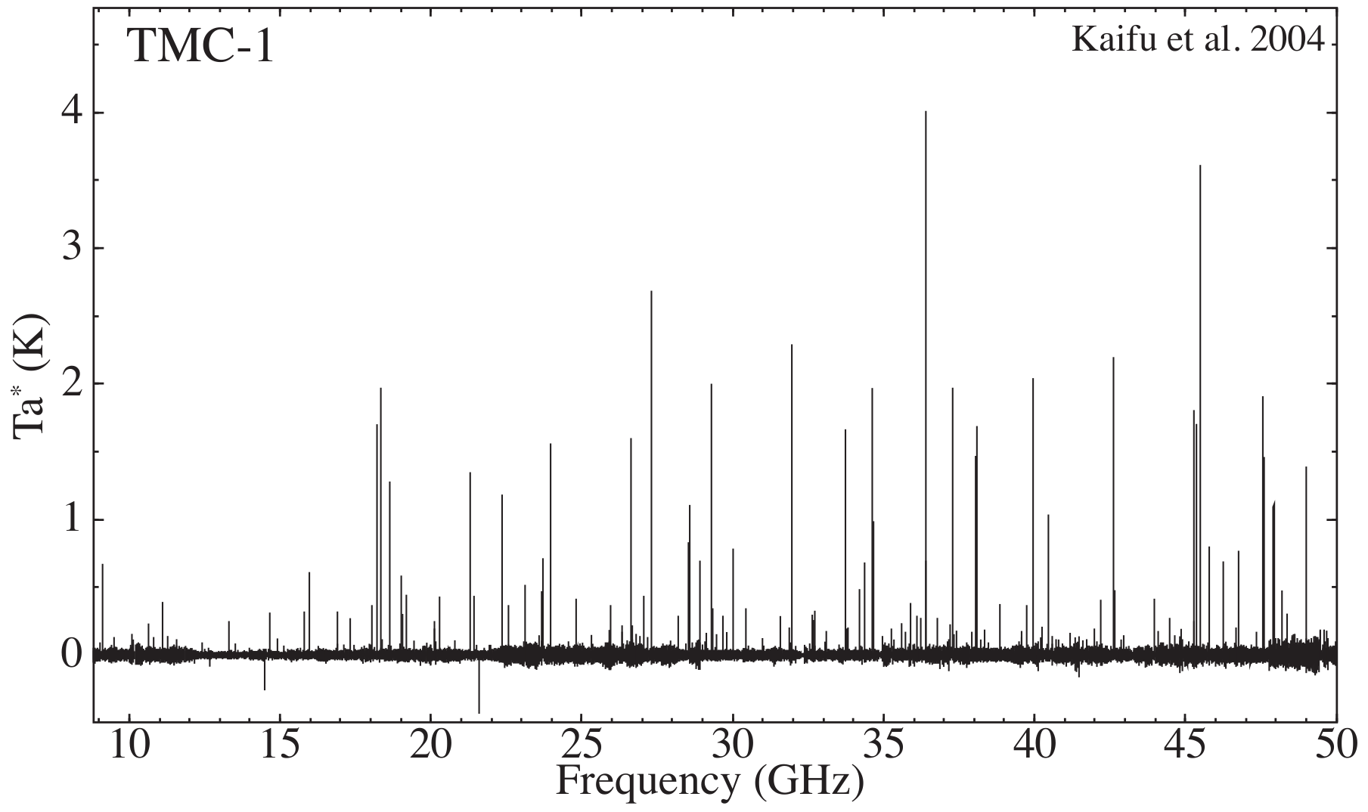
Interstellar Molecules
HC₃N
HC₅N
C₃S
More than 190 species have been identified.
Target Sources in the Milky Way (MW)
- Dark molecular cloud cores
- Star-forming regions
- Late type stars (AGB stars)

Slide 4
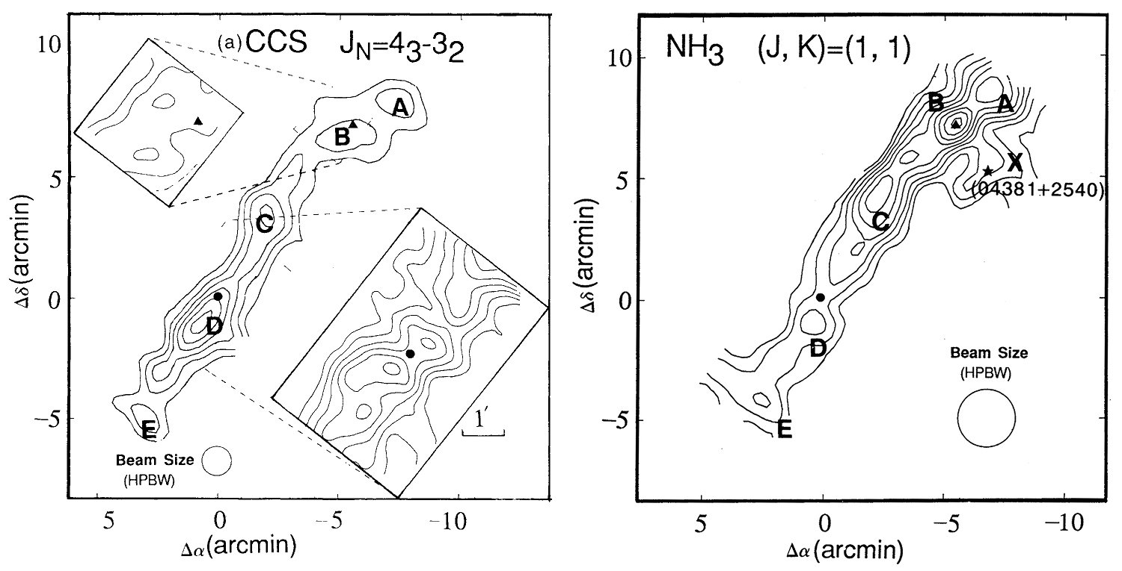
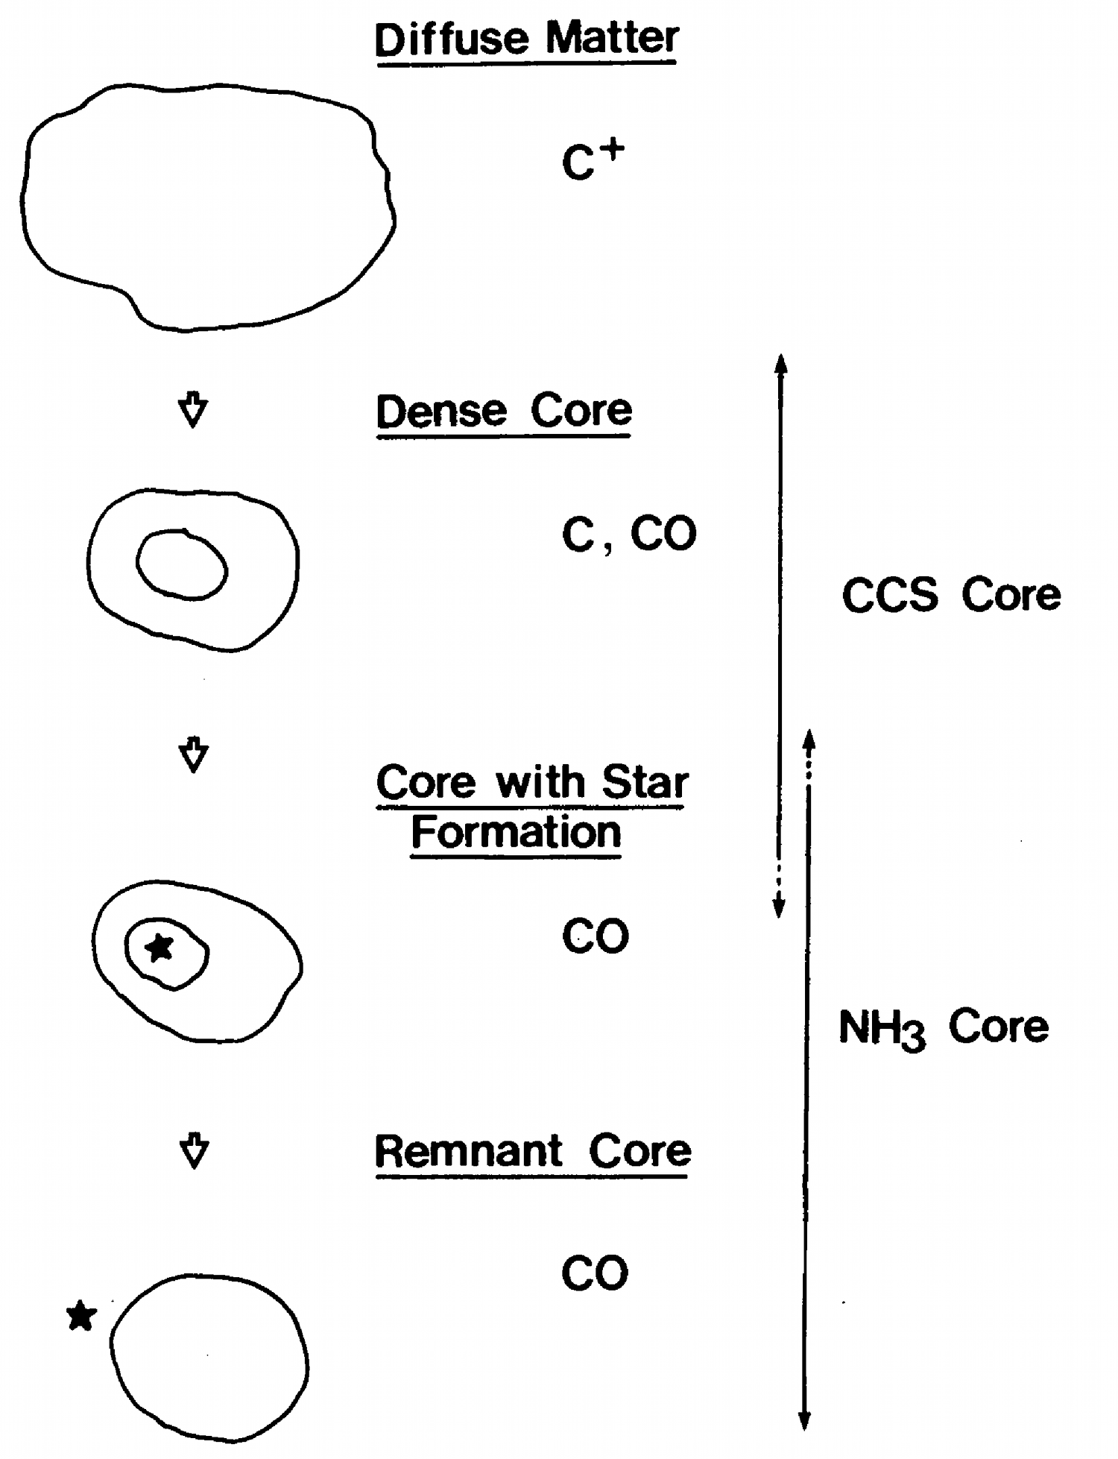
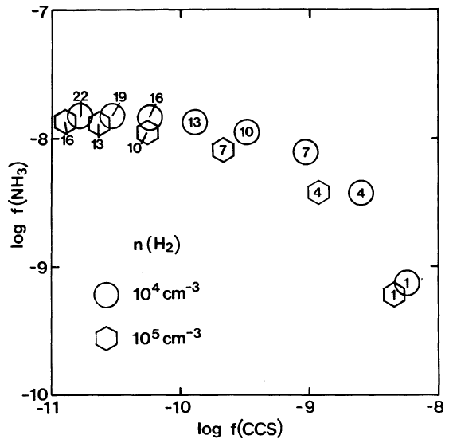
Chemical Evolution of Molecular Cloud Cores
TMC-1
Late-phase
Early-phase
Hirashita et al. 1992
Chemical difference among cores
Starless Cores: high CCS, low NH₃
Protostars : low CCS, high NH₃
Successful chemical modeling
Chemical evolution
Suzuki et al. 1992

Slide 5
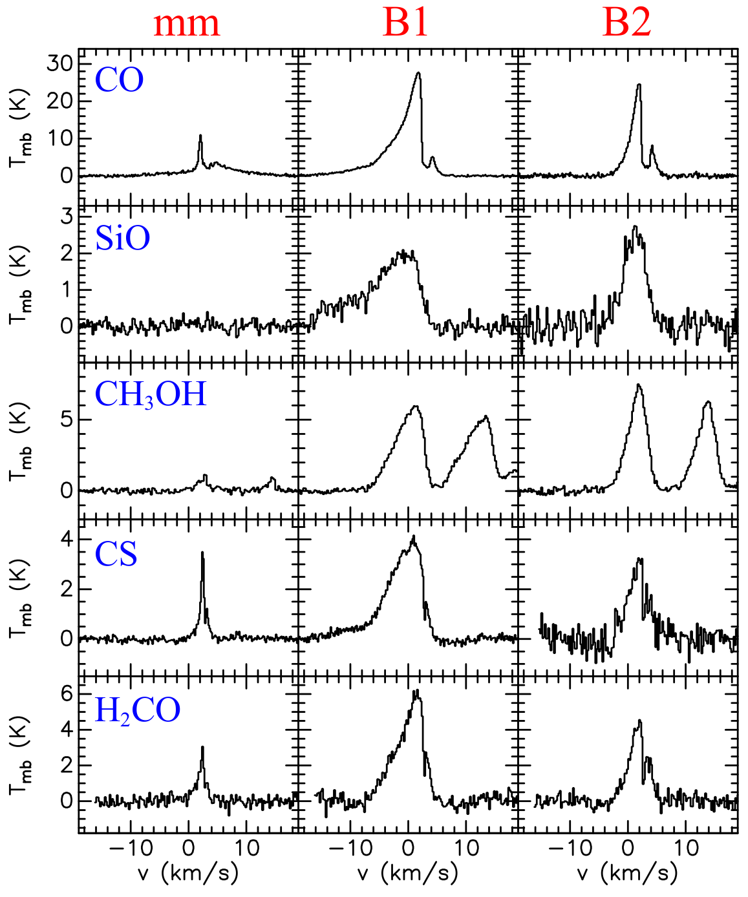
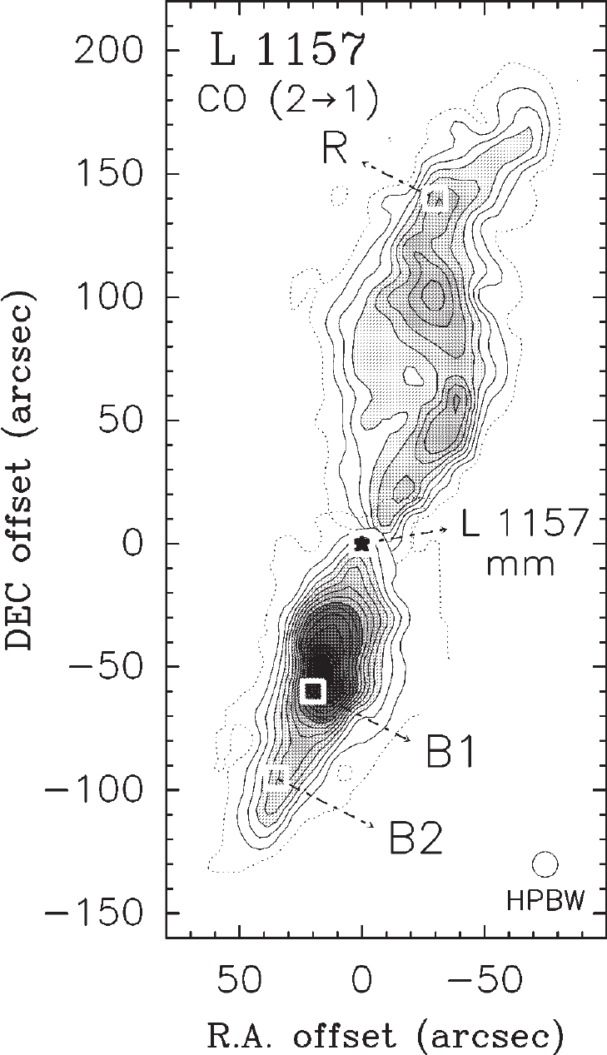
Chemistry as a Diagnostic Tool of Physical Condition
shocked region
Characteristic chemistry in
photodissociation region (PDR)
e.g.: Outflow-shock in L1157
mm
B1
B2
Bachillar et al. 1997
Evaporation of molecules from grain mantle
e.g.: CH₃OH, SiO, complex organic molecules..

Slide 6
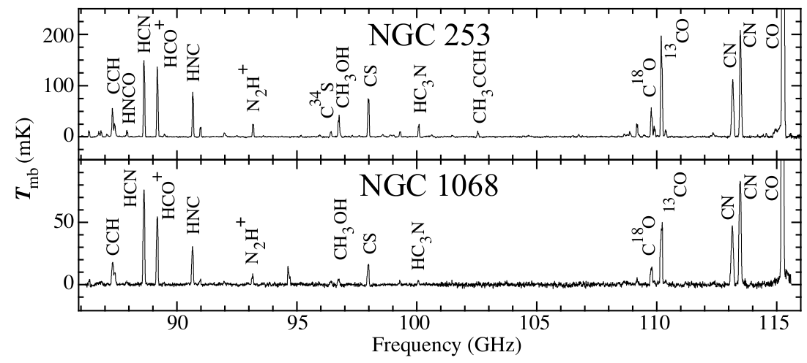
Chemical Studies in External Galaxies
Aladro et al. 2015
59 molecular species have been identified in external galaxies
Target Sources
Spectral line surveys
Starburst: NGC 253, M82 ..
Chemical diagnostics
AGN: NGC1068, NGC 1096, ..
- Nuclear activities
LIRG/ULIRG: Arp220, NGC 4418, ..
- HCN/HCO⁺ : XDR?
Notes:
Now, astrochemistry is also more and more important in external galaxies.
Here, I show examples of extragalactic astrochemistry toward nuclear regions reported previously.
This is an example of the spectral line surveys toward well know starburst galaxies NGC 253 and AGN NGC 1068 in the 3 mm bands.
Different spectral pattern can be seen between two sources, showing different chemical characteristics.
Most of astrochemical studies are focused on active regions such as starbutsts, AGNs, and ULIRGs.
They focus on the chemistry as a diagnostic tool of nuclear activities such as AGN and starburst.
For example, HCN/HCO+ ratios are thought to be a tracer of XDR.
But, the meaning of this ratio is still in debate.

Slide 7
Chemical Studies with ALMA
NGC 253
Meier et al. 2015
Beam: 2-4” (35 – 70 pc)
High resolution imaging
with ALMA
Detailed study of chemistry
in nuclear regions
Notes:
Moreover, detailed chemical structures of nuclear regions are observed in many molecular species with ALMA.
Here are distributions of molecules in NGC 253 observed with ALMA. Even the rare species such as CH3SH
NH2CHO can be imaged. As you find, distributions are different from molecules to molecule.

Slide 8
Chemistry of External Galaxies
Diagnostic tool of nuclear activities (AGN & Starburst)
Chemical compositions
Peculiar physical conditions
- PDR, XDR, Shocks...
Can astrochemical concepts established in the MW be applied to the studies in external galaxies?
Large scale difference
- Galactic observations: smaller than > 0.1 pc
- Extagalactic observations: > 1 kpc – 10 pc
A few order of magnitude...
Notes:
The large difference between extragalactic astrochemistry and galactic astrochemistry is the size-scale.
A typical size scale of galactic observation is much less than 1 pc.
On the other hand, that of extragalactic observation is larger than 10 pc, even with ALMA.
The size-scale difference indicates that astrochemical concept of galactic objects cannot be applied to extragalaxy directly.
So, the problem is how we can learn chemistry averaged over a large scale from kpc to 10 pc from observations.
For this purpose, we focused on these three effects, star formation, galactic-scale dynamics and metallicity, on the chemical composition.
I will not discuss effect of AGN and Starburst in this talk.
But, understanding of these three effects is essential for the nuclear studies.
First, I focus on effects of star formation.

Slide 9
Chemistry of Molecular Cloud-Scale Gas
For interpretation of extragalactic astrochemistry..
Chemical composition of ‘starndard molecular clouds’
- e.g.: Giant molecular cloud (GMC) in a spiral arm
Effect of star formation
Effect of galactic-scale dynamics
Effect of metallicity
Notes:
The large difference between extragalactic astrochemistry and galactic astrochemistry is size-scale difference.
Typical size scale of galactic observation is much less than 1 pc.
On the other hand, that of extragalactic observation is more than 10 pc, even with ALMA.
The size-scale difference indicates that astrochemical concept of galactic object cannot be applied to extragalaxy directly.
So, the problem is how we can learn chemistry from observations averaged over a large scale from kpc to 10 pc.
For this purpose, we focused on these three effects, star formation, galactic-scale dynamics and metallicity, on the chemical composition.
I will not discuss effect of AGN and Starburst in this talk.
But, understanding of these three effects is important for the nuclear studies.
First, I focus on effects of star formation.

Slide 10
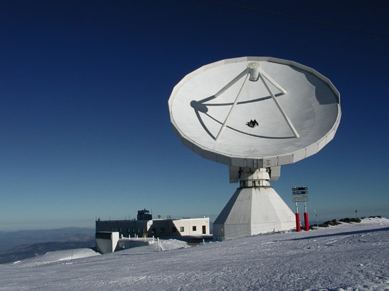
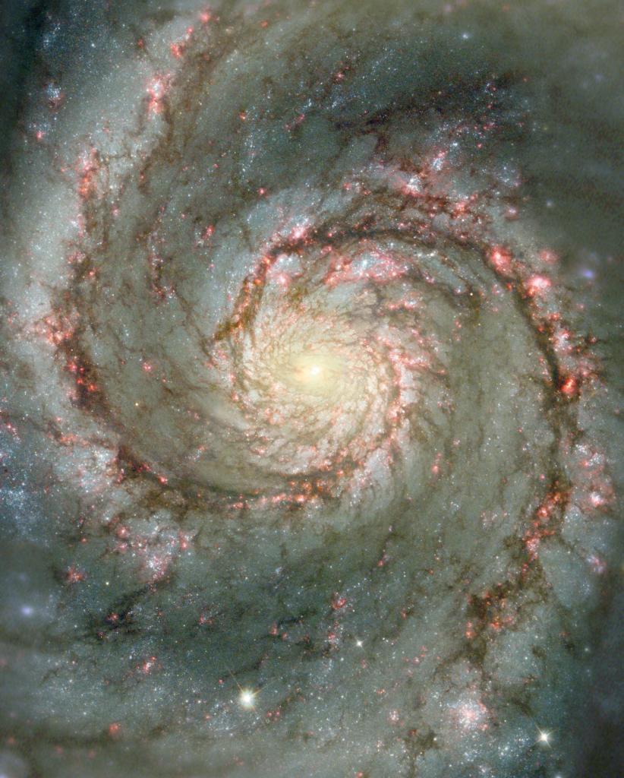
Spectral Line Survey of M 51
HST
IRAM 30m
Date :
Frequency：
Resolution :
Dec. 2011, Aug. 2012
83 – 116 GHz
130 – 148 GHz
30” - 17” (~ 1 kpc)
Schinnerer et al. 2013
d：~ 8.4 Mpc (Feldmeier et al. 1997)
H α
24 μm
P1
SFR: 0.055 M yr⁻¹
SFE: 4.5 x 10⁻¹⁰ yr⁻¹
P2
SFR: 0.022 M yr⁻¹
SFE: 2.9 x 10⁻¹⁰ yr⁻¹
Notes:
The first example is the spiral arm of M51.
This is famous M51.
This is distribution of CO gas.
We did not observe the nucleus region, but two positions P1 and P2 in the spiral arm.
The observations were conducted with the IRAM 30m telescope in the 3 mm and 2mm bands.
Resolution of this observation corresponds to 1 kpc.

Slide 11
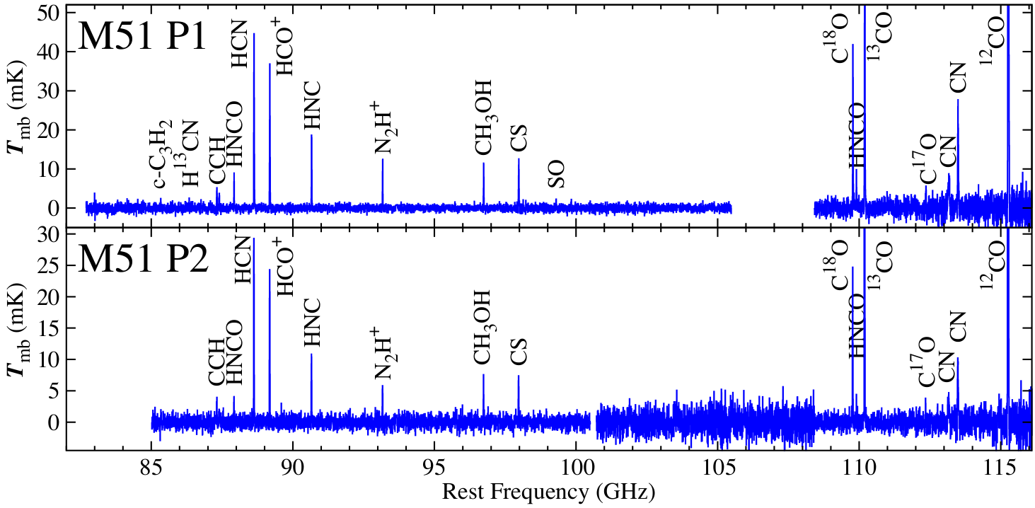
Comparison between Positions 1 and 2
N_{H2} = N_{C18O} × 2.94 × 10⁶ cm⁻²
LTE approximation
Watanabe et al. 2014
Identified molecules
c-C₃H₂
H¹³CN
H¹³CO⁺
CCH
HNCO
HCN
HCO⁺
- 13 molecular species
HNC
N₂H⁺
C³⁴S
CH₃OH
CS
SO
C¹⁸O
- 6 isotopologues
¹³CO
C¹⁷O
CN
¹²CO
H₂CO
Notes:
Here is the spectrum of a P1.
We identified 13 molecular species and 6 isotopologues in this position.
This is the spectrum of P2.
Line intensities are weaker in P2 than P1.
However, the spectral pattern is very similar to each other,
showing similar chemical compositions.

Slide 12
Rotation Temperatures
Low rotational temperatures (< 10 K) of CH₃OH, HNCO and CS
H₂CO observation (1-0, 2-1) => H₂ density of 10⁴ cm⁻³ (Nishimura et al.)
Detected molecules reside in quiescent diffuse cold molecular gas
Notes:
THEN, where the emission comes from?
For this purpose, we derived rotation temperatures for CH3OH, HNCO, and CS.
Here are the rotation diagram plots for HNCO and CS.
The rotation temperatures are derived to be less than 10 K,
indicating that the emission comes from cold and quiescent regions.
Moreover, H2 density derived from the two lines of H2CO is 10^4 per cubic centimeters.
These results indicates that detected molecules reside in quiescent and rather diffuse （これは次のスライドとの関係で必要）molecular gas.

Slide 13
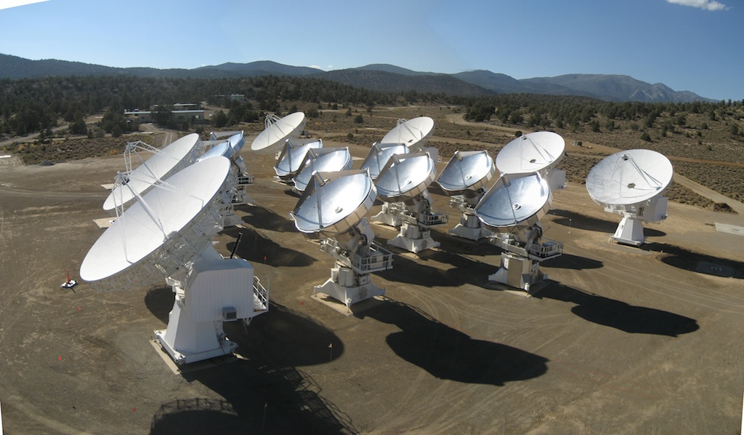
Insight into 100 pc Scale
HST
Schinnerer et al. 2013
CARMA
Date :
Configuration:
FoV：
Resolution:
May - Jul. 2014
D + E (Baseline: 2 – 55 kλ)
~ 60”
~ 5-7” (~300 pc)
Band :
3 mm
CH₃OH, CS, C¹⁸O,
HNCO, ¹³CO, CN
Notes:
In order to go into 100 pc-scale chemical composition, we conducted higher angular resolution observations with the CARMA interferometer.
Here is the field of view of this observation.
The observation filed covers the P1 and P2 positions.
Angular resolution of 5-7” corresponds to about 300 pc scale.
We observed these 6 molecular spices in the 3mm band.

Slide 14
Integrated intensity maps
Watanabe et al. 2016
Notes:
Here are images obtained in this observation.
These 6 molecules are successfully detected.
CO isotopologues traces distribution of entire molecular gas.
On the other hand, we can see small differences in the distributions of other molecules.
CS and CN are bright here.
But, the CH3OH peak is slightly shifted from them toward south.
Here is star formation rate map of same field.
The distribution of star formation is different from molecular distributions.

Slide 15
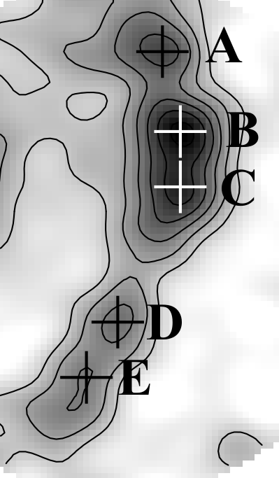
Position-to-Position Chemical Composition
C¹⁸O
A
B
C
D
E
Almost similar chemical compositions
Notes:
We estimated fractional abundances under the LTE approximations at the five peaks of C18O.
Here are plots of fractional abundances as a function of galactocentric distance.
Colors indicate molecules.
Black indicates star formation efficiencies.
Although the CS abundance shown in orange is constant among the positions, we can see small difference in the other molecules.
For example, CH3OH abundance shown in green tends to increase slightly from here to here,
while, CN abundance shown in red tends to decrease slightly from here to here.
These differences may originate from these three possibilities,
but we need higher angular resolution observations to explore them.

Slide 16
Meaning of Large-Scale Chemical Composition
Maybe reflects quiescent, cold, and diffuse molecular clouds
How to confirm it….?
Our Strategy:
Mapping spectral line survey of
representative Galactic molecular clouds
→ Averaged spectrum over a large area
→ Representative area in GMC
Notes:
From our observations, chemical compositions of large scale molecular gas seem to be almost free from star formation activities and dominated by extended diffuse molecular cloud .
To confirm that the emission is from diffuse molecular clouds, we conducted mapping spectral line survey toward the Galactic giant molecular cloud W51.
By averaging over a large area, we can obtain spectrum of a large-scale molecular cloud in our Galaxy.
With physical conditions of the molecular cloud, we can model the chemistry of large scale molecular cloud.

Slide 17
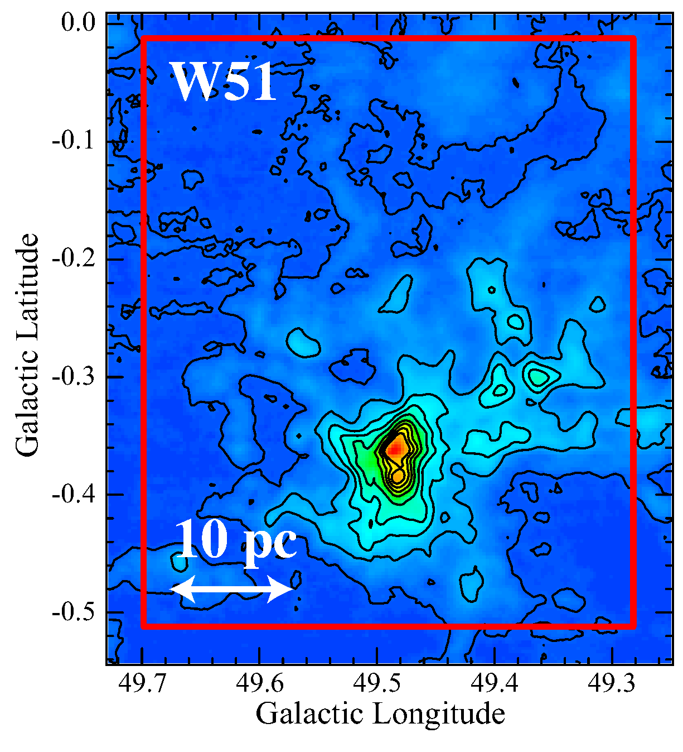
Mapping Spectral Line Survey toward W51
¹³CO
Distance: 5.4 kpc
Bieging et al. 2010
- 5’ = 8 pc
(Sato et al. 2010)
the most vigorous recent star formation in the Galaxy
48 pc
Observation with Mopra
Date: Oct. 2013 – Sep. 2014
Obs. Mode : OTF
- 30’ x 25’
- ~40 pc x ~48 pc
40 pc
Frequency Range: 84 – 103 GHz
106 - 114GHz
Watanabe et al. 2017
Notes:
For this purpose, we carried out mapping observation toward W51 molecular cloud.
W51 is the most active star forming region in our galaxy.
This is 13CO map of W51.
In the central region, strong star formation activities can be seen.
There exist hot cores around here （指しながら）.
We observed this area （指しながら）enclosed with the red lines that is 40 pc by 48 pc.
The observation was carried out with Mopra telescope in the 3mm band.

Slide 18
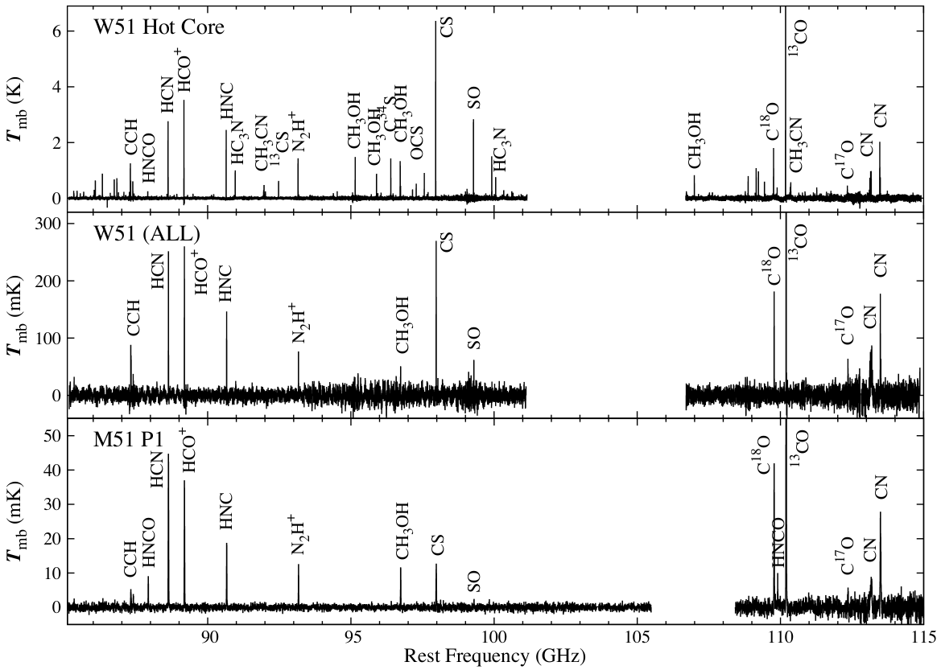
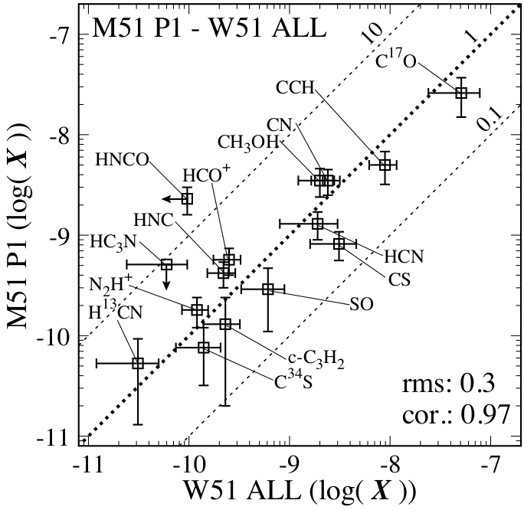
Averaged Spectra of W51
Hot Cores
Averaged
M51
Watanabe et al. 2017
Notes:
This is a spectrum taken toward the hot cores.
You can see many lines from minor molecular species.
Here is a spectrum averaged over the all region.
Only a few lines are remaining.
Here is the spectrum of M51 as a reference.
The averaged spectrum is similar to that of M51 except for HNCO and CS.
but is different from that of the hot core.
This means that contribution of star forming cores is diluted in the averaged spectrum,
and only a diffuse part is contributing to the averaged spectrum.

Slide 19
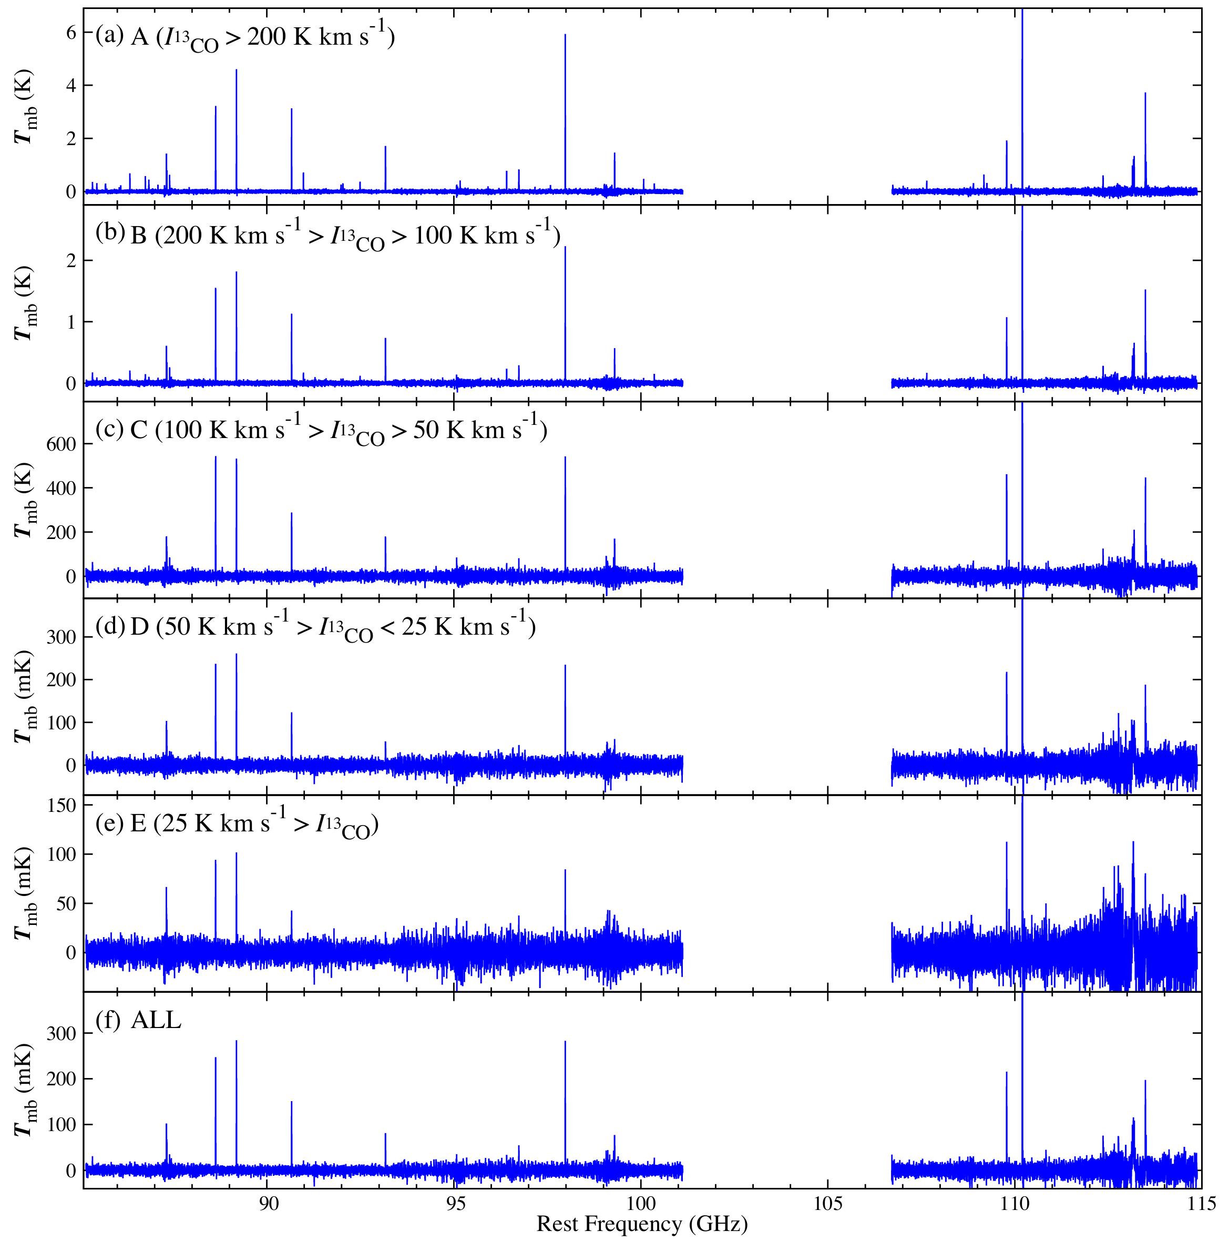
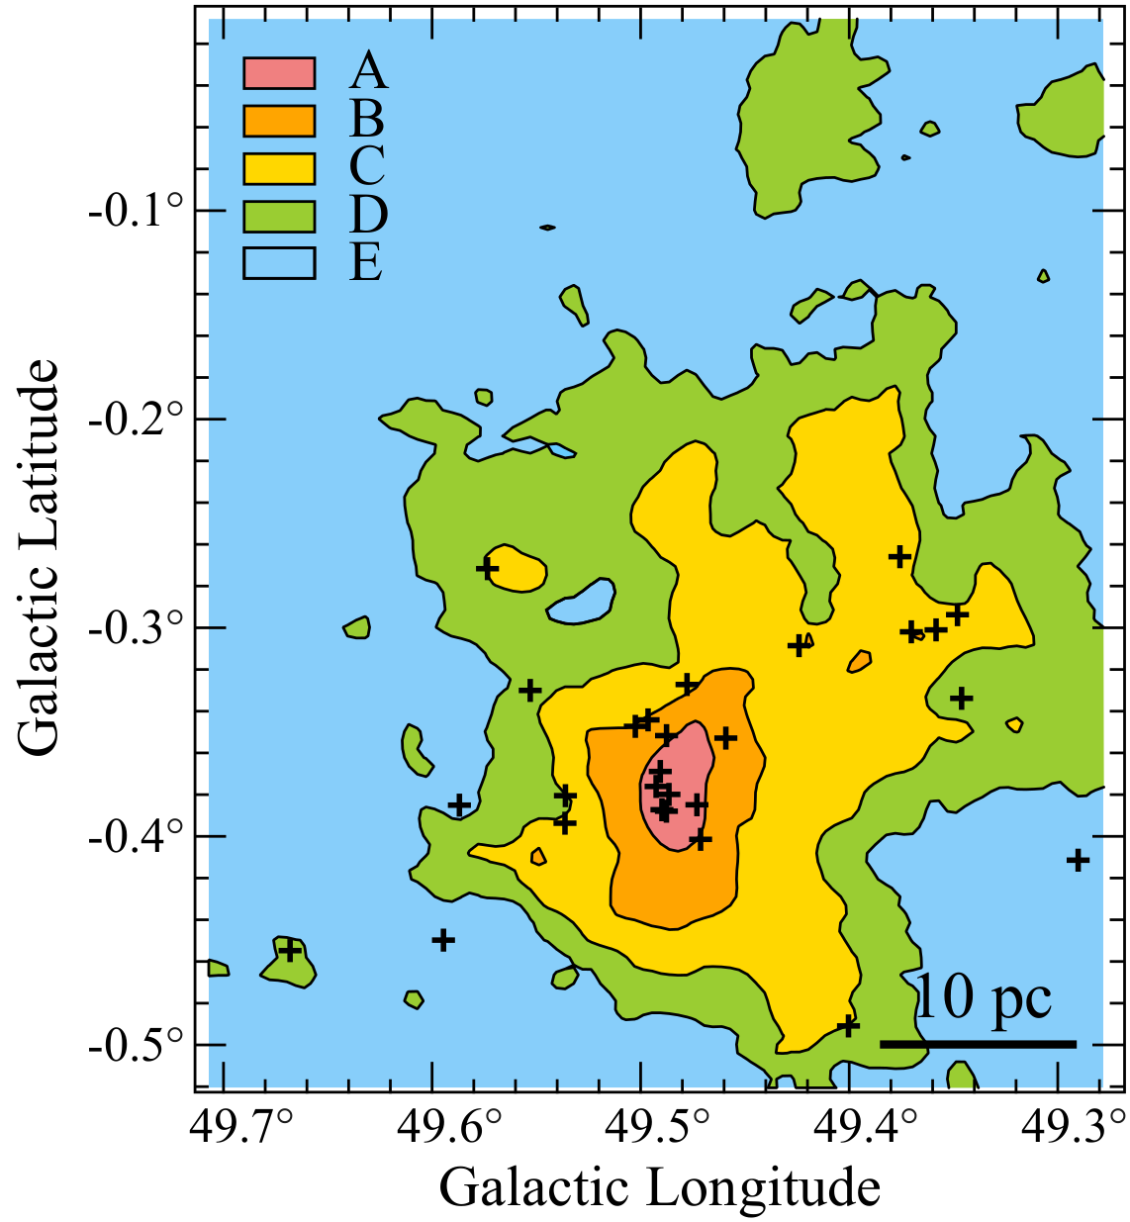
Contribution of Extended Molecular Gas in W51
A
¹³CO
B
C
D
E
Average
Notes:
Here, we examined contributions from different parts in the cloud to the averaged spectrum.
We divided the observed region into five parts according to the integrated intensity of 13CO,
and prepared the spectra.
This is high density region （指しながら）, mid density region, and diffuse region.
The top spectrum is for the hot core.
The bottom is averaged spectrum for reference.
These spectrum in the mid density region, that is around this area, is similar to the averaged spectrum.

Slide 20
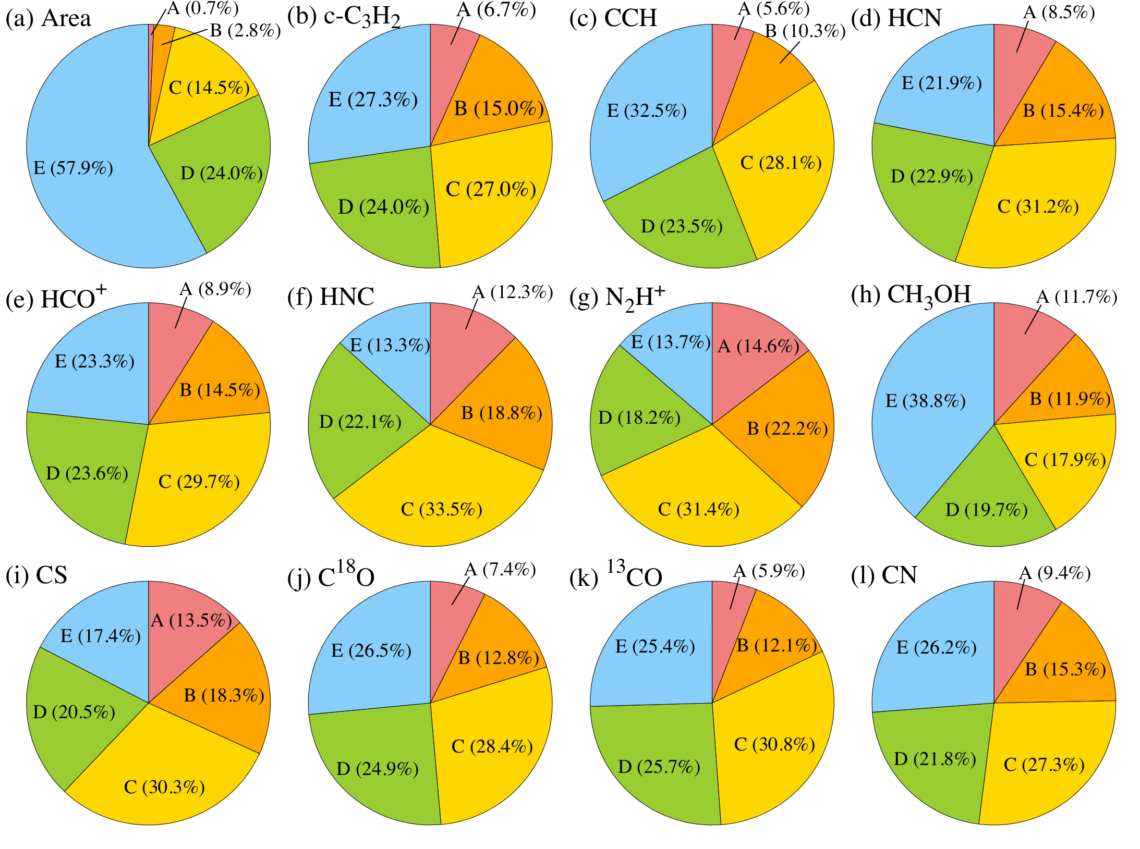
Contribution of Extended Molecular Gas in W51
Most flux comes from the regions C,D, and E.
Local SF activities are smeared out by extended gas.
Notes:
In order to examine contributions of each region more clearly, we estimated flux fraction
of each regions relative to the total flux.
The definition of flux fraction is here. S is area of each regions.
The first panel is fraction of area.
The others are flux fractions of various molecules.
In most of molecules, more than 50 % of flux comes from C and D.
The contribution of E is also high, although N2H+, HNC, and CS are exception.
So, kpc-scale spectra are dominated by rather diffuse molecular gas in C and D. （はっきり言った方がよい）
This indicates that chemical composition of active star forming site (A and B) is smeared out by the extended molecular gas.

Slide 21
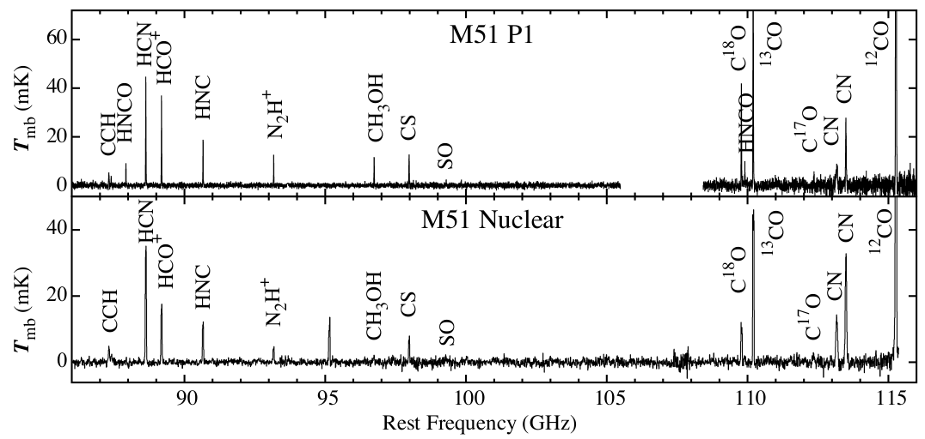
Smeared-Out by Extended Molecular Gas
Spiral Arm
Watanabe et al. 2014
Seyfert2 type AGN
×
Aladro et al. 2015
AGN/Starburst Observation
Observation in the 3 mm band
Ambient gas
Circum Nuclear Region
No effect of SF/Nuclear activities
BH
●
at ~1 kpc scale
Tracing chemical composition
of cloud itself

Slide 22
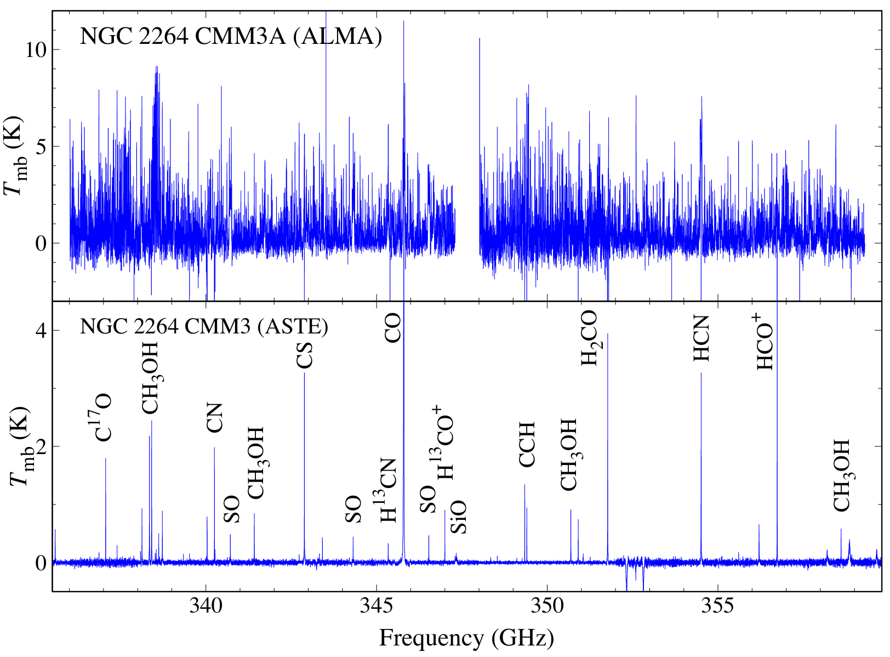
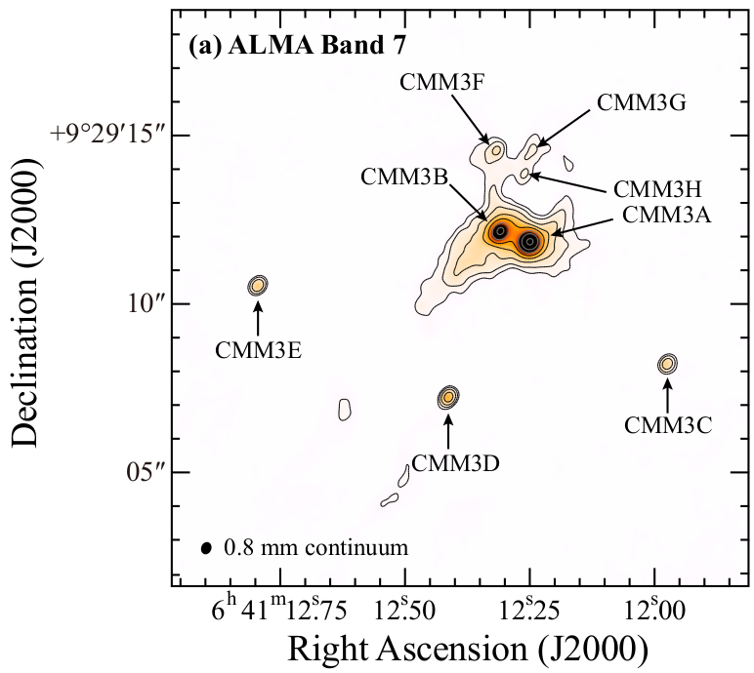
Similar Situation in Galactic Observation
Watanabe et al. submitted
300 au
Watanabe et al. submitted
Watanabe et al. 2015
15000 au
Watanabe et al. 2015
Notes:
こちらがCMM3AにおけるALMAで観測したスペクトルです。
比較のために、下にASTEで観測したスペクトルを示しています。
一見して、ALMAのスペクトルは雑音だらけにみえますが、これは全て分子輝線です。
実際にこの部分を拡大すると

Slide 23
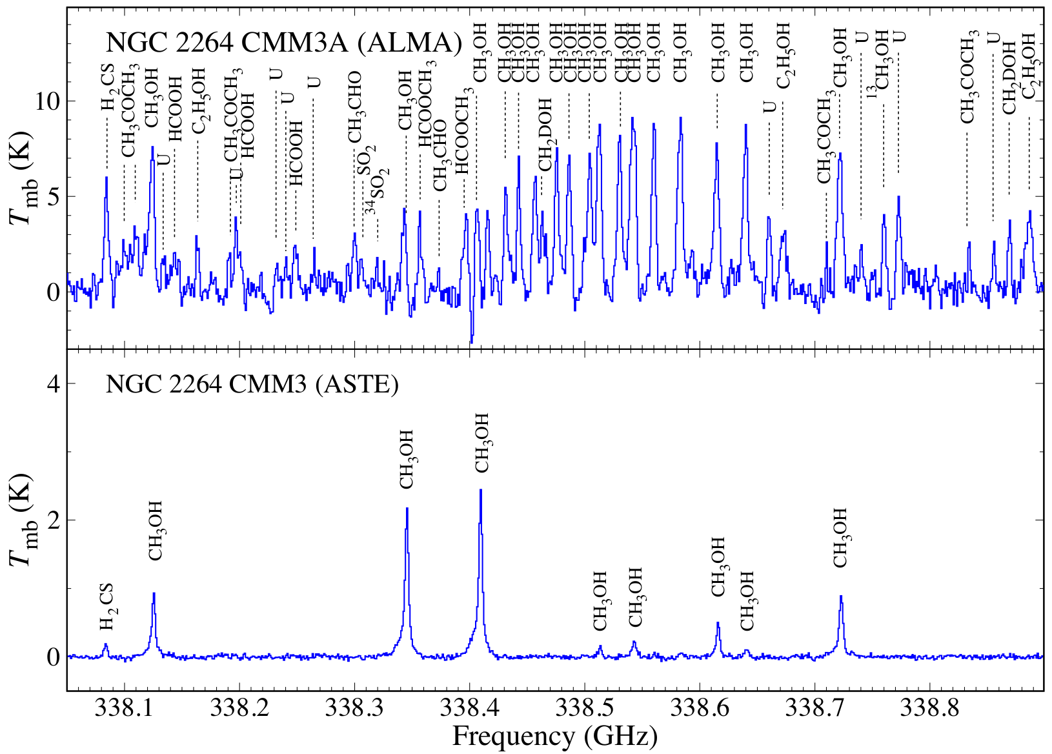
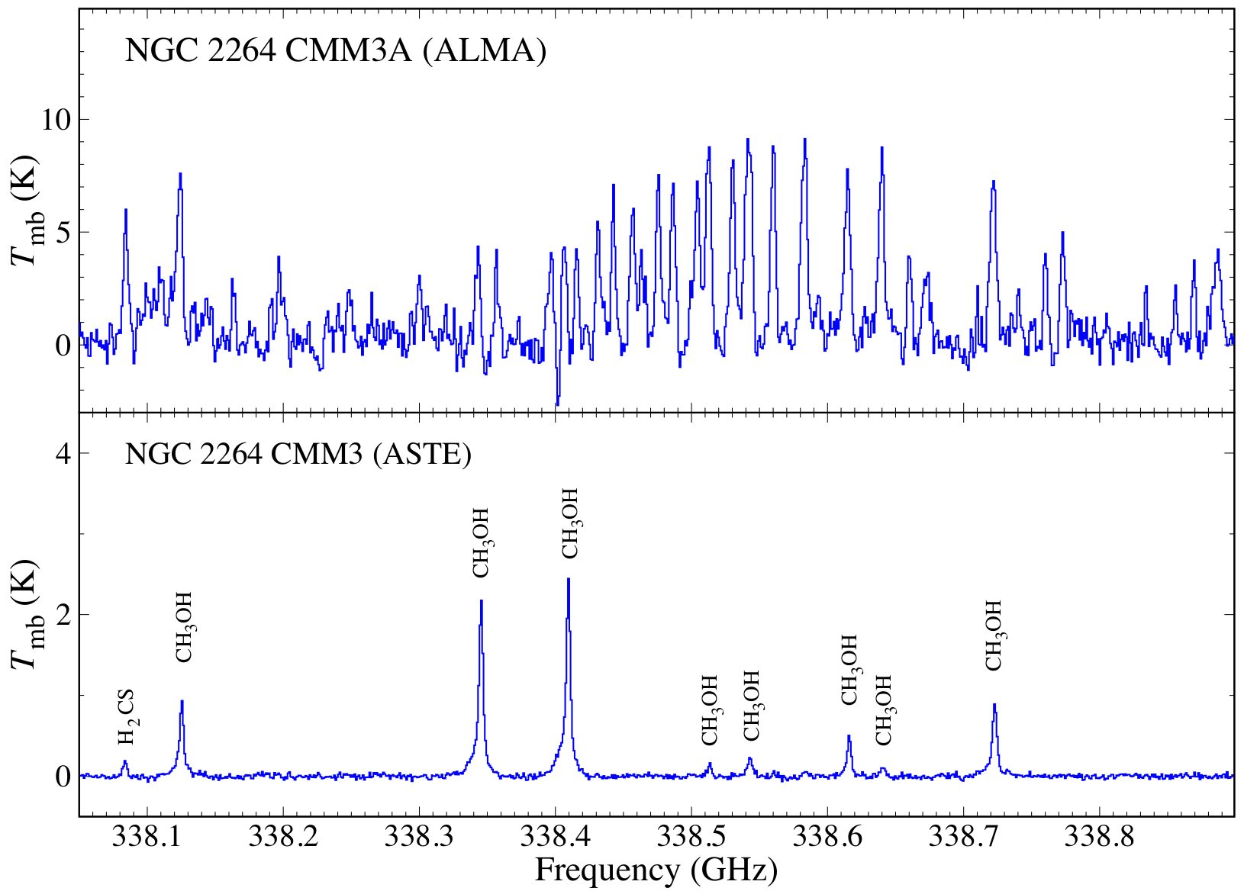
Expanded Spectrum toward NGC 2264 CMM3A
Watanabe et al. submitted
300 au
Watanabe et al. 2015
15000 au
Notes:
このようになります。
これらの分子輝線の多くは、CH3OHの高励起線です。
さらにこのスペクトルでは、アセトン、エタノール、ギ酸メチルなどの複雑な有機分子です。
こういった分子輝線は従来のASTEの観測では捉えられていませんでした。
次に複雑な有機分子の分布をお見せします。

Slide 24
Smeared-Out by Extended Molecular Gas
Spiral Arm
Watanabe et al. 2014
Seyfert2 type AGN
×
Aladro et al. 2015
AGN/Starburst Observation
Ambient gas
Circum Nuclear Region
Observation in the 3 mm band
No effect of SF/Nuclear activities
BH
●
at ~1 kpc scale
Galactic observation
Tracing chemical composition
of cloud itself
Envelope
Disk
★
We can compare GMCs
in different Galaxies.
Protostar
~10000 au scale
Notes:
これまで、銀河中心核は主にミリ波帯で観測されてきましたが、ミリ波では中心核領域は見えません。
こちらは、M51の渦状腕とAGNのペクトルの比較ですが、このように中心核がまわりのガスに埋もれています。
そこで、先ほど紹介した臨界密度10^8-9個/ccトレーサーで観測することで、中心核の核を捉え、中心核部分の化学組成
物理状態を明らかにしたいと思います。
特にこのTHz帯では非常に高密度の領域をトレースできるため、空間分解すること無く銀河中心核の核心部分に迫ることが
できます。ラインプロファイルから、内部の空間構造も推定することができるでしょう。
一方で、ALMAは高い空間分解能により、同様に中心核にせまることができます。
このように南極望遠鏡とALMAは相補的な関係にあると思います。

Slide 25
Chemistry of Molecular Cloud-Scale Gas
For interpretation of extragalactic astrochemistry..
Chemical composition of ‘Starndard molecular clouds’
- e.g.: Giant molecular cloud (GMC) in a spiral arm
Effect of star formation
⇒ No at a scale of 1 – 0.1 kpc
(No star formation feedback and chemical evolution)
Effect of galactic-scale dynamics
Effect of metallicity
Notes:
The large difference between extragalactic astrochemistry and galactic astrochemistry is size-scale difference.
Typical size scale of galactic observation is much less than 1 pc.
On the other hand, that of extragalactic observation is more than 10 pc, even with ALMA.
The size-scale difference indicates that astrochemical concept of galactic object cannot be applied to extragalaxy directly.
So, the problem is how we can learn chemistry from observations averaged over a large scale from kpc to 10 pc.
For this purpose, we focused on these three effects, star formation, galactic-scale dynamics and metallicity, on the chemical composition.
I will not discuss effect of AGN and Starburst in this talk.
But, understanding of these three effects is important for the nuclear studies.
First, I focus on effects of star formation.

Slide 26
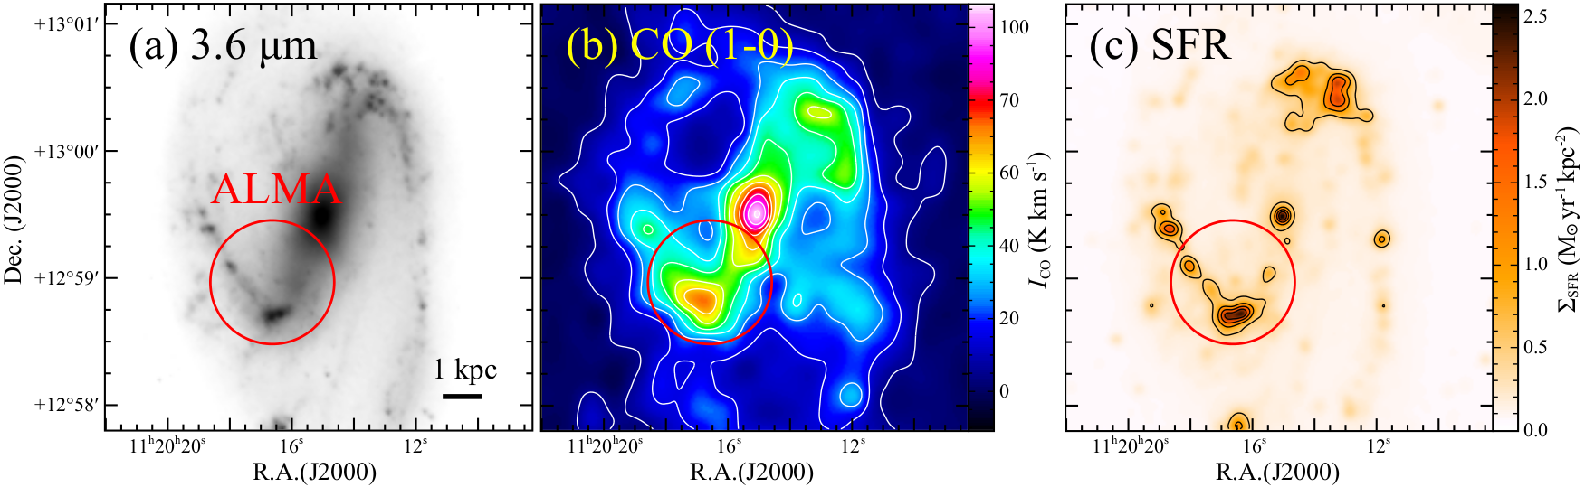
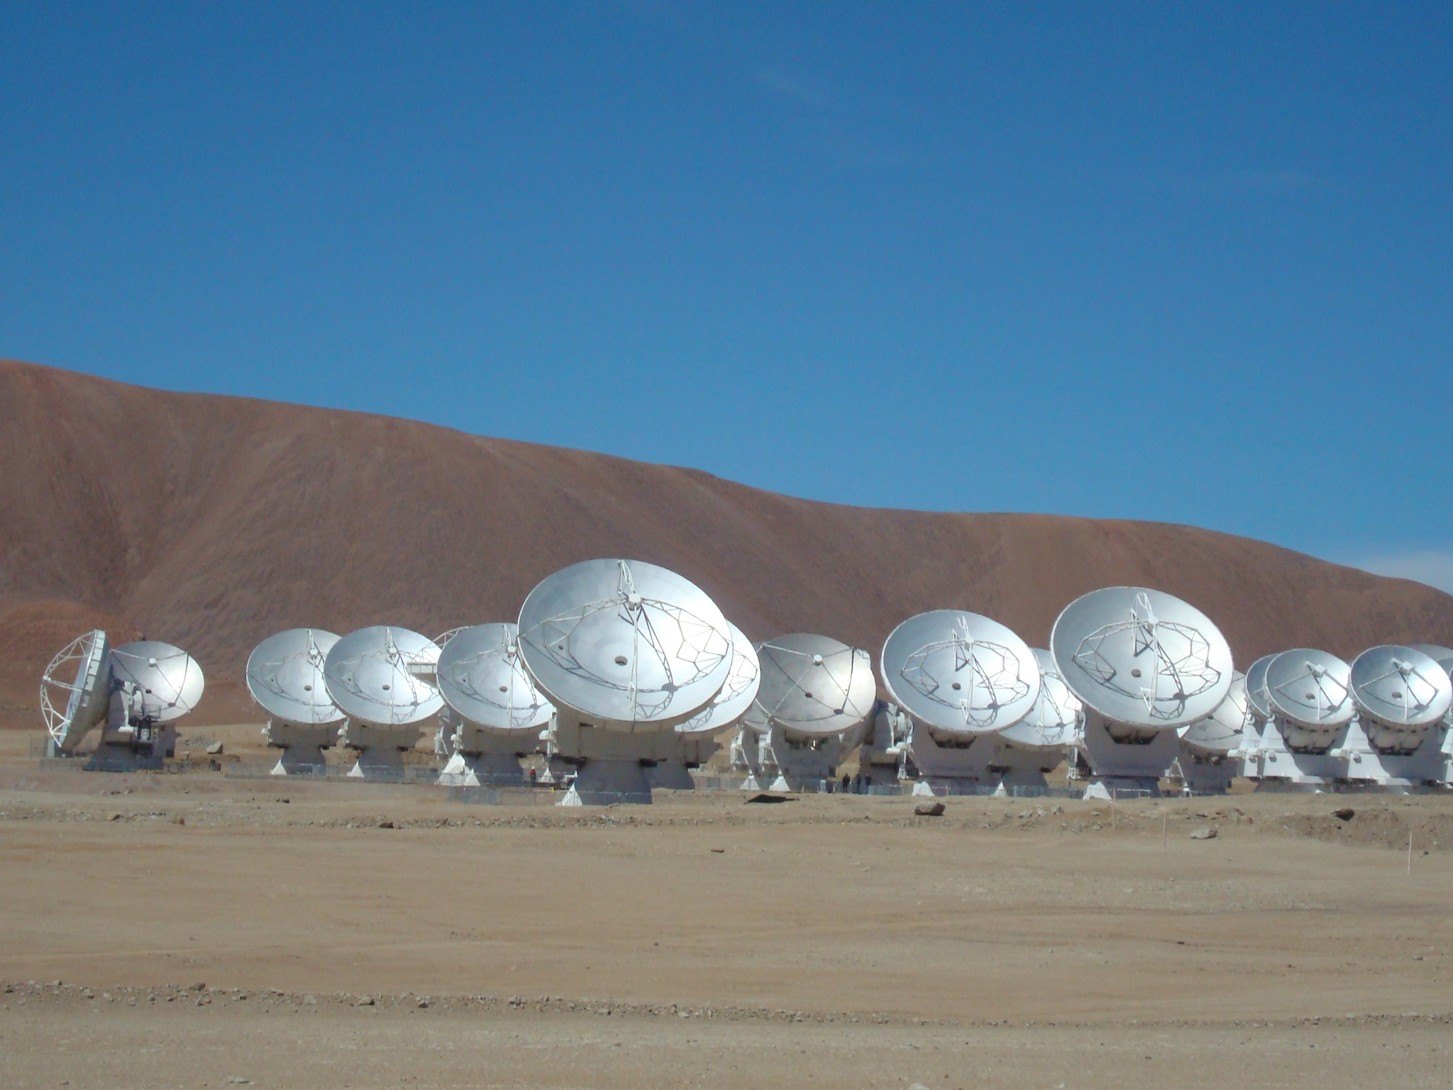
Observations of NGC 3627 with ALMA
NGC 3627
ALMA cycle-3, Band3
Distance: 11 Mpc
Many CO mapping observations
(e.g. Helfer et al. 2004, Kuno et al. 2007,
Watanabe et al. 2011, etc.)
Active star formation in the bar-end
Beam Size
1.6” – 2.6” (~ 100 pc @ 11 Mpc)
- Due to orbit crowding?
Sensitivity
(Beuther et al. 2017)
0.8 – 0.2 mJy/beam in 10 km/s
Notes:
In order to compare chemical compositions between bar region and spiral arm, we observed M83 with ALMA.
M83 is a nearby barred spiral galaxy.
Many CO observations have been done.
Shock is identified by continuum observations.
In the bar region, the star formation efficiency is lower than the other region.
We observed M83 in ALMA cycle-2.
Observed frequency ranges are here.
The beam size is about 2 arcsecond.
That corresponds to 35 pc.
So, we can resolve giant molecular cloud in this observation.
We observed spiral arm position and Bar region.

Slide 27
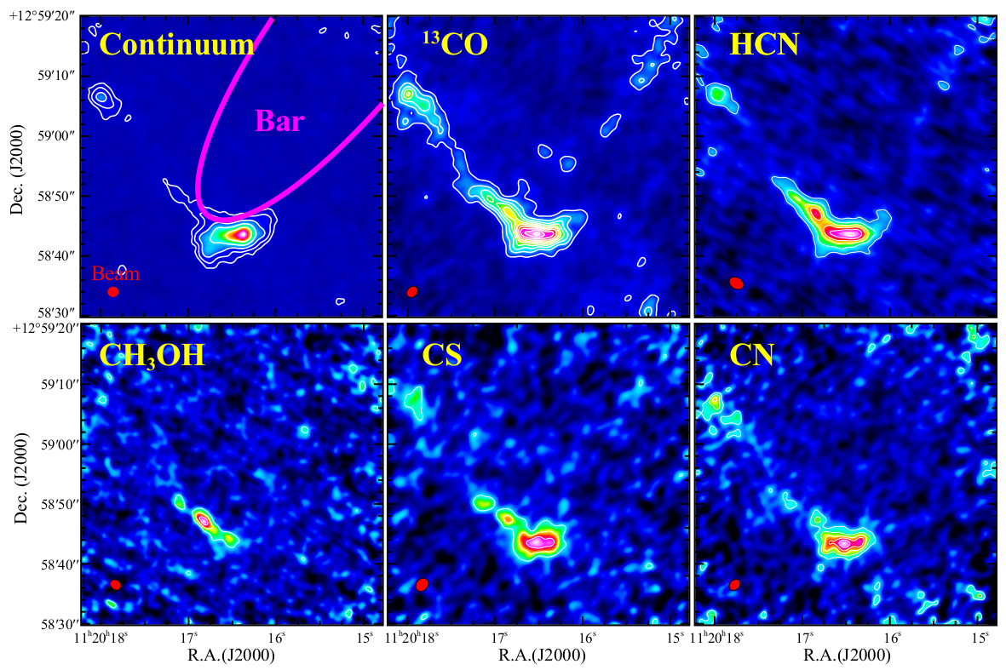
Distributions of Molecules
Other Molecules:
C¹⁸O, HCO⁺, HNC, N₂H⁺, CCH
Notes:
In addition to 13CO, several molecules are detected in the spiral arm.
Here are integrated intensity maps of 13CO, HCN, CH3OH, and CS.
Red crosses are peak positions of 13CO as guides.
HCN and CS are detected in the northern GMCs.

Slide 28
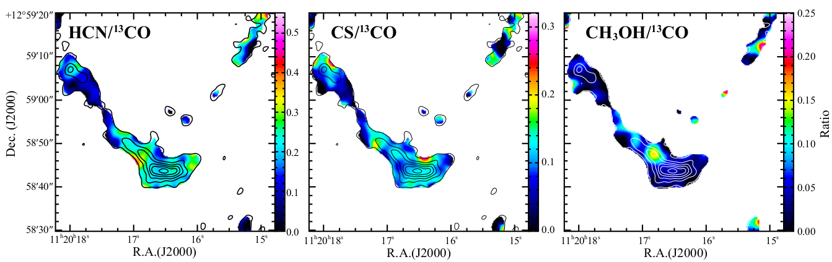
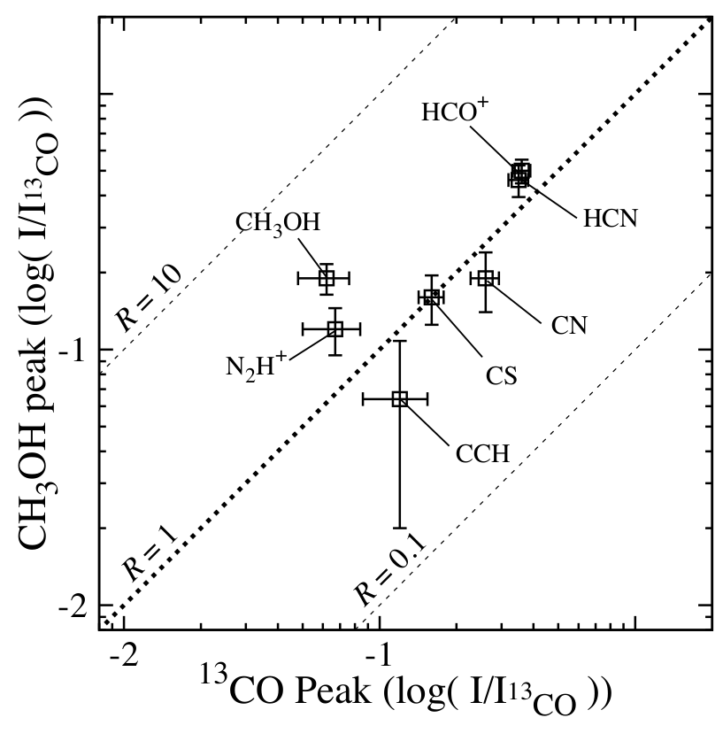
Enhancement of CH₃OH in Bar-end
CH₃OH peak
¹³CO peak
Distribution of CH3OH is different from
other molecules.
- Higher CH₃OH/¹³CO ratio by factor of 3
- No enhancement in other molecule
Why is CH₃OH enhanced?
Notes:
In addition to 13CO, several molecules are detected in the spiral arm.
Here are integrated intensity maps of 13CO, HCN, CH3OH, and CS.
Red crosses are peak positions of 13CO as guides.
HCN and CS are detected in the northern GMCs.

Slide 29
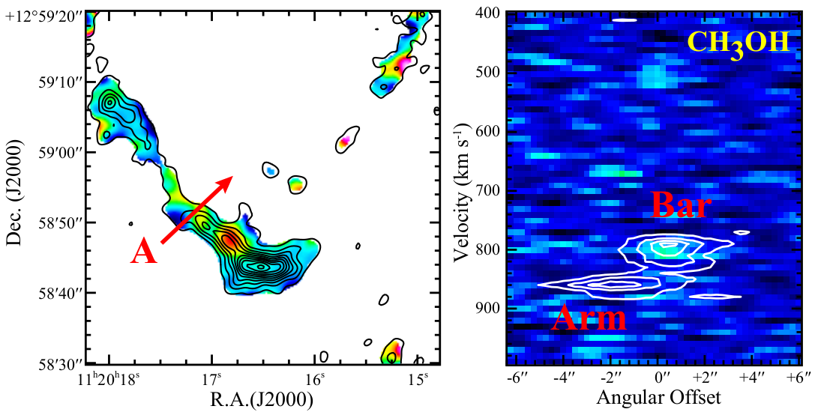
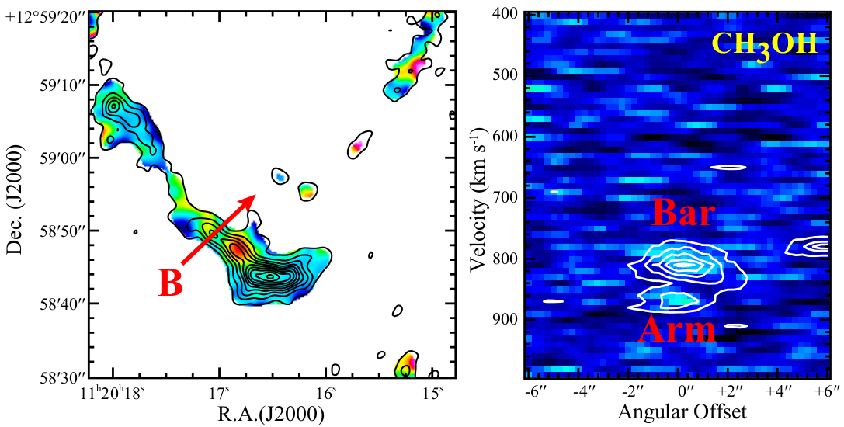
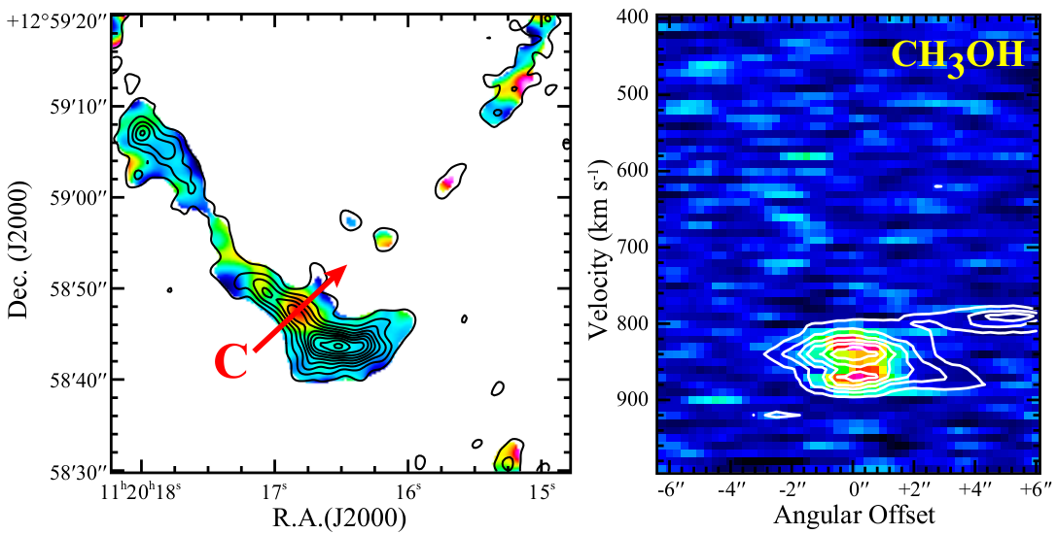
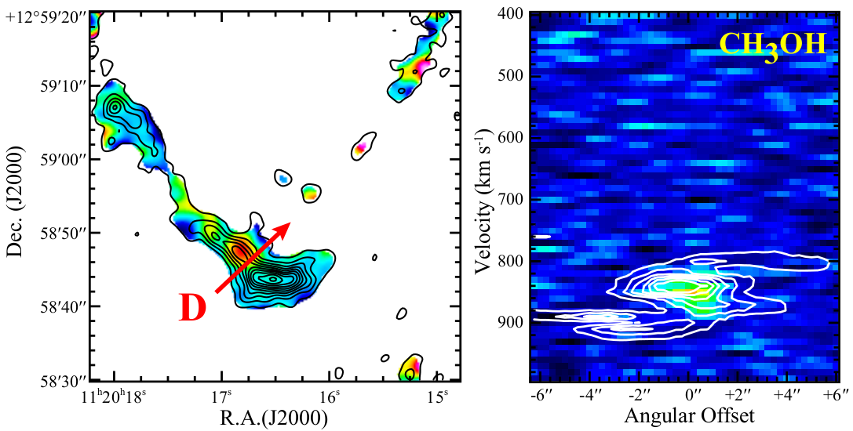
Position Velocity Diagrams
CH₃OH/¹³CO
Notes:
In addition to 13CO, several molecules are detected in the spiral arm.
Here are integrated intensity maps of 13CO, HCN, CH3OH, and CS.
Red crosses are peak positions of 13CO as guides.
HCN and CS are detected in the northern GMCs.

Slide 30
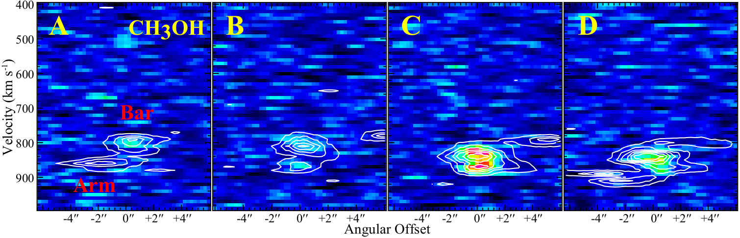
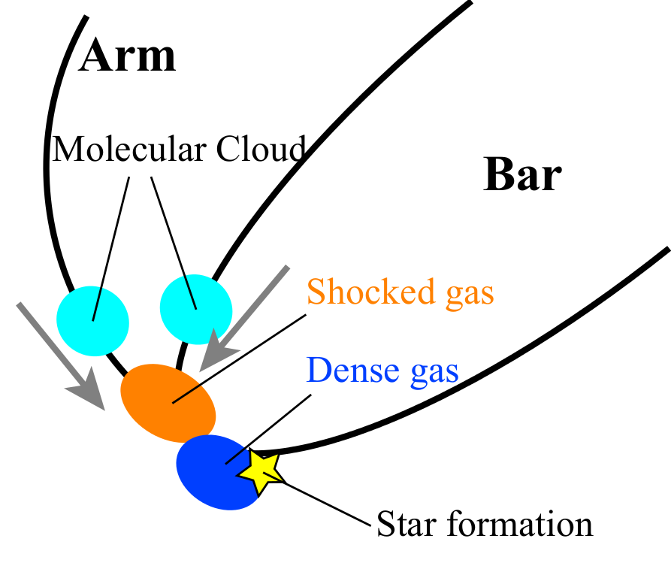
Collision between Molecular Clouds in Bar-end?
Two components of molecular cloud
Signature of interaction in PV diagram
- Enhancement of CH₃OH
⇒Collision between clouds?
⇒ CH₃OH evaporation by shock?
Good tracer of gas dynamics?
Notes:
In addition to 13CO, several molecules are detected in the spiral arm.
Here are integrated intensity maps of 13CO, HCN, CH3OH, and CS.
Red crosses are peak positions of 13CO as guides.
HCN and CS are detected in the northern GMCs.

Slide 31
Chemistry of Molecular Cloud-Scale Gas
For interpretation of extragalactic astrochemistry..
Chemical composition of ‘Starndard molecular clouds’
- e.g.: Giant molecular cloud (GMC) in a spiral arm
Effect of star formation
⇒ No at a scale of 1 – 0.1 kpc
(No star formation feedback and chemical evolution)
Effect of galactic-scale dynamics
⇒ Yes (< 100 pc)
Effect of metallicity
Notes:
The large difference between extragalactic astrochemistry and galactic astrochemistry is size-scale difference.
Typical size scale of galactic observation is much less than 1 pc.
On the other hand, that of extragalactic observation is more than 10 pc, even with ALMA.
The size-scale difference indicates that astrochemical concept of galactic object cannot be applied to extragalaxy directly.
So, the problem is how we can learn chemistry from observations averaged over a large scale from kpc to 10 pc.
For this purpose, we focused on these three effects, star formation, galactic-scale dynamics and metallicity, on the chemical composition.
I will not discuss effect of AGN and Starburst in this talk.
But, understanding of these three effects is important for the nuclear studies.
First, I focus on effects of star formation.

Slide 32
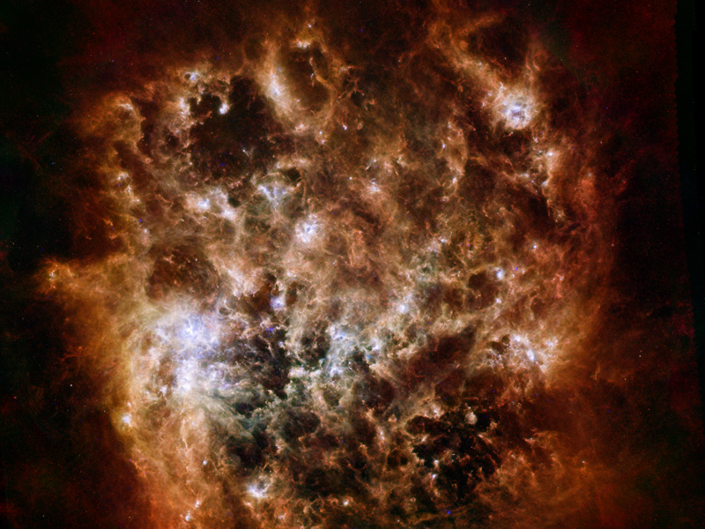
Effect of Metallicity (PI: Nishimura, Y.)
Spectral Line Survey toward the LMC
Disntance: 50 kpc
(38” = 9.2 pc)
Low metal abundance
- A half of solar abundance
(Westerlund, B.E., 1990)
Intense UV radiation field
- 10 – 100 times higher than our galaxy value
Survey of 7 Target Sources
Nishimura et al. 2016
Notes:
In order to examine the effect of metalicity on the chemical composition, we observed the large magellanic cloud.
This study was done by Nishimura-san. She is Ph.D student in our laboratory.
The LMC is the nearest galaxy,
And so we can resolve 10 pc scale by single dish observations.
This has low metal abundances, that is a half of solar abundances.
The UV radiation is high, that is 10 to 100 times higher than our galaxy value.
So far, chemical composition in the LMC have been studied to ward very active star forming regions with extended HII regions.
However, in order to explore chemical compositions at 10 pc scale, we observed 7 molecular clouds with different star formation activities.
Observations were conducted with Mopla telescope in Australia.
The spatial resolution corresponds to about 9 pc.

Slide 33
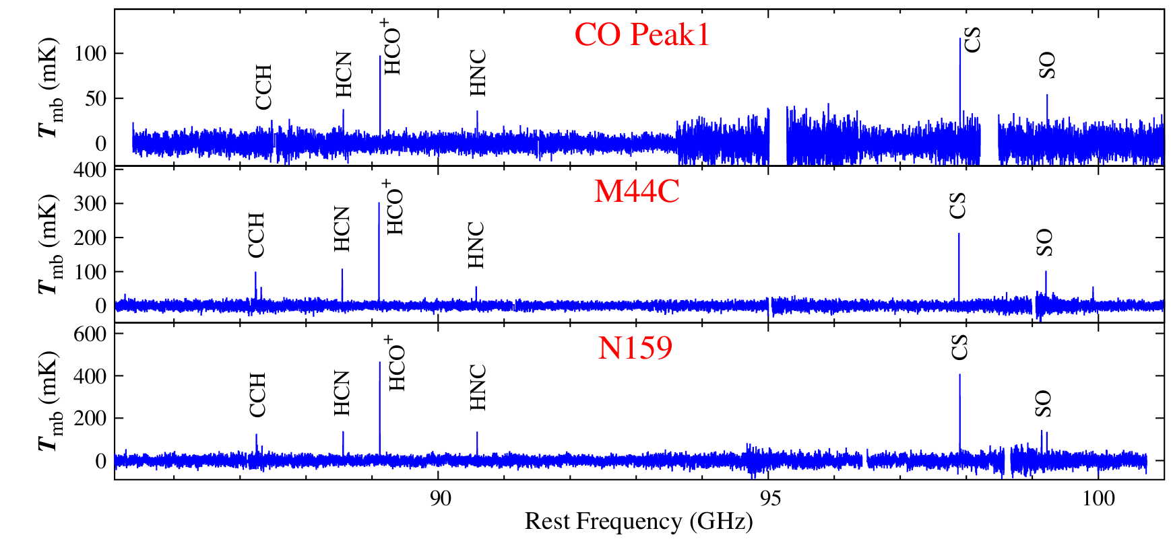
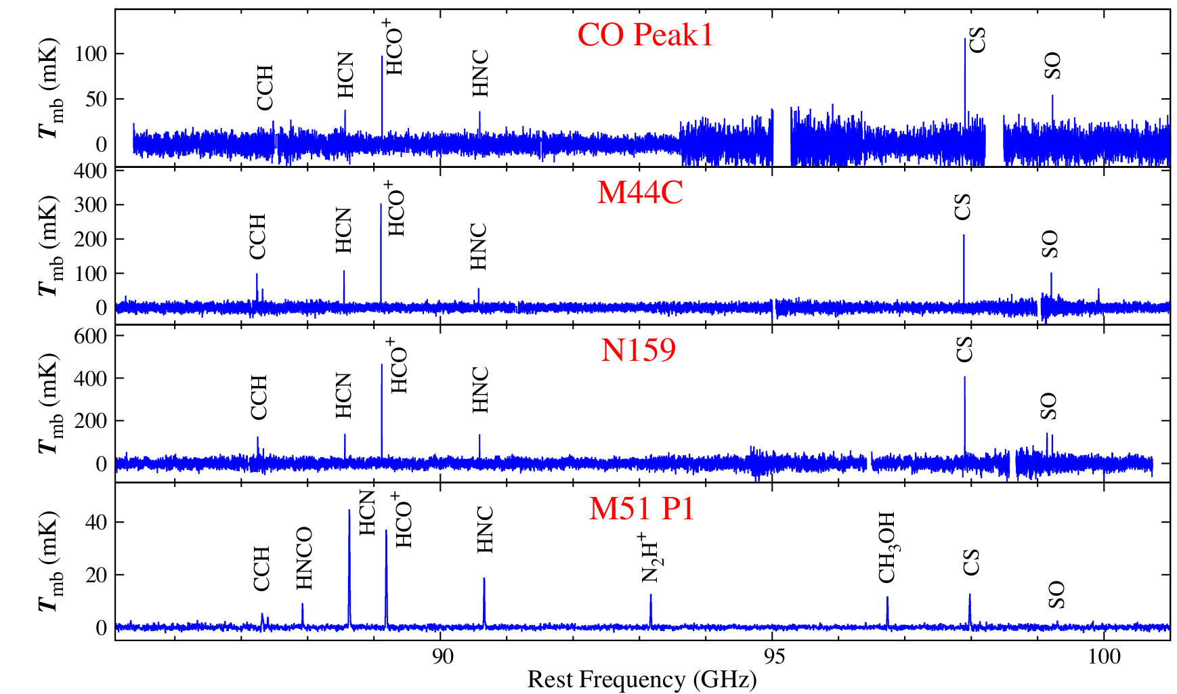
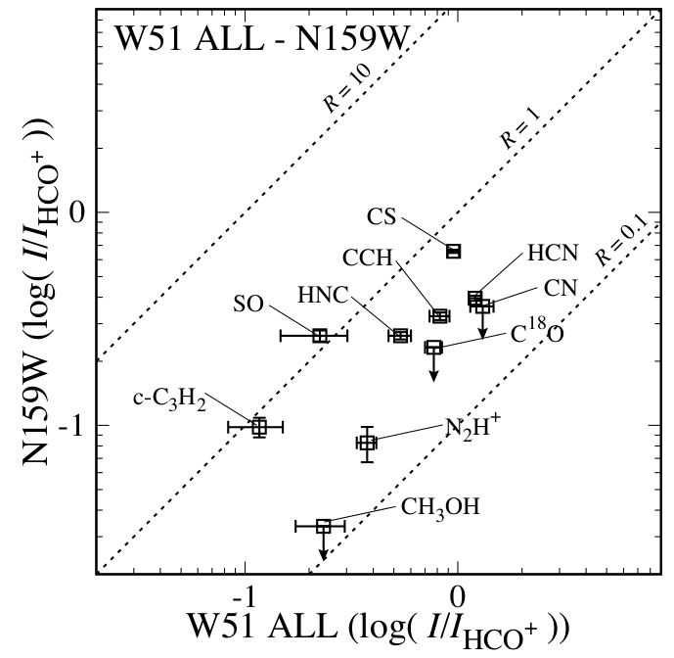
Spectra of the LMC
No YSO
(Nishimura et al. 2016)
Elemental Abundances
With YSOs
LMC
M51
Solar
O/H
2.40
6.31
7.41
C/H
0.79
3.98
4.47
HII regions
N/H
0.087
1.59
0.91
( × 10⁻⁴ )
Small effect of SF on chemical compositions
Weak intensity of N-bearing species
⇒ Effect of the lower elemental abundance of N in the LMC
New probe of elemental abundance measurements!
Notes:
Here are examples of the observed spectra.
CO peak1 has no young stellar object, M44C has high-mass YSOs, and N159 has large HII regions.
In spite of these differences of star formation activities, spectral patterns are similar to each other.
Again, effect of star formation activity cannot be seen in the molecular-cloud-scale chemical compositions in the LMC clouds.
Here is the reference spectra of M51.
Comparing with M51, the LMC spectra show relatively weak emission lines of Nitrogen-bearing molecules such as HCN and HNC.
This result reflects low elemental abundance of Nitrogen in Mgellanic cloud.

Slide 34
Chemistry of Molecular Cloud-Scale Gas
For interpretation of extragalactic astrochemistry..
Chemical composition of ‘Starndard molecular clouds’
- e.g.: Giant molecular cloud (GMC) in a spiral arm
Effect of star formation
⇒ No at a scale of 1 – 0.1 kpc
(No star formation feedback and chemical evolution)
Effect of galactic-scale dynamics
⇒ Yes (< 100 pc)
Effect of metallicity
⇒ Yes
Notes:
The large difference between extragalactic astrochemistry and galactic astrochemistry is size-scale difference.
Typical size scale of galactic observation is much less than 1 pc.
On the other hand, that of extragalactic observation is more than 10 pc, even with ALMA.
The size-scale difference indicates that astrochemical concept of galactic object cannot be applied to extragalaxy directly.
So, the problem is how we can learn chemistry from observations averaged over a large scale from kpc to 10 pc.
For this purpose, we focused on these three effects, star formation, galactic-scale dynamics and metallicity, on the chemical composition.
I will not discuss effect of AGN and Starburst in this talk.
But, understanding of these three effects is important for the nuclear studies.
First, I focus on effects of star formation.

Slide 35
Tsukuba THz 10 m Telescope for Interstellar Chemistry

Slide 36
Observation Target in the THz band
High density and high temperature tracer
(Continuum & Spectral Lines)
e.g.) HCN (J=17-16), HCO⁺(J=17-16)
Star Forming Regions, Protoplanetary Disks,
Shocked Regions, AGNs, & SBGs
Fundamental molecular species
(Spectral Lines)
Simple Hydrides (HF, OH⁺, H₂O⁺, H₂D⁺ etc. )
Atomic Lines (C, C⁺, N⁺, O etc.)
e.g. ν (J=1-0) = h/(4π²μｒ ^{２}）
Notes:
このようにTHz天文学はHerschelによって切り開かれました。
このTHz帯での観測ターゲットは主に２つあります。
一つは高密度・高温の分子トレーサーの観測です。
これを観測することにより、星形成領域、原始惑星円盤、衝撃波領域、ANGやスターバーストなどの
構造形成の核心部分を捉えることができます。
もう１つは、これらの基本的な原子分子線の観測です。
これらの原子分子を観測することで、星間空間中での分子反応の根幹部分を明らかにできます。

Slide 37
Deuterium Fractionations
- H₂D⁺ is a key molecule. -
Tracer of Evolution of Starless Cores
H₃⁺ + HD → H₂D⁺ + H₂
Depletion of CO enhances H₂D⁺
c.f. For heavy depletion of CO,
H₂D⁺ + HD → D₂H⁺ + H₂
D₂H⁺ + HD → D₃⁺ + H₂
Tracer of Onset of Star Formation
H₂D⁺ + CO → HD + HCO⁺
Evaporation of CO destroys H₂D⁺
Tracer of star formation history in the universe?
- Element produced only in the big bang
- Consumption by nuclear fusion in stars

Slide 38
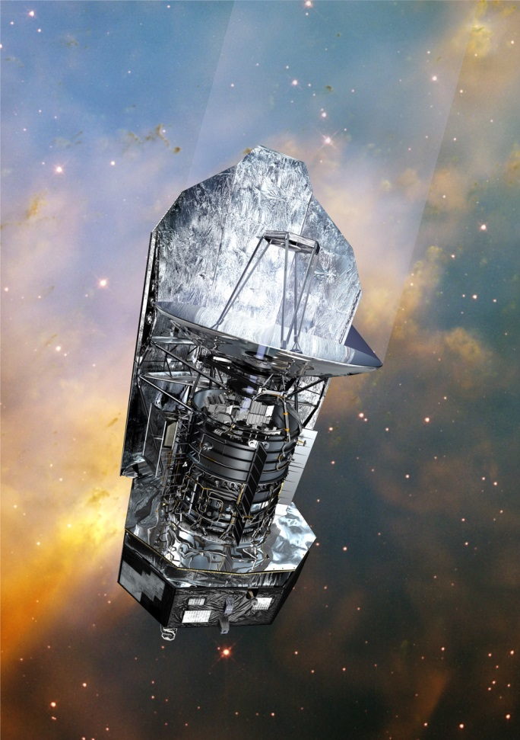

Line Survey in Orion KL with Herschel HIFI
Bergin et al. (2010）

Slide 39

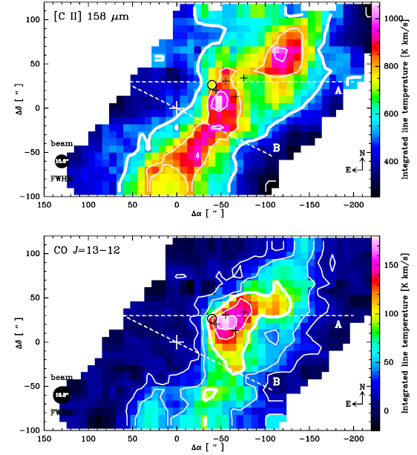
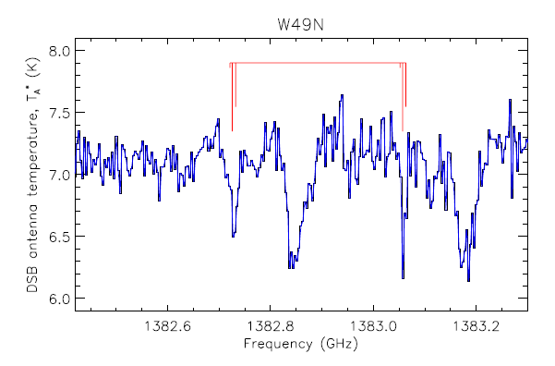
SOFIA in Operation
Perez-Beaupuits et al. 2012
M17SW
SH
Neufeld et al. 2012

Slide 40
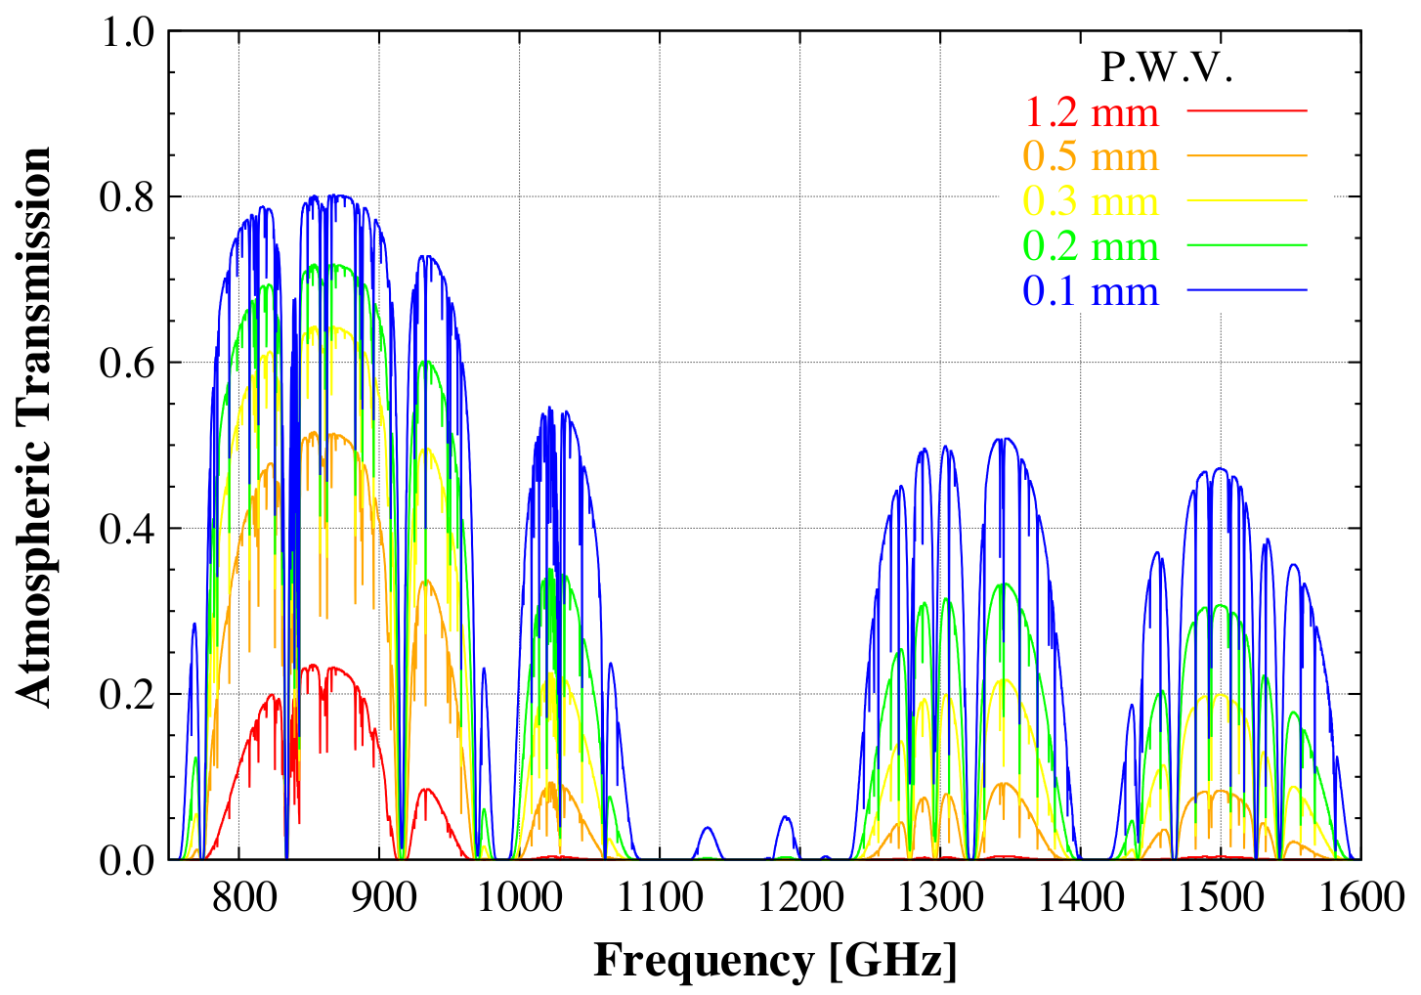
Atmospheric Transparency in the THz Band
Notes:
これまで、THz帯の観測は、衛星や航空機による観測が主体でした。
しかし、いくつかの周波数帯では地上からの観測も可能です。
こちらは、横軸に周波数、縦軸に大気の透過度をプロットしたものです。
下降水量が0.2mmの非常に条件のときに着目すると、1.3-1.4THzの２つの
大気の窓での大気透過度は30%の透過率があり、十分地上から観測できます。

Slide 41
Main Targets in the 1.3-1.5 THz Band
Deuterium Fractionation
p-H₂D⁺ (1.37 THz) and o-D₂H⁺ (1.48 THz)
High density and temperature tracers
E_{u}
n_{crit}
HCN J=17-16 1505.029 GHz 650 K 2(9) cm⁻³
HCO⁺ J=17-16 1514.583 GHz 650 K 3(8) cm⁻³
J=15-14 1336.714 GHz 510 K 2(8) cm⁻³
CO J=13-12 1496.922 GHz 350 K 2(6) cm⁻³
J=11-10 1267.014 GHz 250 K 1(6) cm⁻³
Atomic and fundamental molecular species
Notes:
この1.3-1.4THzの大気の窓に着目すると、３つの観測ターゲットがあります。
１つ目は、H2D+とD2H+です。
この分子は、10Kから20Kの非常に低温な分子ガスにおける星間化学で特有の現象である、重水素濃縮の鍵となります。
２つ目は、超高密度分子ガストレーサの観測です。
この周波数帯で観測可能なこれらの分子は、臨界密度が10^8-9個/ccとこれまで電波天文学では観測がされたことの無いような高い臨界密度を持ちます。
３つ目は、スペクトル線サーベイです。
この周波数帯はHerschelでも観測されたことがないので、どのような原子・分子が検出できるのかはまだ分かっておらず、非常に興味があります。
以上のような観測を目標に、私の所属する山本研究室では、THz帯の受信機の開発を進めています。

Slide 42
Development of HEB Mixers at UT
Waveguide-Type HEB Mixer Using a Relatively Thick NbTiN Film
Waveguide-Type HEB Mixer Using a NbN/AlN Film
Quasi-Optical HEB Mixer Using an NbTiN Film
(in collaboration with Dr. Maezawa)
(QCL as a Local Osc. in collaboration with
Drs. Hosako, Sekine, and Irimajiri)
Notes:
我々の研究室では、超伝導体を用いたHot Electron Bolometerを開発してきました。
このような開発項目があります。
この中で、特筆すべき点は、HEB世界最高性能のHEBミキサーの開発です。

Slide 43
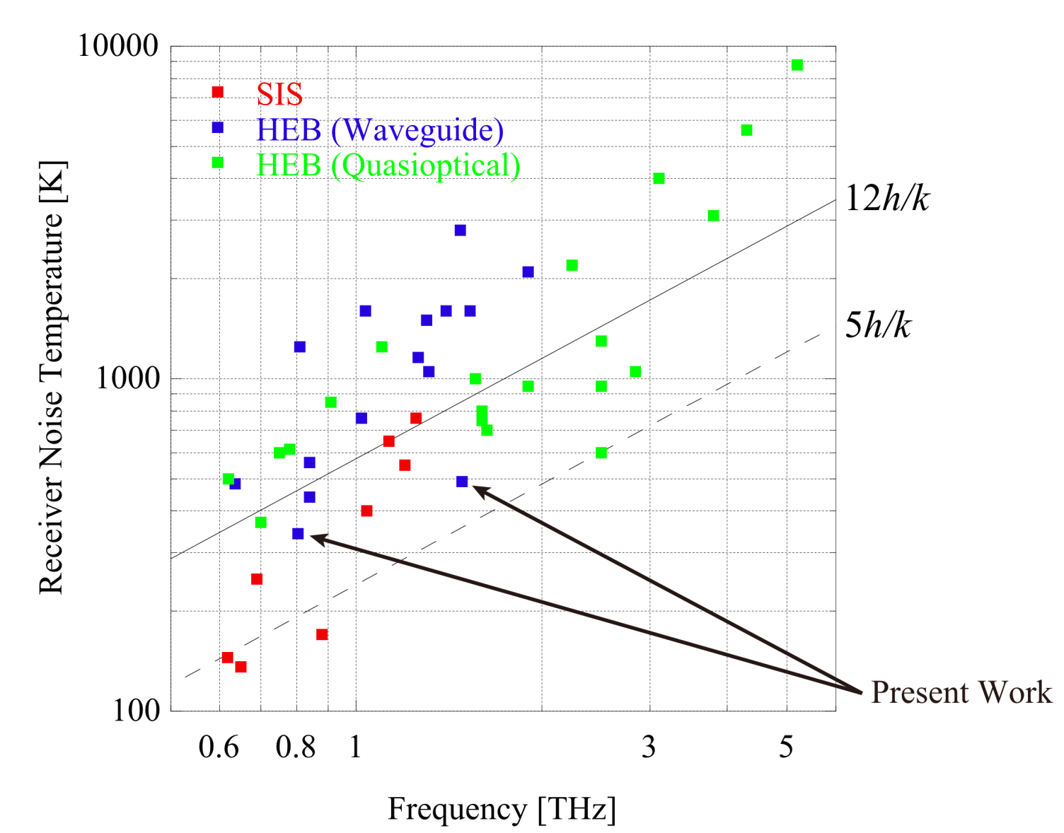
Our Waveguide-type HEB Mixer Receiver
Comparison with other groups
NbTiN mixers
1.475 THz
T_{rx}=490 K
0.81 THz
T_{rx}=350 K
Shiino et al. JJAP 2015.
Notes:
このように、1.475THzで490 Kと、世界最高の性能を達成しています。

Slide 44
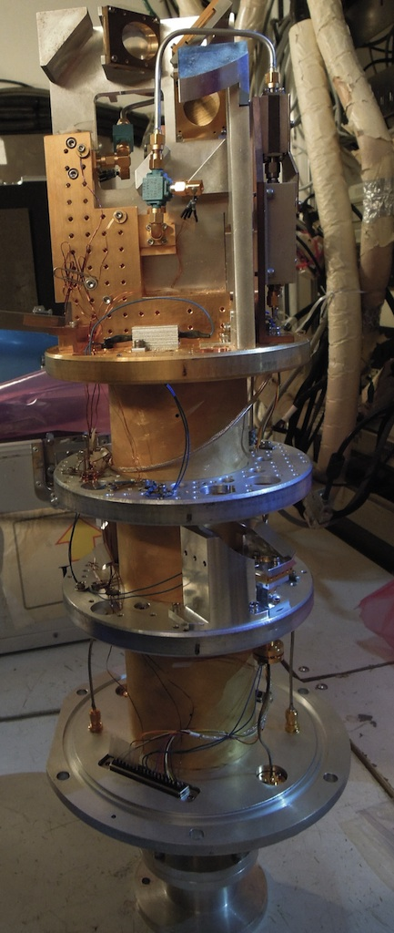
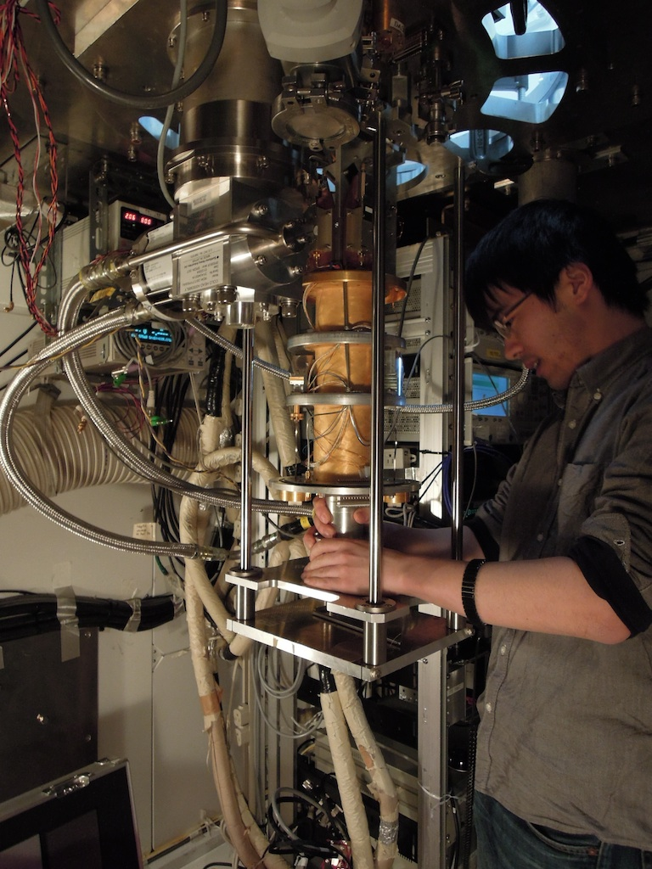
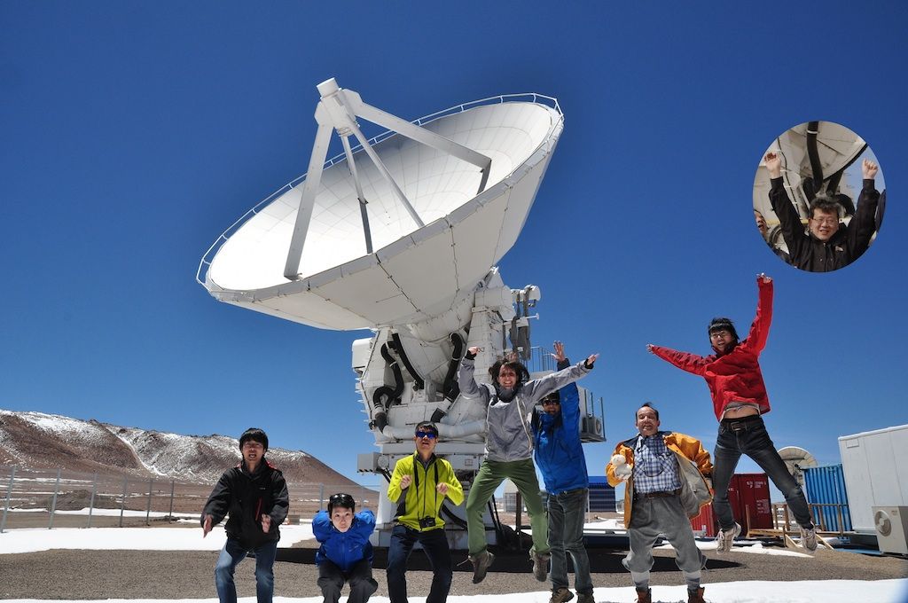
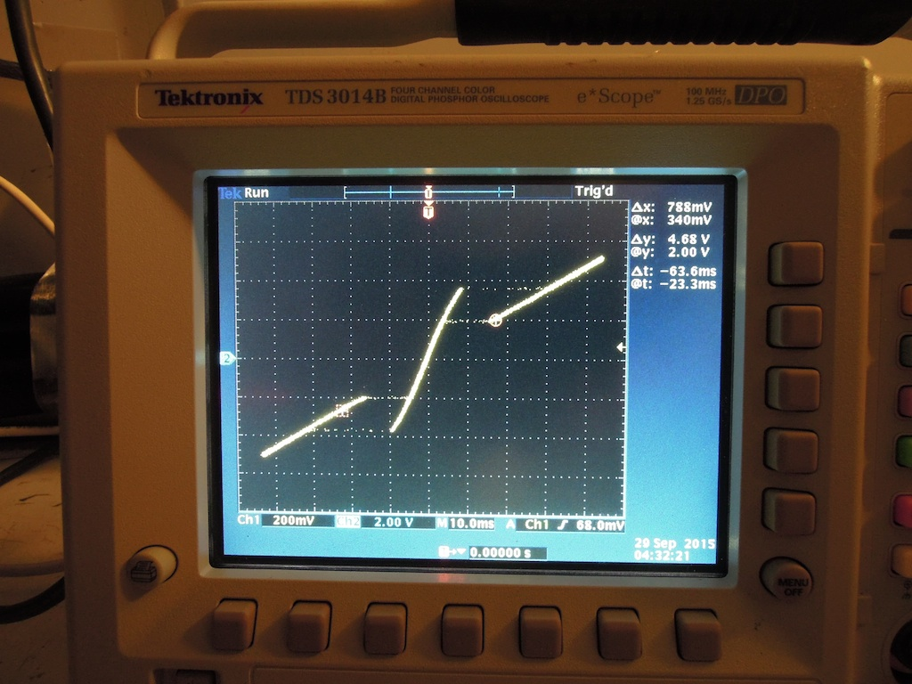
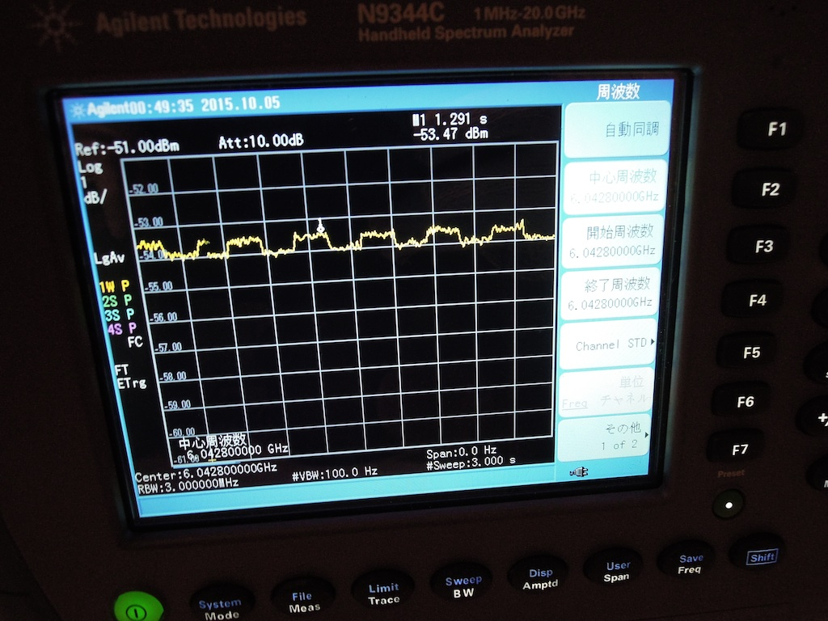
Test Observation of THz Receiver with ASTE
Telescope: ASTE 10 m @ Chile
Date：2015/9/26 – 10/23
Receiver：HEB9
(LO:880-960 GHz)
HEB13
(LO: 1360 - 1480 GHz)
Noise Temp.： 1500 K (HEB9)
2200 K (HEB13)
Beam Size： ~ 10” (HEB9)
Notes:
我々の研究室では、HEBミキサーの開発だけでなく、これを受信機に組み込み、国立天文台が運用しているASTE望遠鏡に搭載して観測実験を行なってきました。
これまで、ASTEへの搭載実験は数年にわたり続けてきて、今年の9月から10月にかけても実施しました。
搭載した受信機は、0.9THzと1.4THzの２つのバンドです。
受信機の雑音性能はこのようになっています。
これらの写真は、受信機の搭載の様子です。
0.9THzについては観測に成功していますが、1.4THzでは良い天候に恵まれず観測に至っていません。

Slide 45
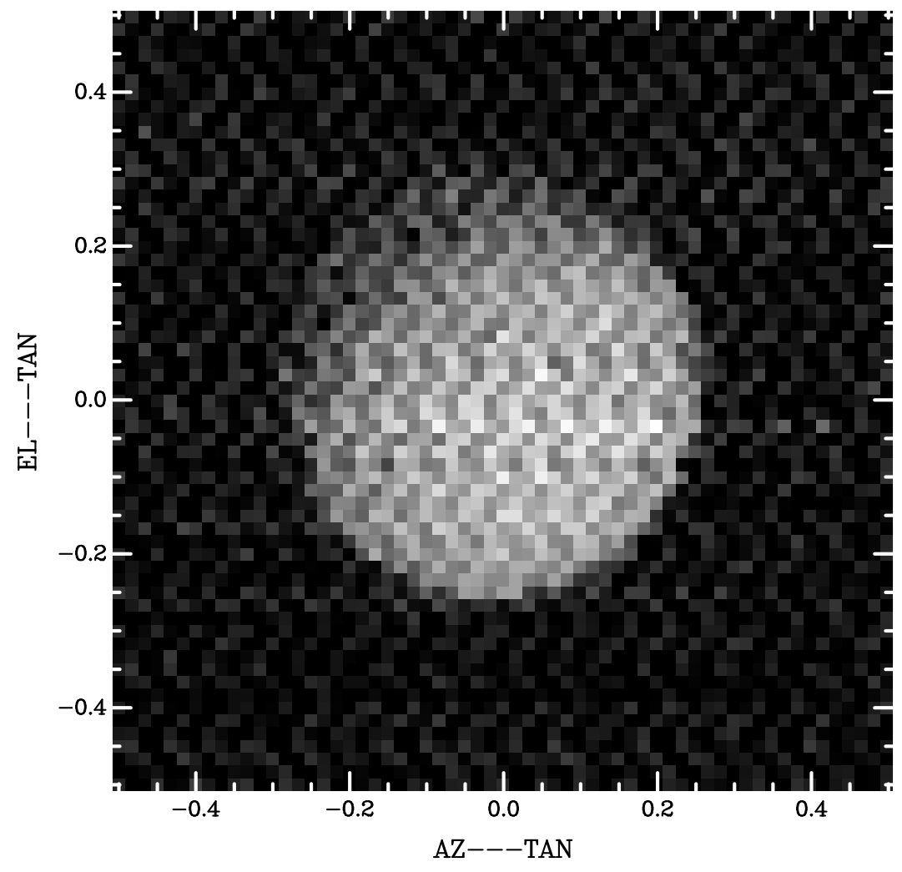
Observation with ASTE in the THz Band
Moon
Date: 10/1, 4, 5, 6, 13, 14, 15
Noise Temperature: 4000 – 8000 K (0.9 THz)
P.W.V.: 1.0 – 0.4 mm
Main Beam Efficiency: ~ 15 - 20 % (0.9 THz)
< a few %？ (1.4 THz)
Continuum
Feasibility of observation with HEB-mixer receiver
881.272808 GHz
E_{u}/k_{B} = 190 K
¹³CO(J = 8 - 7)
Notes:
昨年の観測期間は約一ヶ月ありましたが、望遠鏡のトラブルや悪天候により実際に観測ができたのは、この7日間だけでした。
観測できた日も、受信機雑音温度が4000-8000 Kと高く厳しい条件でした。
しかし、このように、月の連続波マップや、OrionKLの13CO(8-7)の分光観測に成功しました。
これらの観測により、我々の受信機が天体観測のために十分な性能であることが実証できました。
さらに今年は、このような中小質量星原始星でのスペクトルも取得できました。
その中で、こちらのR CrAを紹介します。

Slide 46
Summary of THz Observation with ASTE
Feasibility of our HEB mixer for observations
- Scientific data in the 0.9 THz band
Unsuccessful observation in the 1.4 THz band
- Bad atmosphere condition (P.W.V. > 0.4 mm)
- Coarse surface of 10 m dish (low main beam efficiency)
For THz observation by ground based telescope
- Good atmosphere condition
- Telescope with high precise surface dish
Tsukuba 10 m THz telescope for chemistry

Slide 47
Summary
Chemical compositions of molecular cloud scale gas
- From M51 and W51 observations
No effect of star formation feedback and chemical evolution
‘Standard chemical composition’ of molecular cloud
- NGC 3627 with ALMA
Gas dynamics can change chemical composition by shock.
- Low metal galaxy LMC
Elemental abundance is important to understand molecular-cloud scale chemistry.
Observation of molecules in THz band

