Slide 1
Search for in muonic atom at COMET experiment
μ
e
e
e
Masato Yamanaka (ICRR, Univ. of Tokyo)
Masafumi Koike (Saitama Univ.) Yoshitaka Kuno (Osaka Univ.) Joe Sato (Saitama Univ. )
Collaborators

Slide 2
Introduction

Slide 3
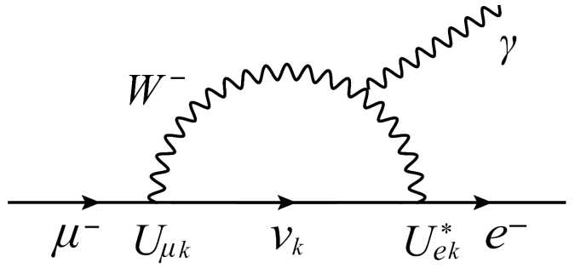
Introduction
In Standard Model (SM)
Lepton Flavour Violation (LFV) through the neutrino oscillation
But …
Forever invisible
Discovery of the LFV signal
One of the evidence for beyond the SM

Slide 4
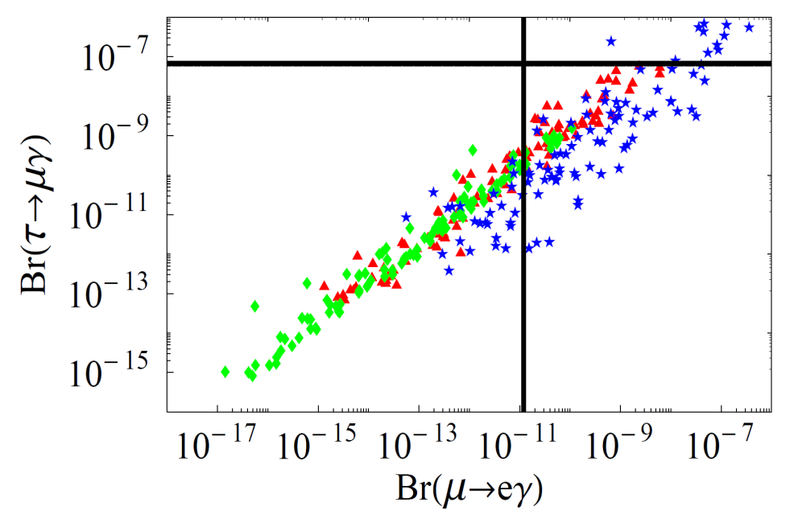
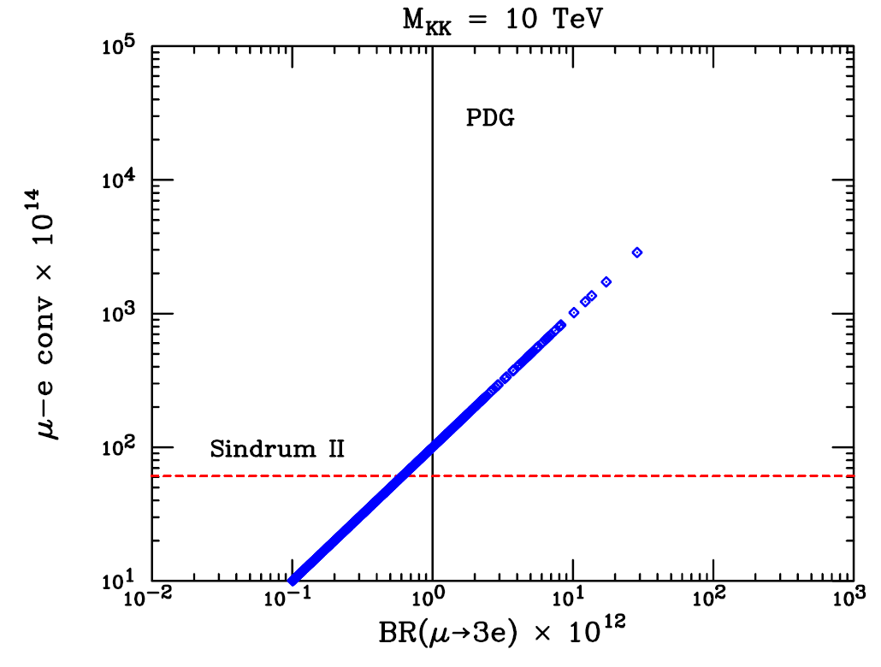
Introduction
Supersymetric model
Extra dimension model
Comparing LFV signals in each process type
Discrimination of new physics models
Prove for structure of new physics
Desire for detectable new LFV process

Slide 5
Introduction
New idea for LFV search
μ
e
e
e
in muonic atom
What is advantage ?
Clean signal, and simultaneous search with other LFV processes
Where is the stage ?
MUSIC, COMET, and PRISM
What is sensitive to ?
μ
Flavor violation between and e

Slide 6
μ
e
e
e

Slide 7
μ
e
e
e
Muonic atom
electron 1S orbit
muon 1S orbit
nucleus
muon
electron

Slide 8
μ
e
e
e
LFV vertex
μ
e
e
e
in muonic atom
electron 1S orbit
muon 1S orbit
Interaction rate

Slide 9
μ
e
e
e
LFV vertex
μ
e
e
e
in muonic atom
electron 1S orbit
muon 1S orbit
Interaction rate
Cross section for elemental interaction

Slide 10
μ
e
e
e
Lagrangian
LFV source
Model dependent parmeters

Slide 11
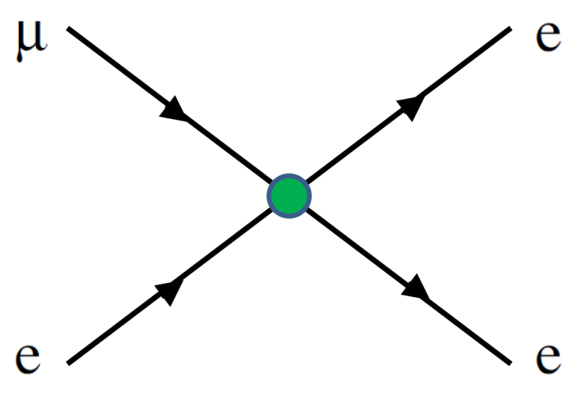
μ
e
e
e
Lagrangian

Slide 12
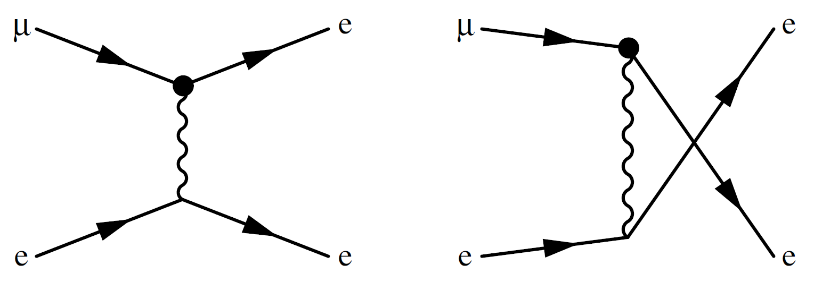
μ
e
e
e
Lagrangian

Slide 13
μ
e
e
e
For A g (i = 1, 2, …, 6)
=
～
i
L(R)

Slide 14
μ
e
e
e
LFV vertex
μ
e
e
e
in muonic atom
electron 1S orbit
muon 1S orbit
Interaction rate
μ
e
Overlap of wave function of and

Slide 15
μ
e
e
e
Muonic atom
Overlap of wave functions
Muon localizing at nucleus positon
∴

Slide 16
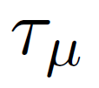
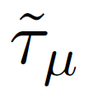
μ
e
e
e
Branching ratio
Lifetime of free muon (2.197 10 s)
×
-6
1
2.19 10 s for H
×
-6
Lifetime of bound muon
238
(7 - 8) 10 s for U
×
-8

Slide 17
Discovery reach

Slide 18
Discovery reach
μ
γ
e
Branching ratio ( )
μ
e
e
μ
γ
e
e
Ratio between BR( ) and BR( )

Slide 19
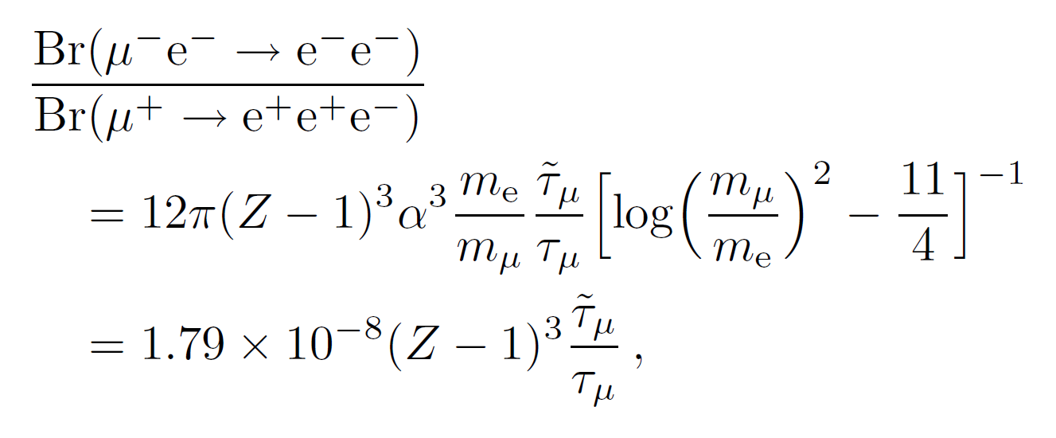
Discovery reach
μ
e
e
μ
e
e
e
e
Ratio between BR( ) and BR( )

Slide 20
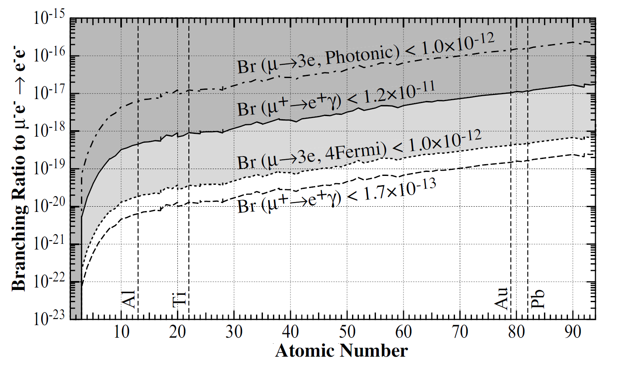
Discovery reach

Slide 21
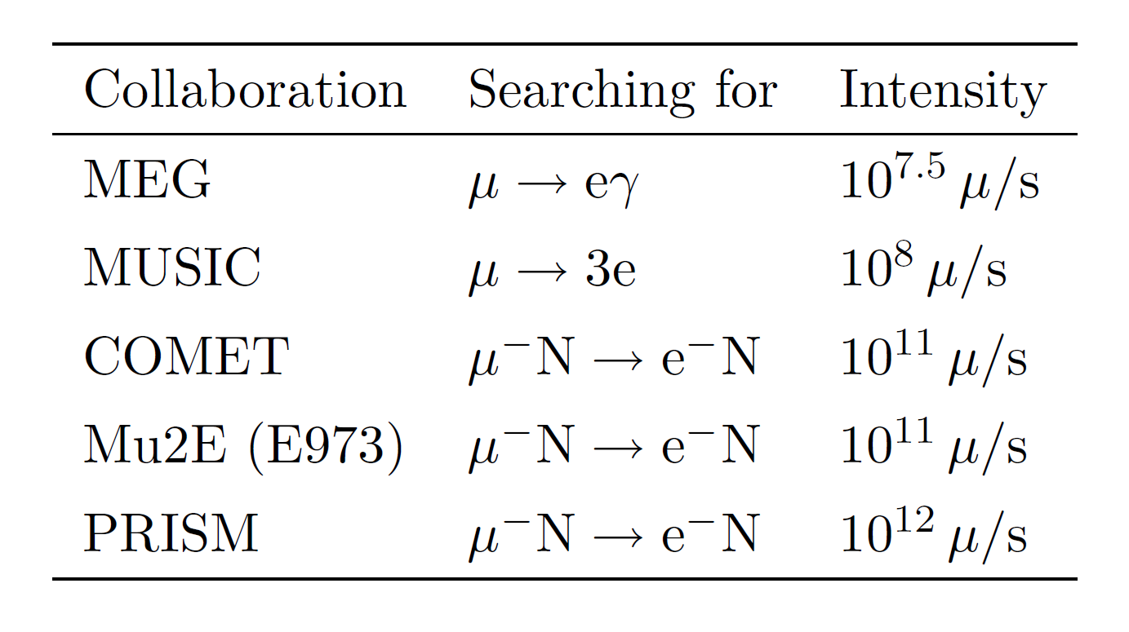
Discovery reach
7
For run-time 1 year 3 10 s
～
×
10
18
10
19
-
muon at COMET experiment

Slide 22
Discovery reach
μ
e
e
e
can be first signal of LFV !?

Slide 23
Summary

Slide 24
Summary
μ
e
e
New LFV process
e
in muonic atom
Clean signal (back to back electron with E m /2)
～
=
e
μ
Interaction rate
Advantage : Large nucleus
Detectable in on-going or future experiments
We wish to observe LFV in the process

Slide 25
Appendix

Slide 26
μ
e
e
e
electron 1S orbit
Muonic atom
muon 1S orbit
nucleus
muon
electron

Slide 27
One of the candidates for beyond the SM
Supersymmetric (SUSY) model
Supersymmetry
Symmetry between boson and fermion
Lepton Slepton
Gauge boson Gaugino
Why SUSY models ??
Stability of Higgs mass, dark matter, gauge coupling unification, hierarchy problem, and so on

