Slide 1
Belle-II実験への導入に向けた
TOPカウンターの研究開発
特定領域「フレーバー物理の新展開」研究会
2010/2/23
森 隆志 （名古屋大）

Slide 2
Contents
Introduction
Current status of R&D
Configuration study
Summary & Plan

Slide 3
1. Introduction

Slide 4
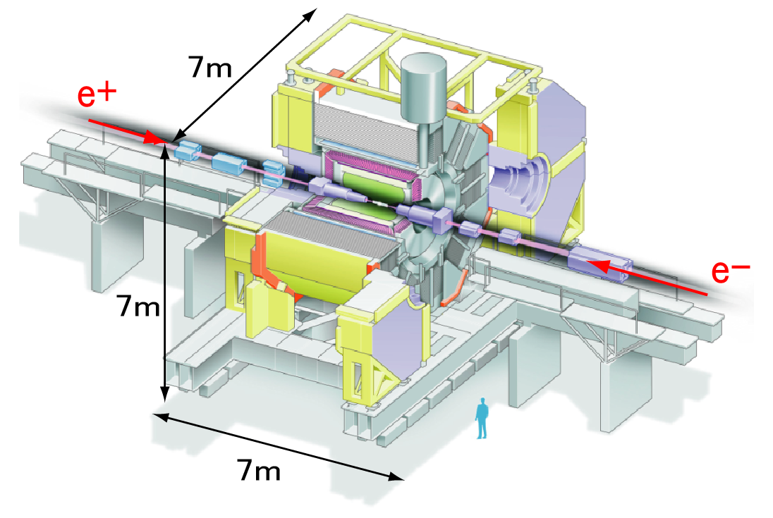
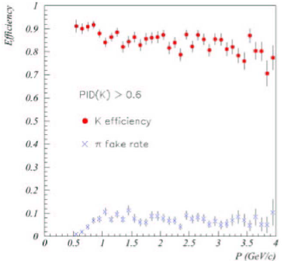
Belle Experiment
e⁺e⁻ asymmetric collision
e⁺ : 3.5GeV
e⁻ : 8.0GeV
e⁺e⁻ → Υ(4S) → BB
Belle detector
π/K ID is key device for flavor tag
Our target of development : Belle-II experiment
B-factory
⇒Super B-factory
Higher statistics： Higher luminosity ×~50
＆
Higher accuracy ： Belle detector upgrade

Slide 5
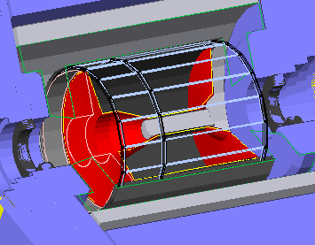
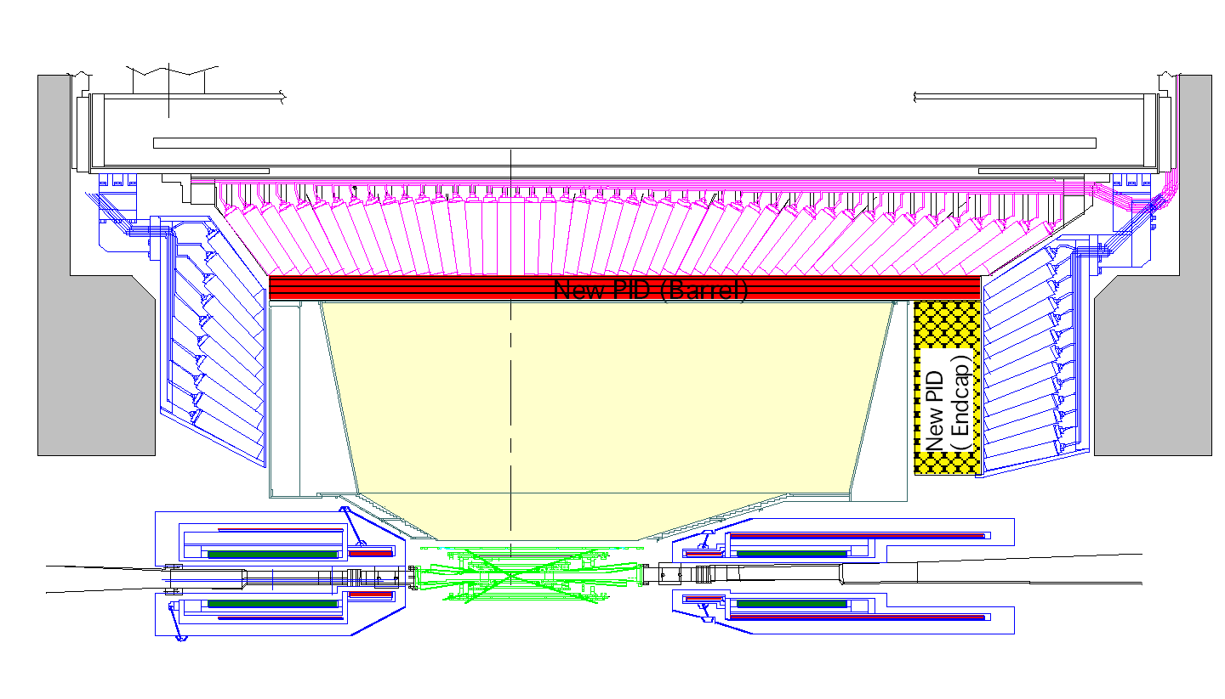
Our Motivation
Current PID system of Belle
For B⁰ → π⁺π⁻ analysis
  B⁰ → K ⁺π⁻ is big background
If separation power : 4σ
  S/N ×5
π/K separation power : 3σ
Install here
(10cm gap of barrel part)
Upgrade
Separation power
  3σ ⇒ 4σ
  0.6 < p < 4 GeV/c
TOF + ACC
(ACC:Threshold type
aerogel Cherenkov counter)
1.5T
1.2m
e⁻
7.0GeV
2.6m
e⁺
4.0GeV
TOP counter
Only suitable solution!
後方
前方

Slide 6
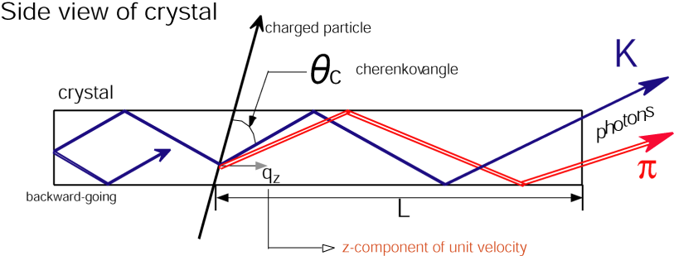
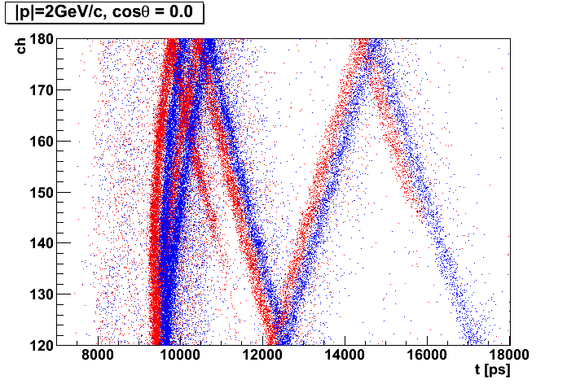
Principle of TOP counter
TOP(Time Of Propagation) counter: new type of RICH counter
  Cherenkov radiator + time sensitive screen
    RICH: Position (x, y) ➔ TOP: Position + time (x, t)
    Very compact & simple
TOP
TOF
1.18m
π
K
time includes TOF information
TOP counter measures
TOF + RICH
⊿ t ～ O(100ps)
High performance expected!

Slide 7
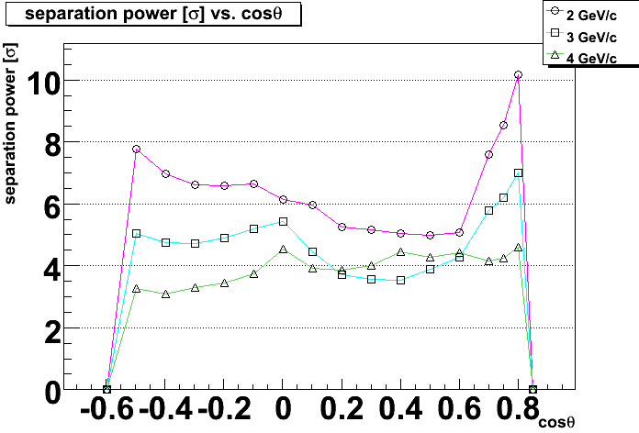
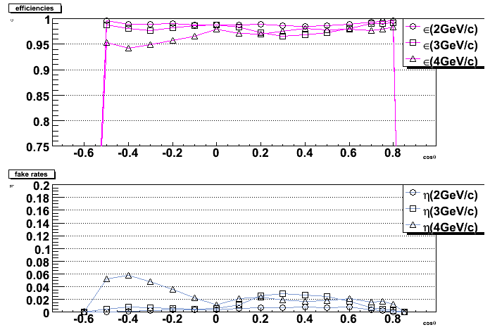
Expected Performance
2-bar + focusing mirror, multi-alkali photo-cathode
後方
前方
cosθ
4σ separation up to 4GeV/c
cosθ
<3% fake rates in forward region

Slide 8
2. Current status of R&D

Slide 9
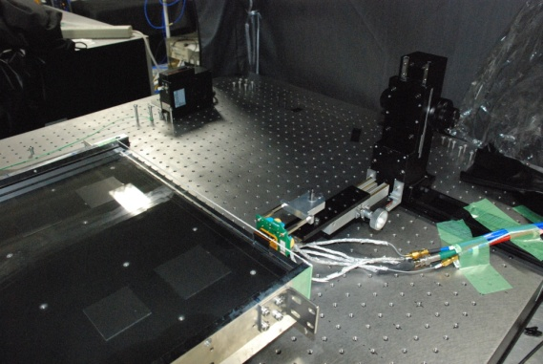
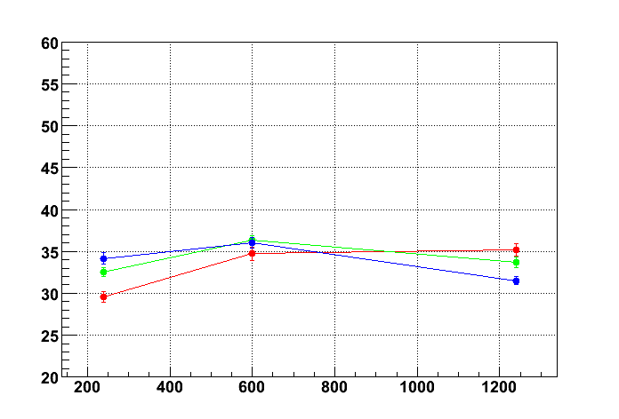
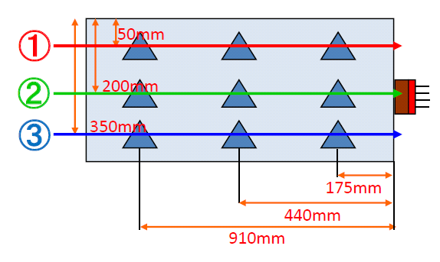
Quartz radiator
MCP-PMT
時間分解能測定
  Single photon pulse laser
    λ=407nm
  MCP-PMT
  Several incident position
➔ TTSはPMT直接入射と同等
  Quartzの性能を確認！
47.2 deg.
MCP-PMT
Quartz
Line 1
Line 2
Line 3
σ<40ps
Time resolution [ps]
Propagation length [mm]

Slide 10
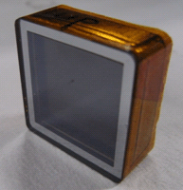
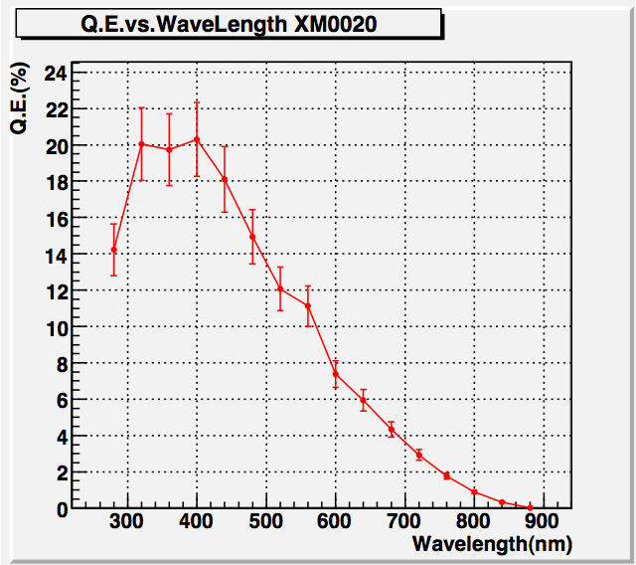
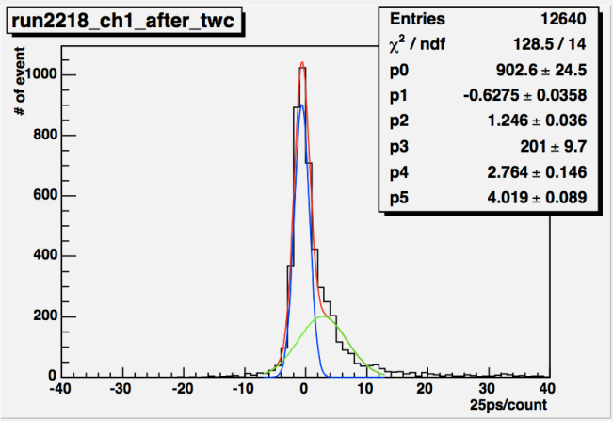
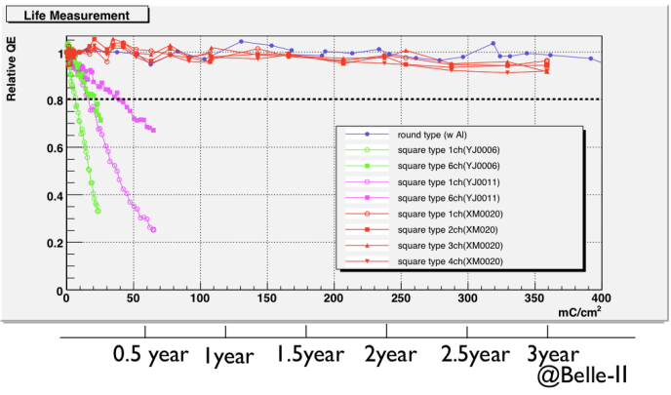
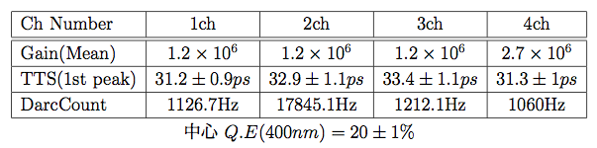
Photo-detector: MCP-PMT
28mm
角型
MCP-PMT
実用に向けたすべての要求を満たす
  TTS
    ～30ps
  QE
    20%@400nm
    さらに改良を検討
    （35%程度？)
  Gain
  位置分解能
    4x4ch(or 1x4ch)
  Lifetime
一光子照射時の時間分布
Q.E.波長依存性
life
詳細 ➔ 明日の有田君の発表

Slide 11
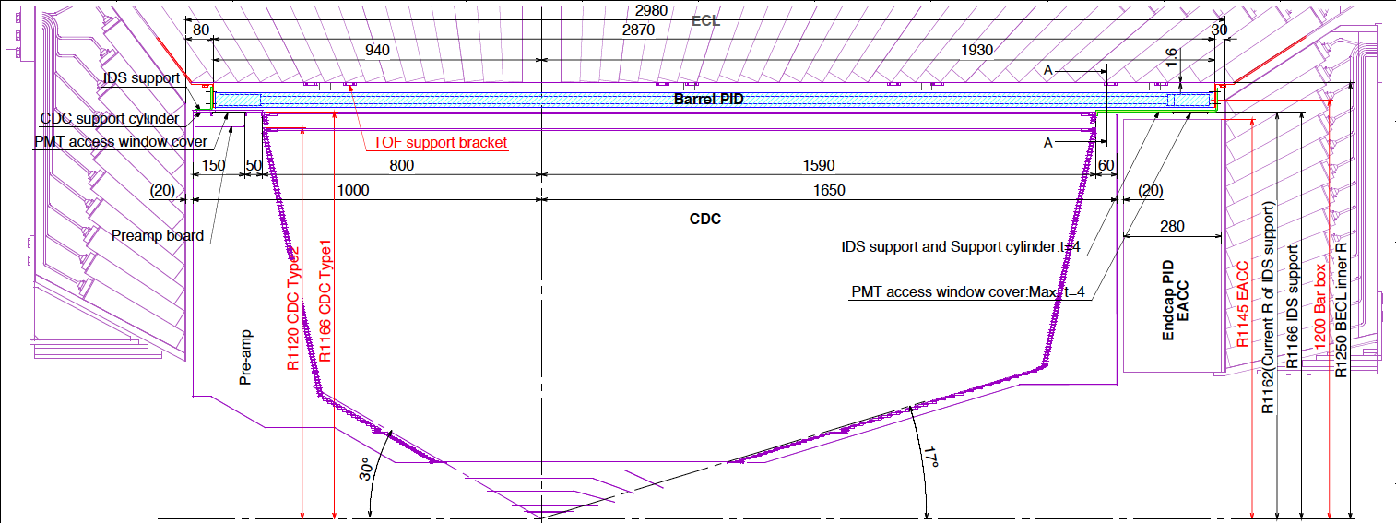
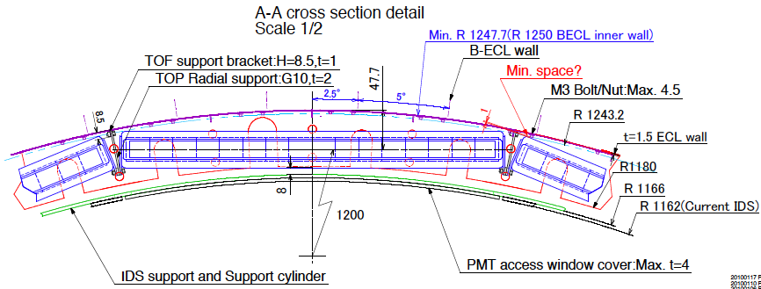
Structure Design in Progress
隣の検出器とのギャップをなるべく小さく
  外側：ECL(電磁カロリーメータ)
    Backscattering check
  内側：CDC(中央飛跡検出器)
    CDCの半径を大きく
PMT着脱用スペース

Slide 12
3. Configuration study

Slide 13


Issues
2 configurations of TOP counter
Realistic estimation of performance in Belle-II
  T₀ jitter & tracking resolution
    これまであまり考慮に入れてこなかった
    σ(t₀) = 25[ps]
    σ(θ)= σ(φ)= 1.5[mrad], σ(z) = 1.4[mm], σ(x) = 1.0[mm]
      現在のBelle検出器の値とBelle-II検出器でのシミュレーションから見積った
1-bar
2-layer PMT
どちらが
適しているか？
2-bar
double sided PMT

Slide 14
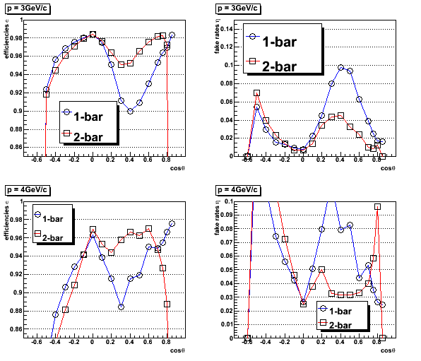
不定性を考慮にいれたときの性能
光電面：マルチアルカリ
Efficiency
Fake rates
3GeV/c
低運動量は問題なし
4GeV/cの前方以外は2-bar > 1-bar
Physics Case?
後方
後方
前方
前方
4GeV/c
cosθ
cosθ

Slide 15
Physics Case Study
B → Kπ, B → ππ
  e-: 7GeV, e+: 4GeV
    π, Kそれぞれ運動量、角度ごとにefficiency, fake rateをかけた
      Correlationは無視
  1-barと2-barの間にほとんど差はない
  運用中の状態に対するrobustnessはどうか？
    tracking resolution
    t₀ jitter
    Quartzの面取り
 | ε(K; K) | ε(K;π) | ε(π; K) | ε(π;π)
1-bar | 0.96 | 0.027 | 0.044 | 0.97
2-bar | 0.96 | 0.023 | 0.040 | 0.98

Slide 16
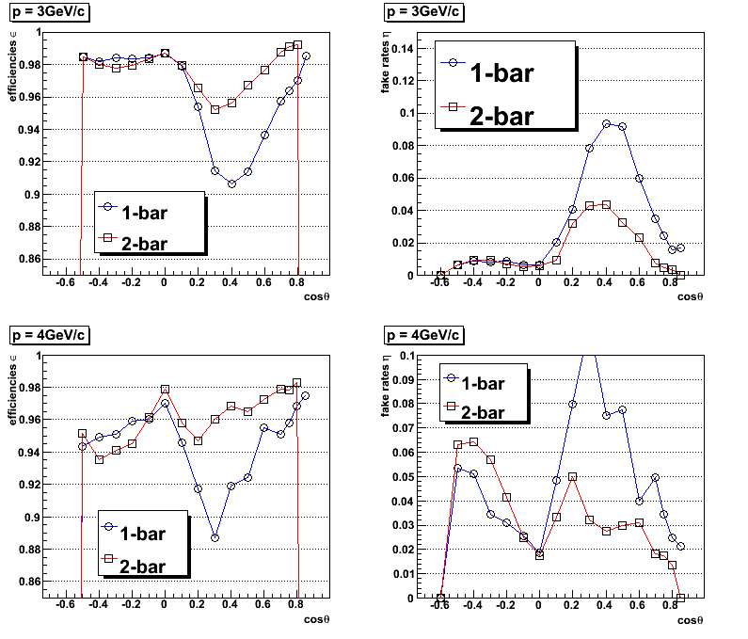
Robustness to tracking resolution
Efficiency
Fake rates
後方
後方
前方
前方
No t₀ jitter
2-bar > 1-bar
1-barは伝播距離が長い
角度不定性の影響大
cosθ
cosθ

Slide 17
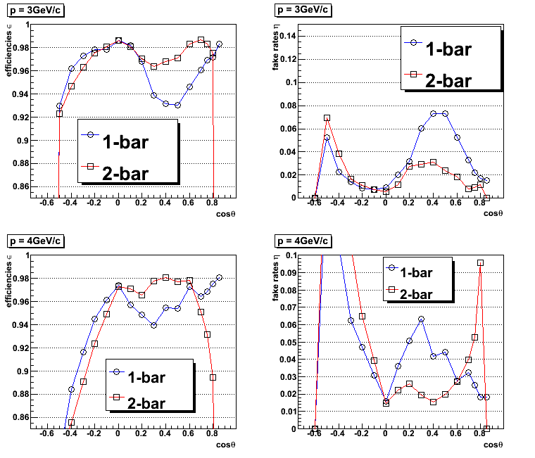
Robustness to t₀ jitter
Efficiency
Fake rates
後方
後方
前方
前方
Perfect tracking resolution
1-bar > 2-bar
2-barの性能はforward部分(cosθ～0.7)でTOFに依存する
t₀不定性の影響大
cosθ
cosθ

Slide 18
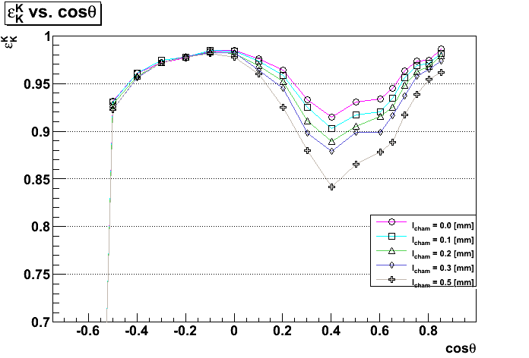
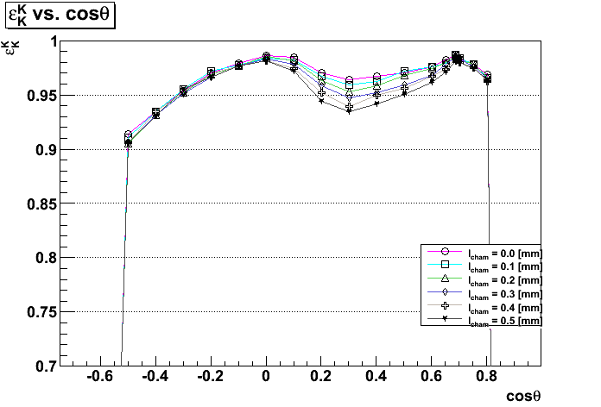
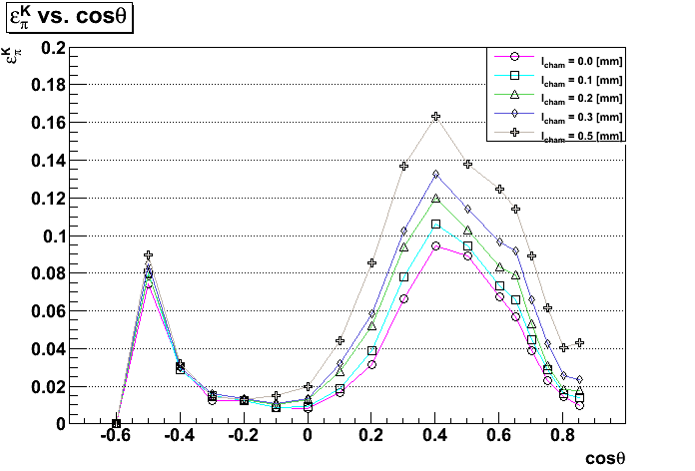
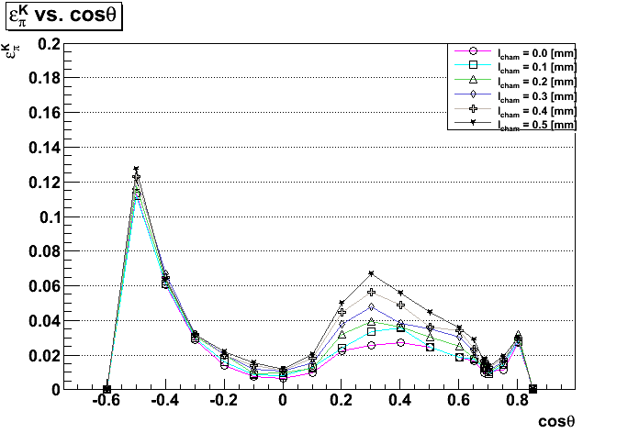
石英に面取りを入れた時の性能変化
l_{cham}: chamfering depth
3GeV/c
1-bar
2-bar
Efficiencies
Fake rates
面取りでの乱反射によりリングイメージが乱れる。バックグラウンドの増加

Slide 19
4. Summary & Plan
Summary
TOP counter : 新型の粒子識別装置、Belle-II実験への導入
  （RICH ➔ １次元位置 + 時間情報） + TOF
TOP counter 開発： プロトタイプの性能テスト×２
  Quartz bar、MCP-PMT: 要求性能を達成
    特に今年度、Belle-IIにおいて３年間安定動作するMCP-PMTの開発に成功した。
  構造体の設計を進行中
Configuration study
  1-barタイプと2-barタイプの候補
  t0 jitter, tracking resolutionを考慮に入れると
    Robustness to t0 jitter: 1-bar > 2-bar
    Robustness to tracking resolution: 2-bar > 1-bar
  Quartzの面取りの影響：0.5mmのとき、fake rateが最大で約２倍に悪化
    Robustness: 2-bar > 1-bar
Configuration studyによってわかったことを総合して最終的な仕様決定を行う
  3月中 ➔ 4月に発注
Plan

Slide 20
Backup Slides

Slide 21
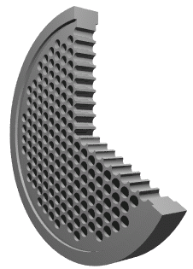
Photo-detector
Requirements
  Gain : 1.0×10⁶
  TTS : <40ps
  QE : >20%@λ=400nm
  Available in B -field
Square type MCP-PMT
Only photo-detector
satisfies requirements
Co-development
with Hamamatsu Photonics
MCP-PMT
(Micro Channel Plate)
Channel
φ~10μm
~400μm
Channel φ~10μm, Bias angle of MCP : 13°
Available in B-field

Slide 22
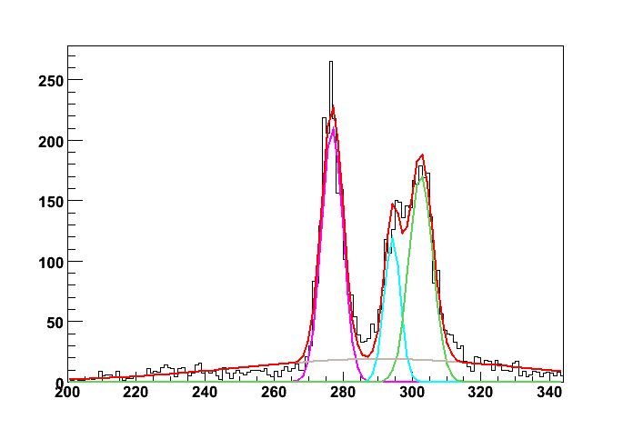
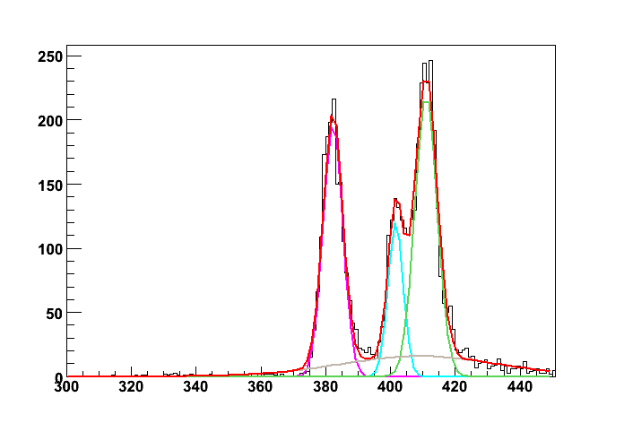
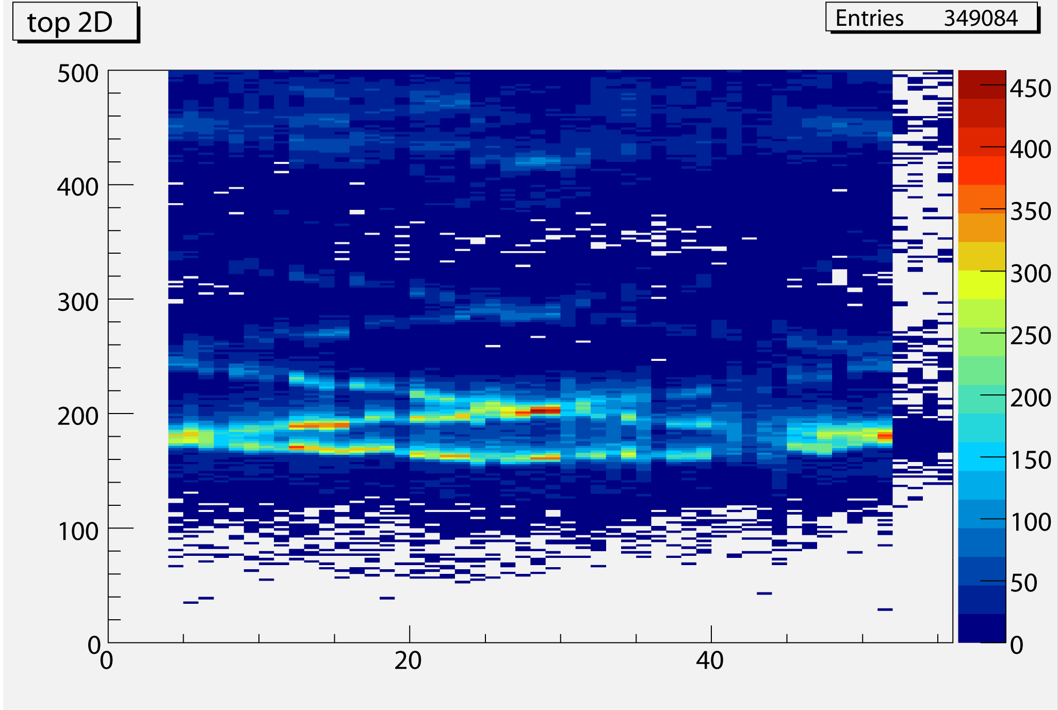
Beam Test Result
data
simulation
[photons]
1st
3rd
カウント数
1st
3rd
2nd
2nd
transit time[25ps]
transit time[25ps]
ch29
quartz
 | TTS（1st peak）
Data | 76.0±2.0 [ps]
Simulation | 77.7±2.3 [ps]
Beam irradiation point
(875mm)
915mm
3rd
875mm
1st
2nd
We confirmed consistency
of transit time distributions
for beam test & simulation

Slide 23
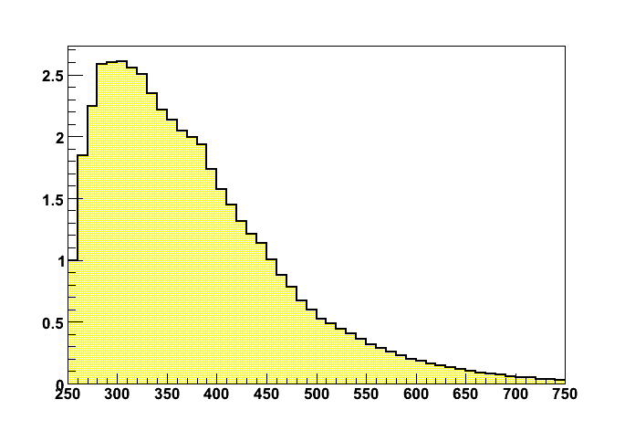
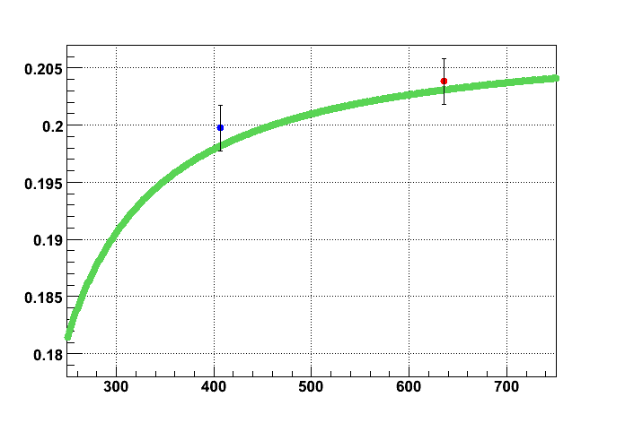
Chromatic Dispersion
Chromatic dispersion
Typical wavelength distribution
of detected photons
Typical wavelength distribution
of group velocity of light
number of detected photons
group velocity of light [m/ns]
wavelength [nm]
wavelength [nm]
Restricts TOP TTS
This is because refraction index has wavelength dependence

Slide 24
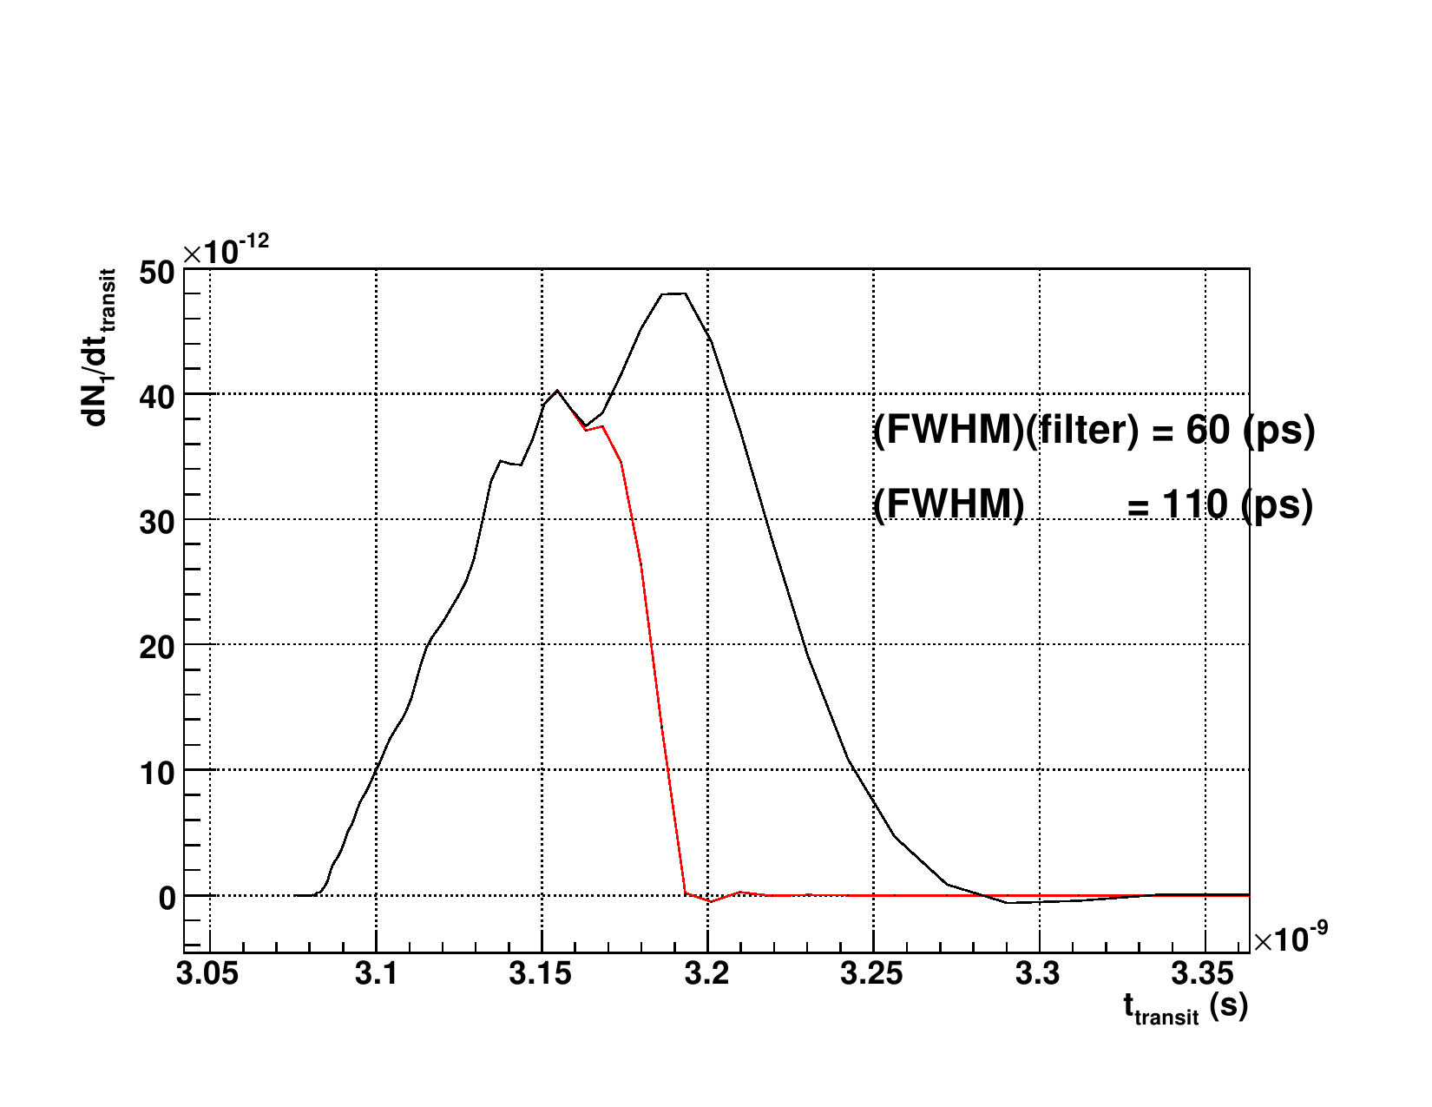
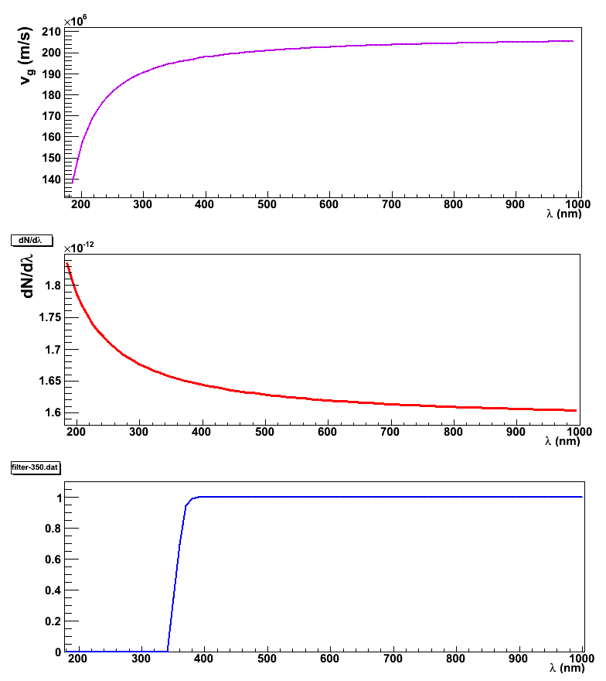
Suppression of Chromatic Dispersion
Wavelength cut
Suppression of chromatic dispersion
with 350nm wavelength cut filter
350nm
Group velocity
of light
σ_{chromatic}
Number of
Cherenkov photons
50
25ps
wavelength cut ⇒ TTS improve
Transmittance of
wavelength cut filter
⇒
N_{det} decrease
fine tune

Slide 25
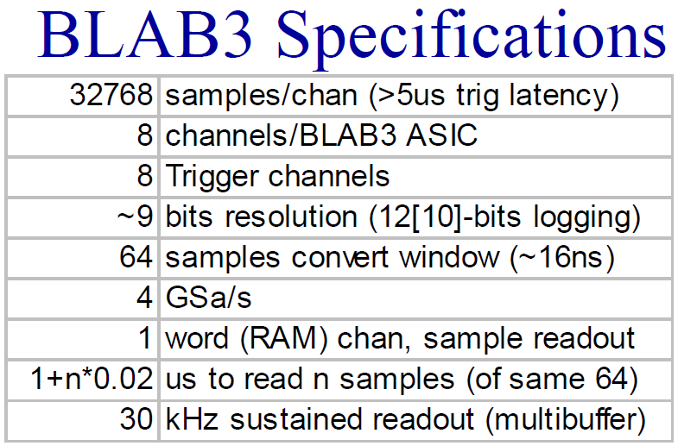
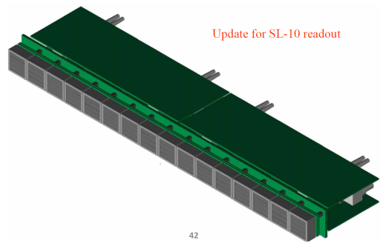
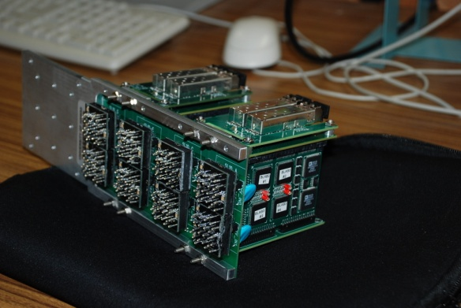
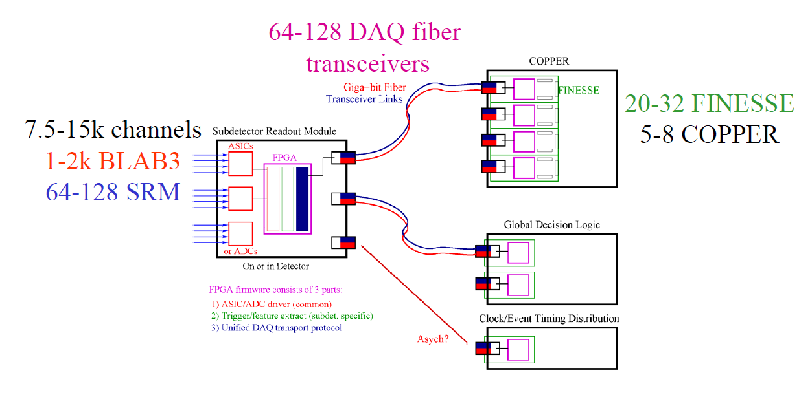
読み出し
BLAB3
From Hawaii group

Slide 26
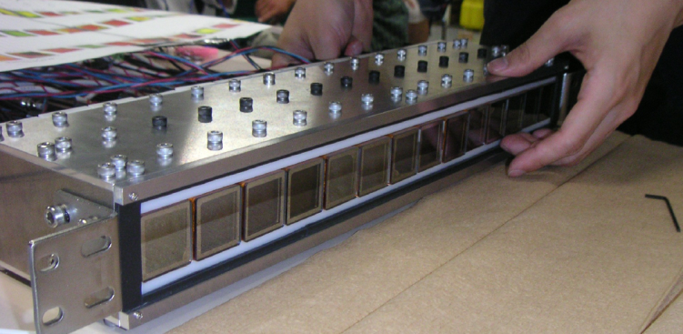
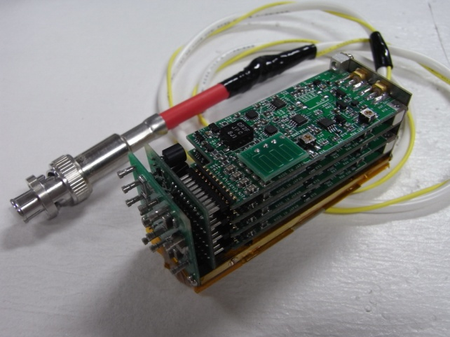
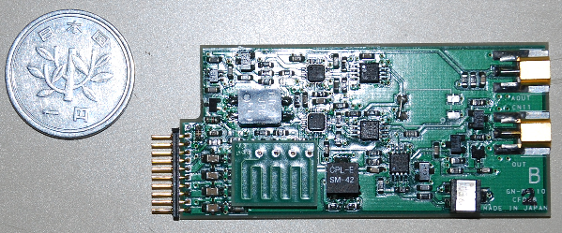
読み出し
Backup option
HV divider + AMP + Discriminator
Small size (28mm^{W})
Prototype
  Fast AMP (MMIC, 1GHz, x20)
  Fast comparator (180ps propagation)
  CFD with pattern delay
Performance
  Test pulse
    ~5ps resolution
  MCP-PMT
    σ<40ps
    Working well
AMP+CFD
amp
comparator
to TDC
to ADC
input
low voltage supply

Slide 27
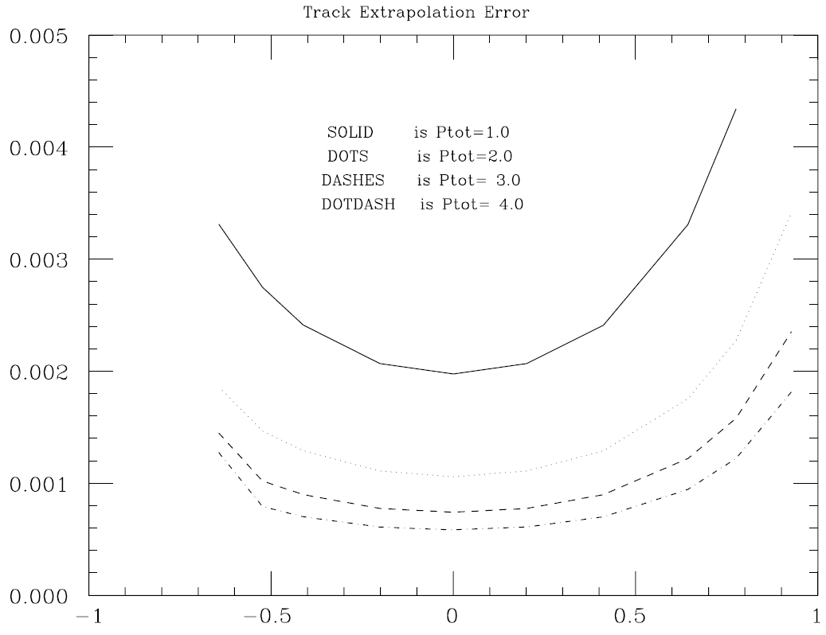
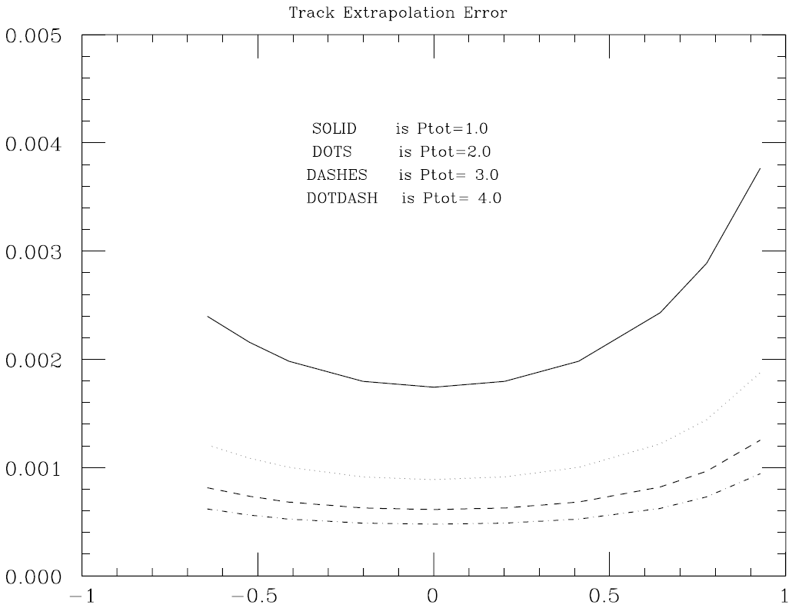
Belleでのtrackの角度不定性
p [GeV/c] | particle | σ(dz) [mm] | σ(φ)[mrad] | σ(θ_{p})[mrad] | σ(φ_{p})[mrad]
2 | π | 2.0 | 0.57 | 2.6 | 3.6
2 | K | 1.8 | 0.49 | 2.6 | 3.3
3 | π | 1.4 | 0.45 | 1.8 | 2.5
3 | K | 1.3 | 0.39 | 1.8 | 2.3
4 | π | 1.3 | 0.42 | 1.5 | 2.0
4 | K | 1.2 | 0.33 | 1.4 | 2.0
Belle
Belle-II
[GeV/c]
[GeV/c]
σ(θ) [mrad]
σ(φ) [mrad]

Slide 28
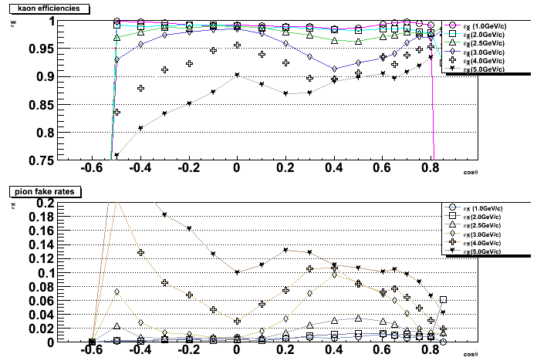

Mirror Bar Glued Accuracy
mirror part
0.2mrad
20mm
変化なし。

Slide 29
比較
 | 1-bar | 2-bar
Structure | Need expansion block support | Need forward PMT box Strong bar box (btw 2-bar)
Gap TOP-CDC | Slightly large (~25mm) | Minimum
PMT window | Access from inner part | Access from endcap or inner
Acceptance | Large for forward | There is a small gap btw 2-bar
Calibration | --- | Precise timing(<35ps) for forward
PMT choice | Photonis or SBA SL10 | SL10
Construction | Mirror alignment? | 2m prototype
Tracking | Affected (<2mrad) | ---

Slide 30
Machine parameters
 |  | LER | HER
Emittance | ε_{x} | 3.2 | 1.7 | nm
Coupling | ε_{y}/ε_{x} | 0.40 | 0.48 | %
Horizontal beta at IP | β_{x}* | 32 | 25 | mm
Vertical beta at IP | β_{y}* | 0.27 | 0.42 | mm
Horizontal beam size | σ_{x}* | 10.1 | 10.1 | μm
Vertical beam size | σ_{y}* | 0.059 | 0.059 | μm
Bunch length | σ_{z} | 6 | 5 | mm
Half crossing angle | φ | 41.3 |  | mrad
Beam Energy | E | 4 | 7 | GeV
Beam Current | I | 3.6 | 2.6 | A
Number of bunches | n_{b} | 2500
Beam-beam parameter | ξy | 0.09 | 0.09
Luminosity | L | 8x10³⁵ |  | cm⁻²s⁻¹

Slide 31
t0について
t0の要因
  RF clock：10ps
  バンチの広がり(6mm)：20ps
  TOF calculation：10ps
  読み出し(BLAB3)：5ps
別の要因があればσ(t₀) > 25ps

Slide 32
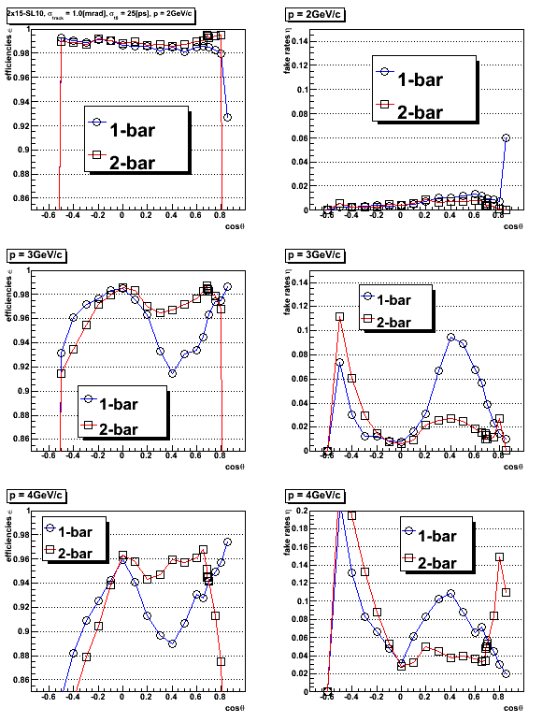
SBAにすると

Slide 33
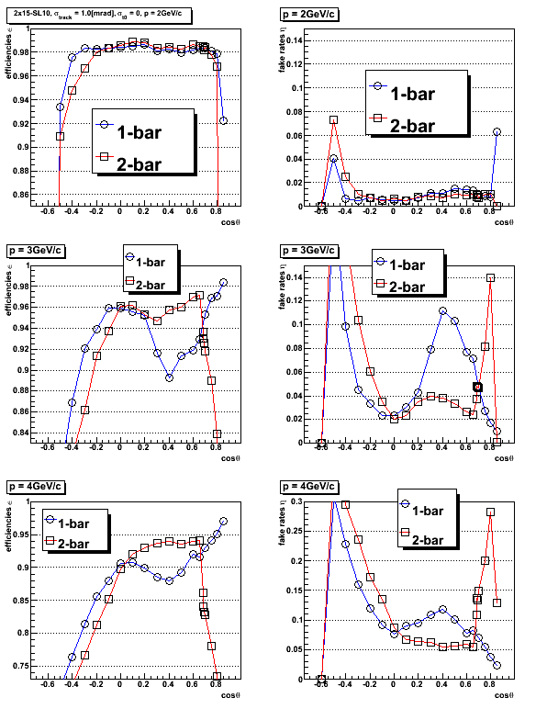
SBAでσ(t0) = 50ps になると

Slide 34
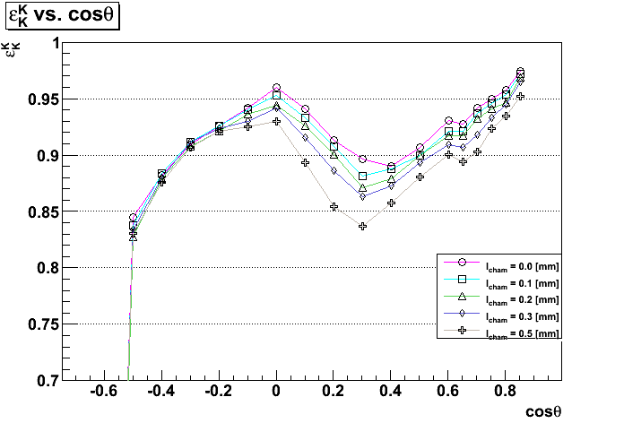
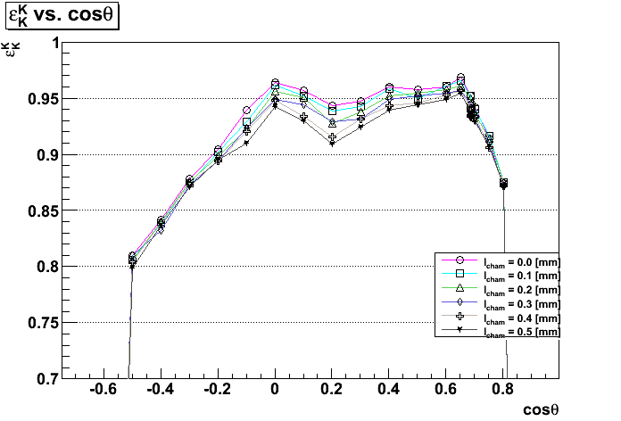
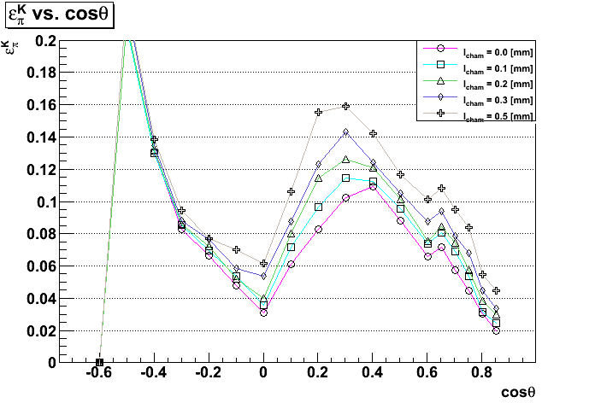
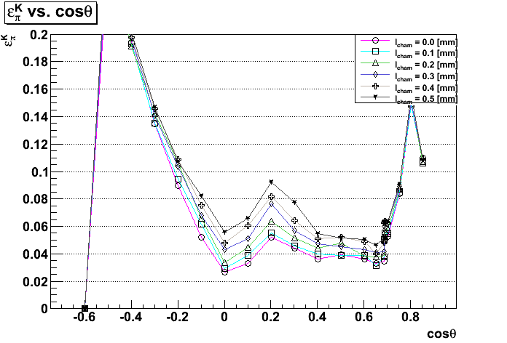
石英の面取りを入れた時の性能変化
4GeV/c
1-bar
2-bar
Efficiencies
Fake rates
面取りでの乱反射によるリングイメージの乱れがおきる。バックグラウンドの増加

Slide 35
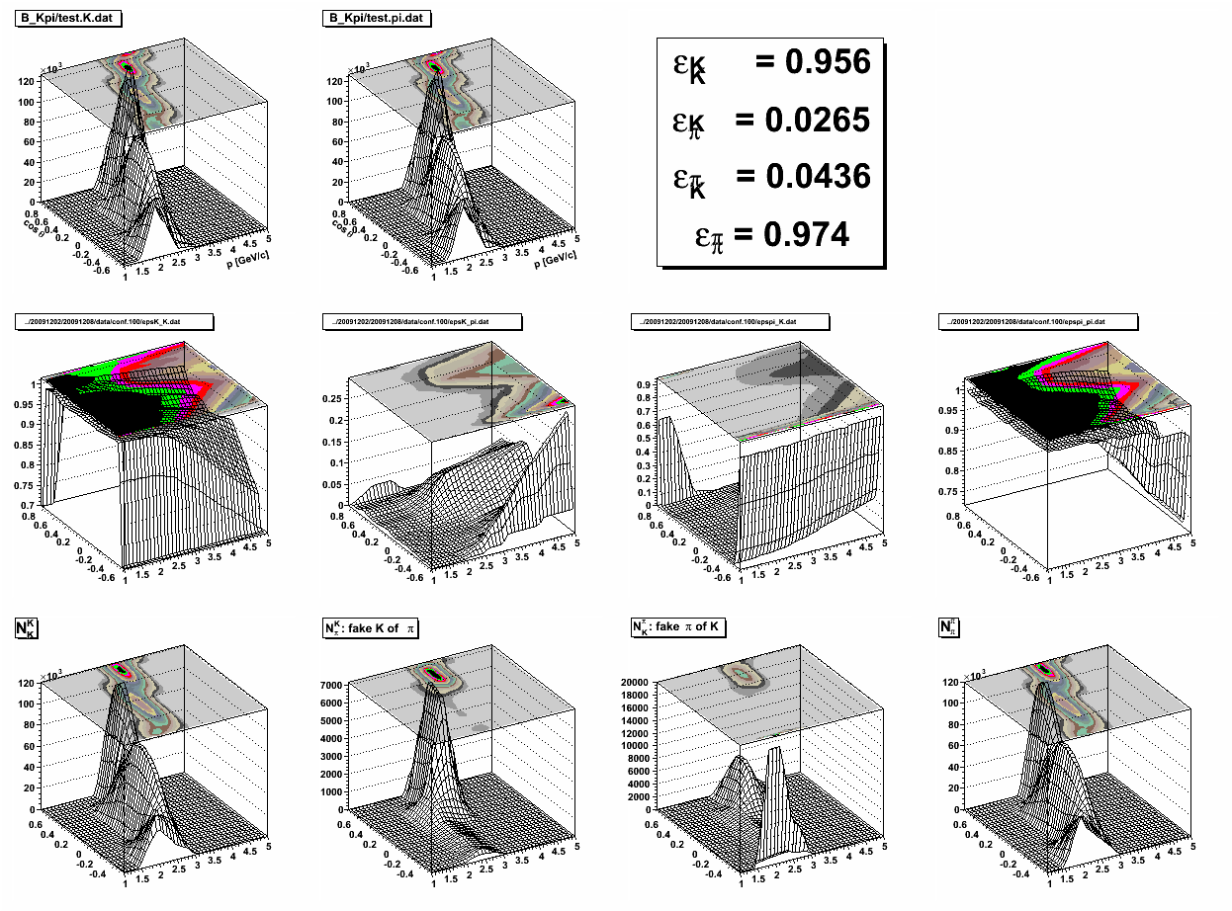
B → Kπ, 1-bar

Slide 36

B → Kπ, 2-bar

