Slide 1
Enhancement of CH₃OH Abundance by Interactions between Molecular Clouds in a Nearby Galaxy
Yoshimasa Watanabe (U. Tsukuba)
Yuri Nishimura (U. Tokyo), Nanase Harada (ASIAA), Nami Sakai (RIKEN)
Kazuo Sorai (Hokkaido U.), Nario Kuno (U. Tsukuba)
Satoshi Yamamoto (U. Tokyo)

Slide 2
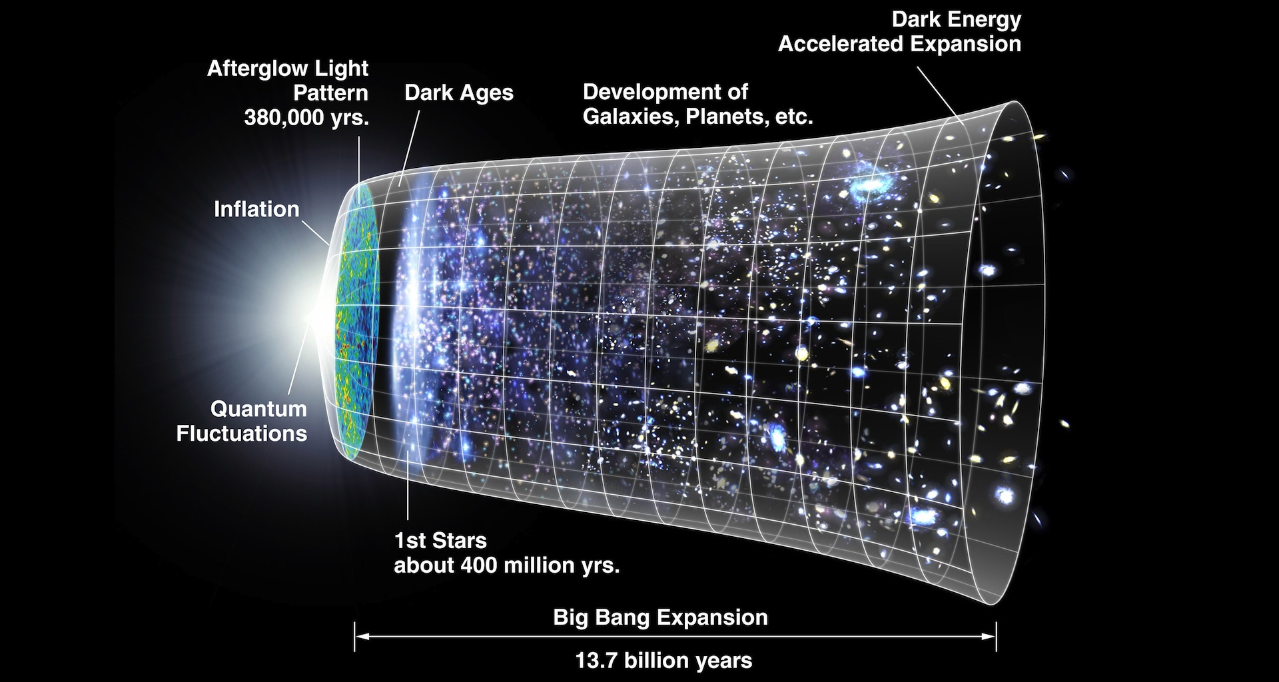
Evolution of the Universe and Matter
WMAP (https://map.gsfc.nasa.gov/)
Just after the Big Bang
At the present
Primordial gas
Variety of heavy elements
H, He and light elements
Nucleosynthesis
in stars and SN
C, N, O, etc.

Slide 3
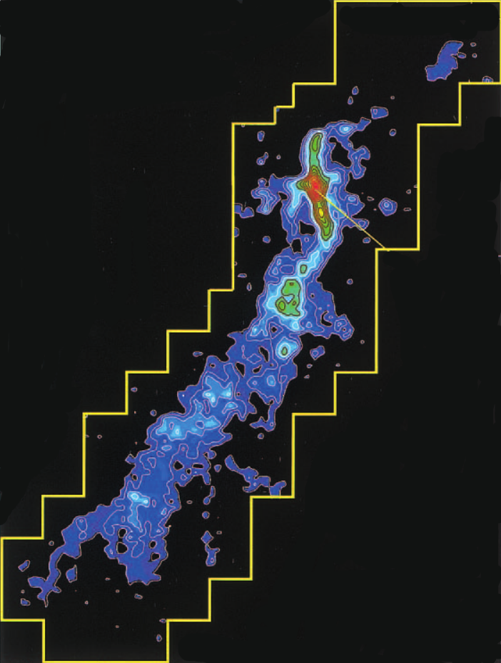
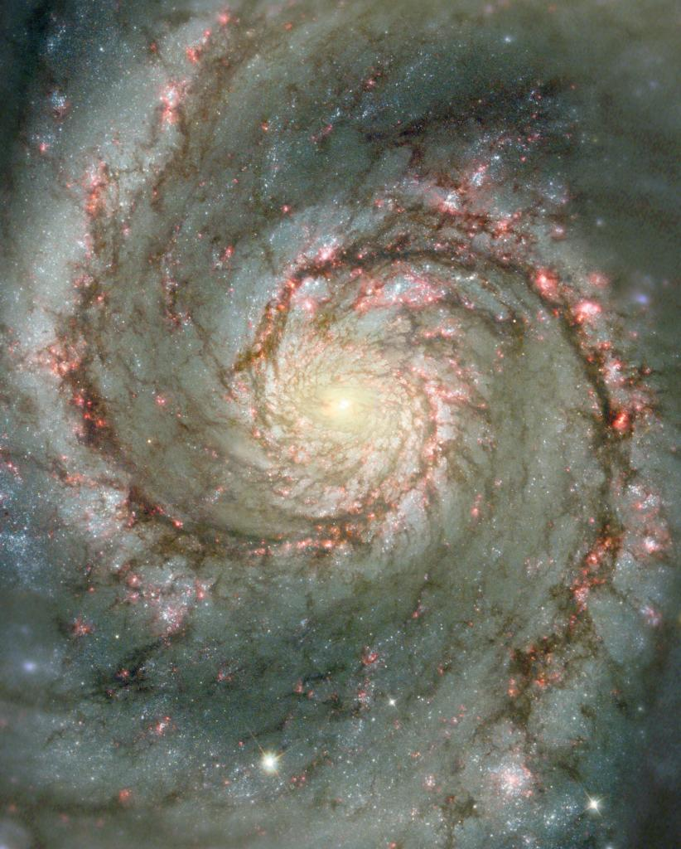
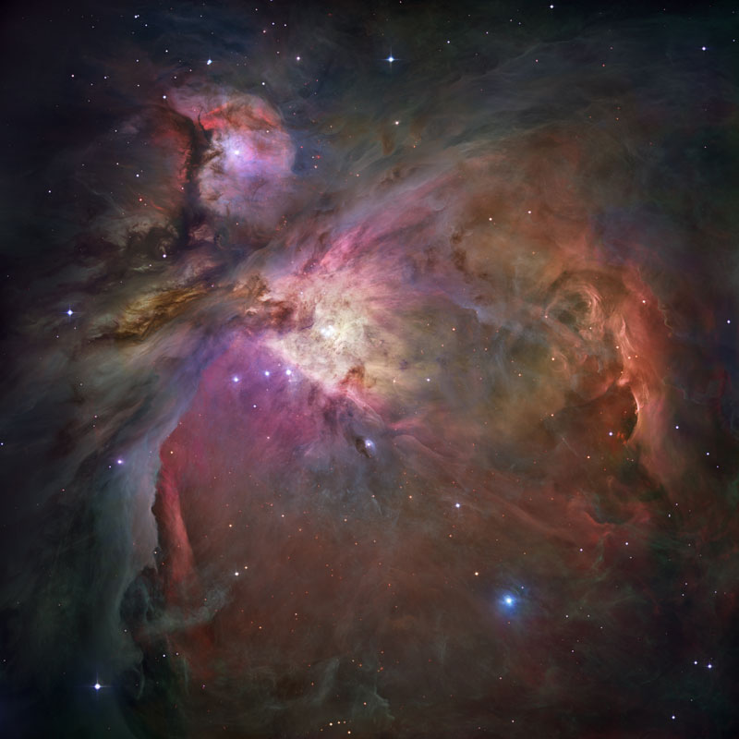
Molecular Cloud / Star Formation in Galaxies
Molecular Cloud: ~10 pc
Galaxy:〜10 kpc
Star Formation :< 0.1 pc
(1 pc ~ 3 light-years)
ESO
HST
Mt Fuji telescope
HST
Diversity of star formation
- Low-mass star, Massive star, Stellar cluster etc.
- Maybe originated from various properties of molecular-clouds
- Galaxy-scale gas dynamics
How does galaxy-scale gas dynamics affect
on molecular-cloud formation?

Slide 4
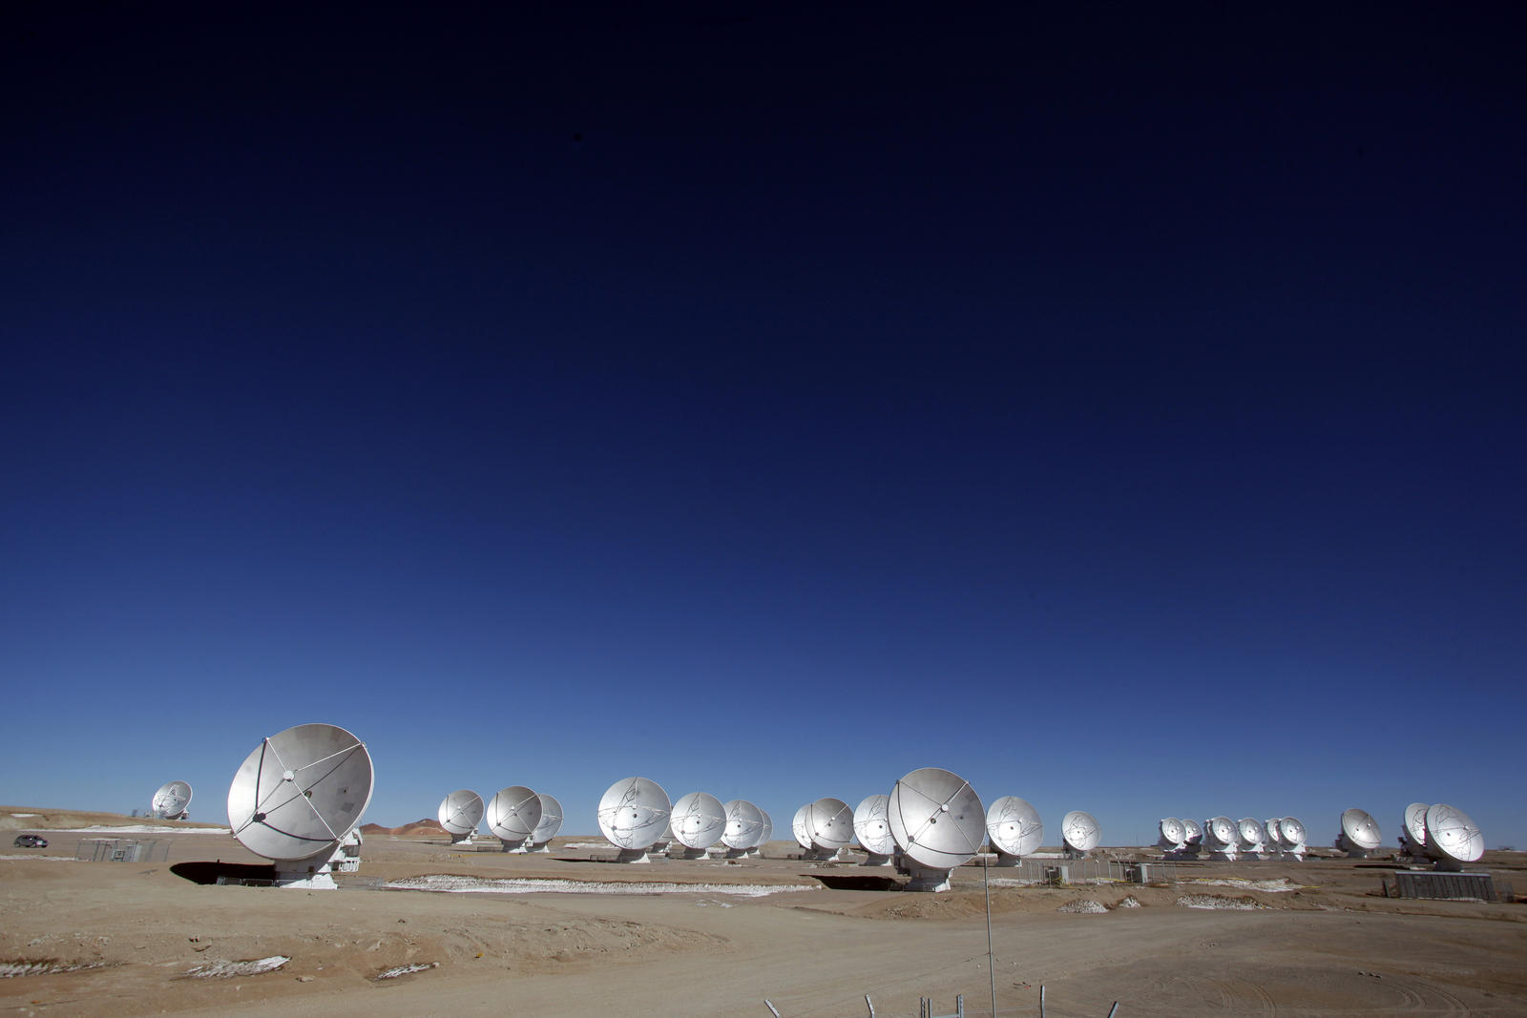
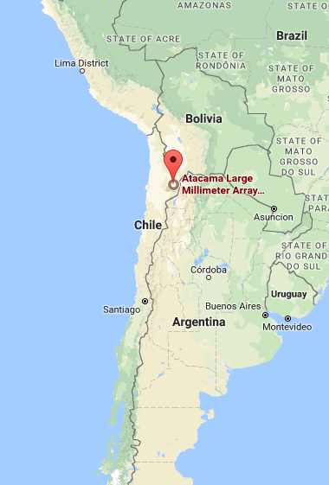
ALMA (Atacama Large Millimeter/submillimeter Array)
Global Collaboration
- ESO, NFS, NINS, NRC, NSC, ASIAA, Chile
66 antennae: 54 × 12 m + 12 × 7 m
ALMA
Frequency: from 31 GHz to 950 GHz
Baseline: up to 16 km
Chile
Angular resolution: up to 0.005 arcsec
(at 16 km × 950 GHz)

Slide 5
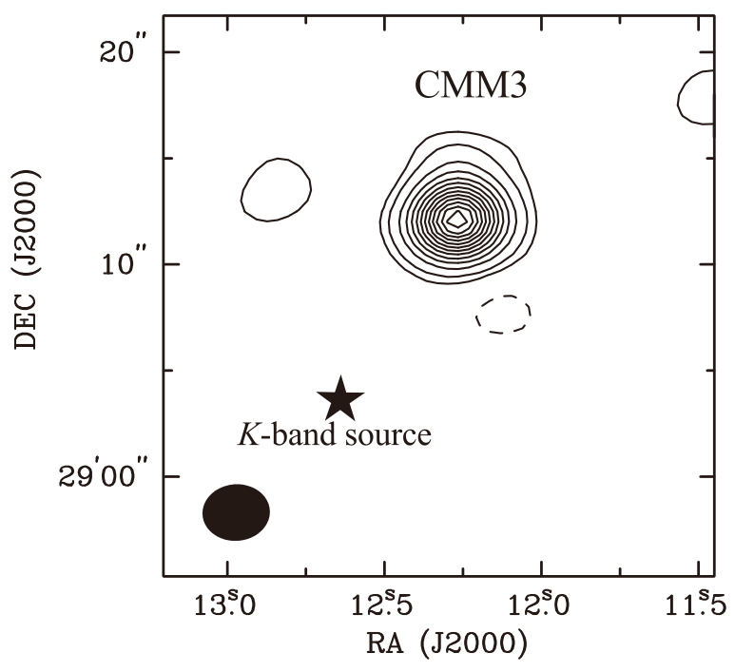
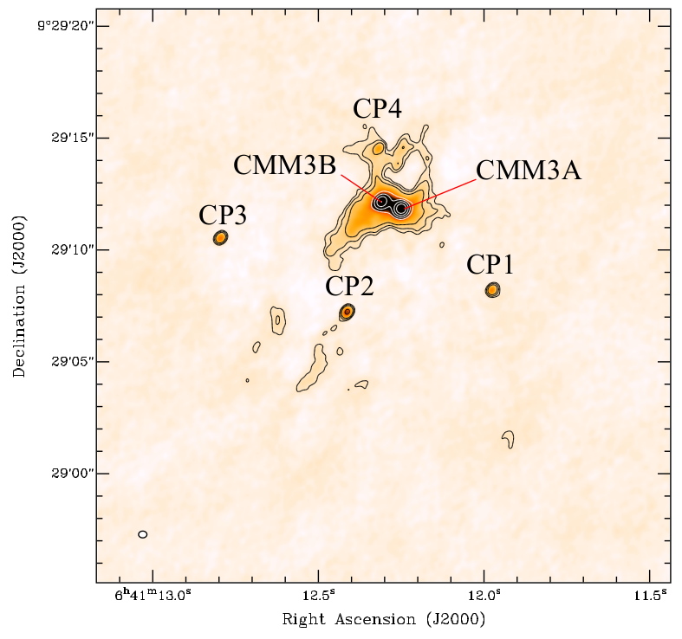
Amazing Power of ALMA (1)
SMA
ALMA
8 × 6 m
35 × 12 m
Saruwatari et al. 2010
Watanabe et al. 2017
Before ALMA: 3 arcsec
After ALMA:0.3 arcsec
3 mJy/beam
0.4 mJy/beam
Higher angular resolution and sensitivity by 10!

Slide 6
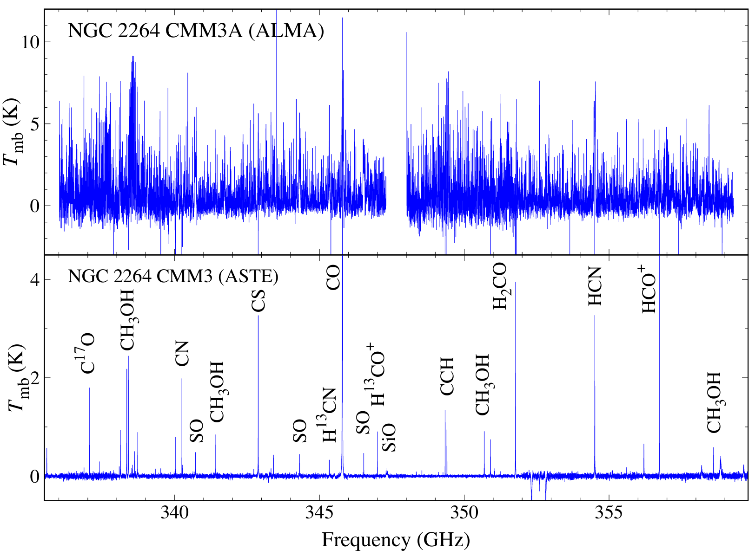
Amazing Power of ALMA (2)
Watanabe et al. submitted
300 au
Watanabe et al. submitted
Watanabe et al. 2015
15000 au
Watanabe et al. 2015

Slide 7
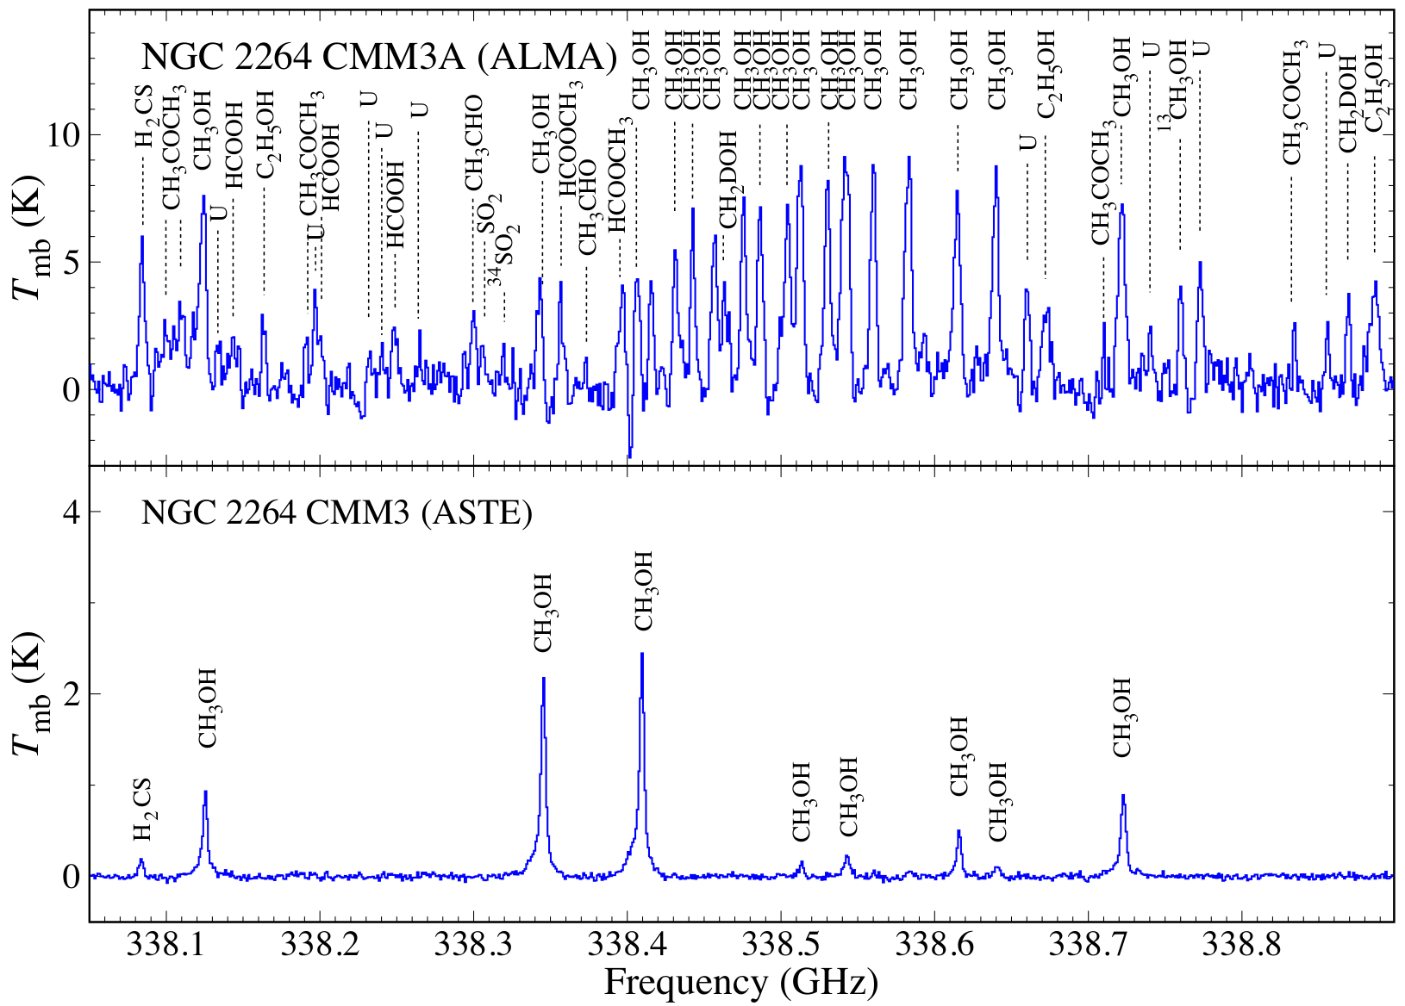
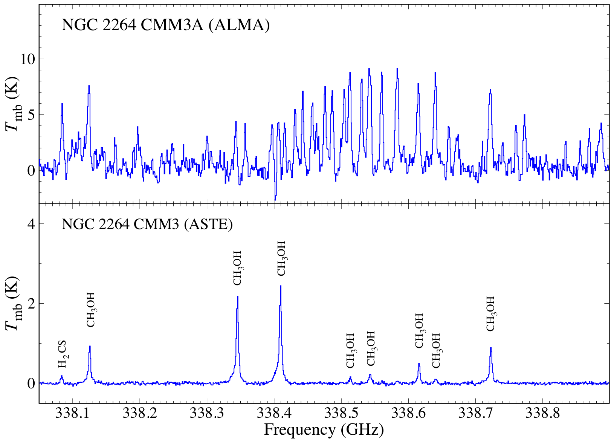
Expanded Spectrum toward CMM3A
300 au
15000 au

Slide 8
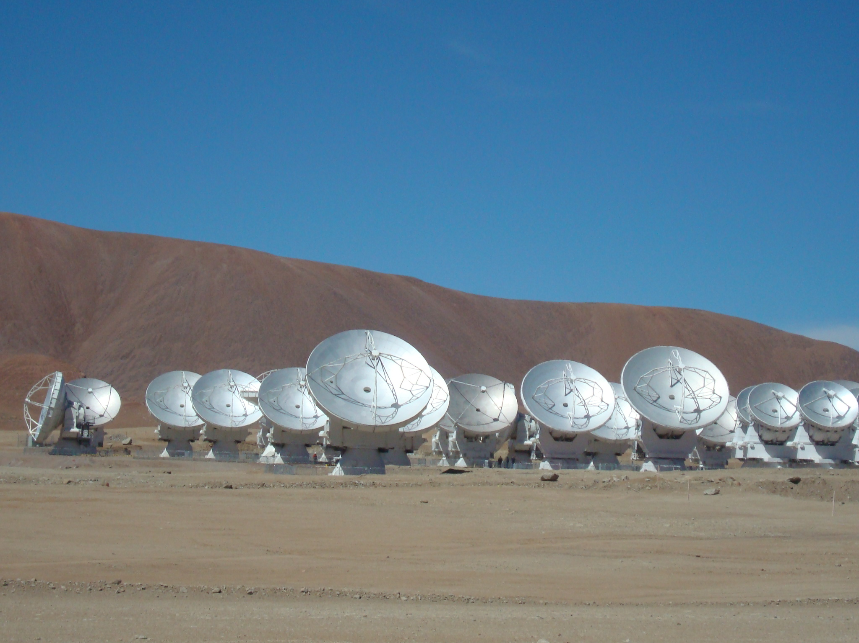
Observations of NGC 3627 with ALMA
NGC 3627
ALMA cycle-3, Band3
Distance: 11 Mpc
Many CO mapping observations
(e.g. Helfer et al. 2004, Kuno et al. 2007,
Watanabe et al. 2011, etc.)
Beam Size
Active star formation in the bar-end
1.6” – 2.6” (~ 100 pc @ 11 Mpc)
- Due to orbit crowding?
Sensitivity
(Beuther et al. 2017)
0.8 – 0.2 mJy/beam in 10 km/s

Slide 9
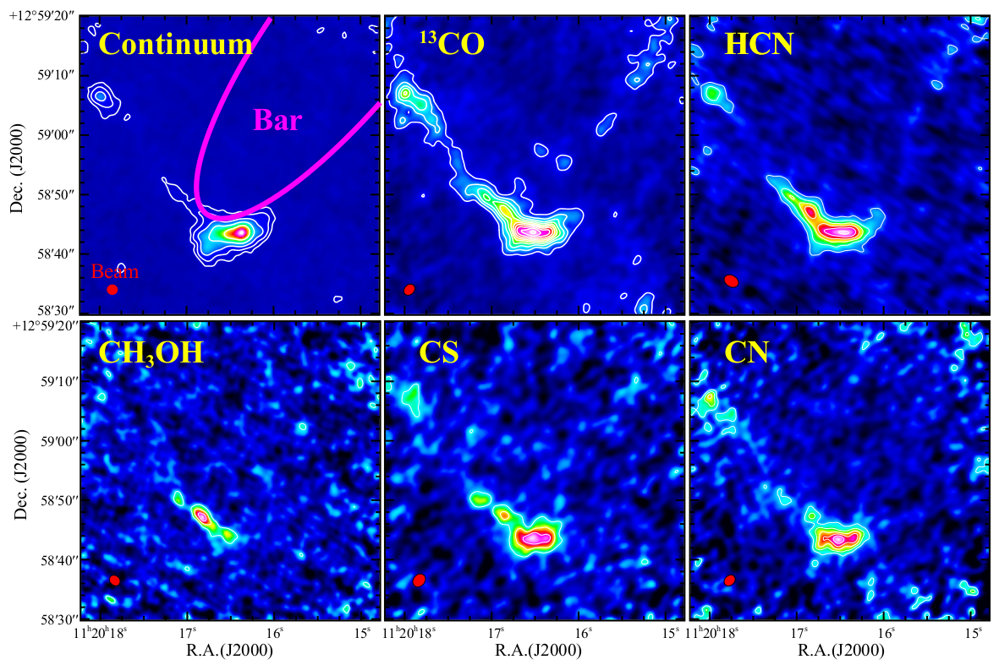
Distributions of Molecules
Other Molecules:
C¹⁸O, HCO⁺, HNC, N₂H⁺, CCH

Slide 10
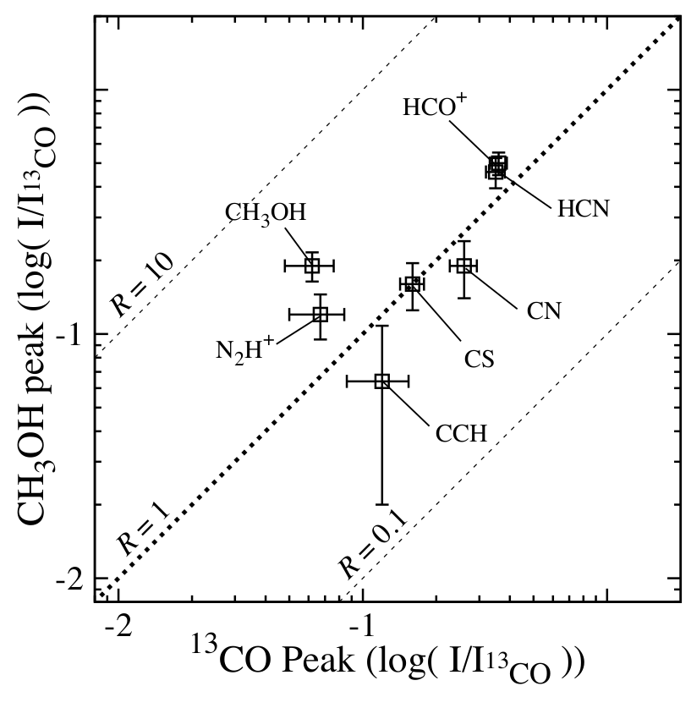
Enhancement of CH₃OH in Bar-end
CH₃OH peak
¹³CO peak
Distribution of CH3OH is different from
other molecules.
- Higher CH₃OH/¹³CO ratio by factor of 3
- No enhancement in other molecule
Why is CH₃OH enhanced?

Slide 11
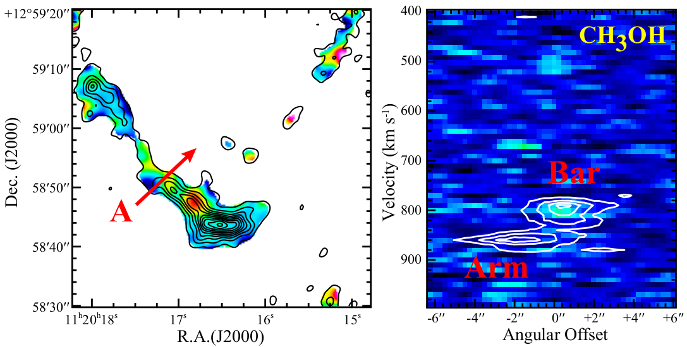
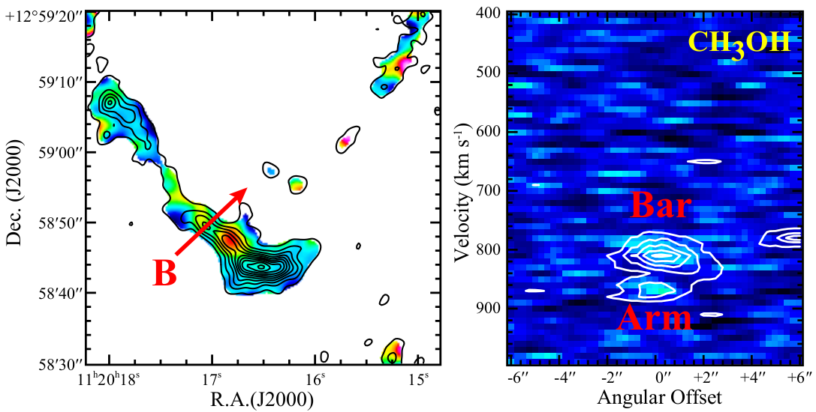
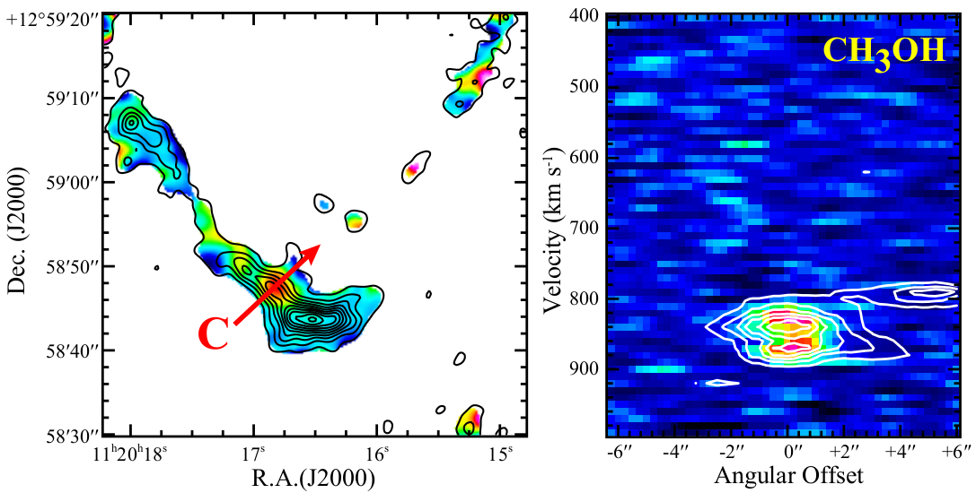
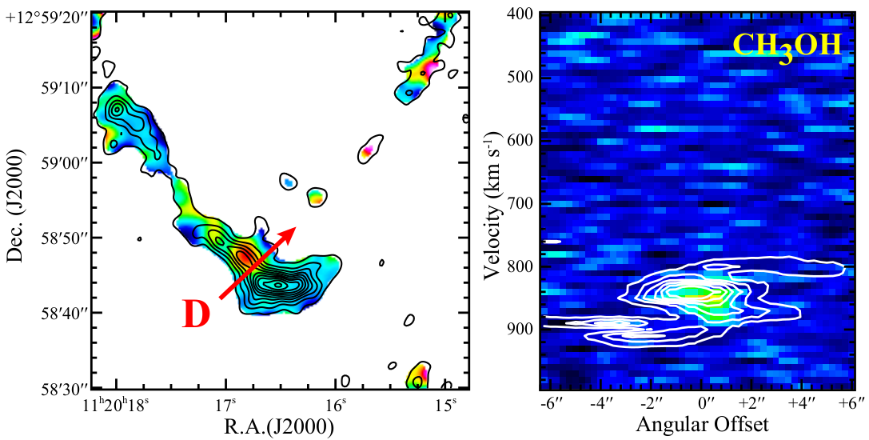
Position Velocity Diagrams
CH₃OH/¹³CO

Slide 12
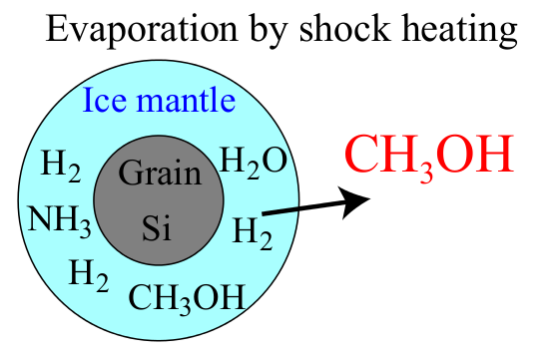
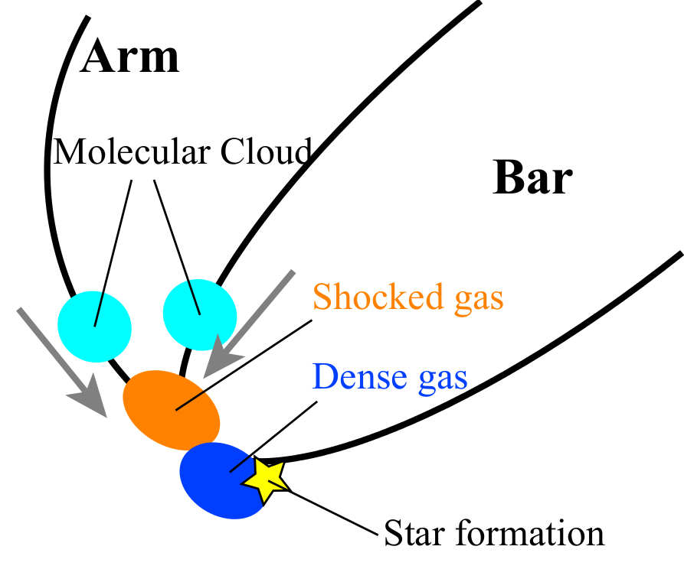
Collision between Molecular Clouds in Bar-end?
Two components of molecular cloud
Signature of interaction in PV diagram
- Enhancement of CH₃OH
⇒Collision between clouds
⇒ Evaporation of CH₃OH by shock
Good tracer of gas dynamics

Slide 13
Summary
Multi-molecular line observation toward NGC 3627 with ALMA
- High-sensitivity observation of ALMA
Nine molecular species are imaged.
- High CH₃OH/¹³CO ratio in bar-end
Two velocity components in the bar-end
Shock heating by cloud-cloud collisions?
- Chemical compositions: good tracer of dynamics
Meanings of chemical compositions of molecular cloud
- More surveys with ALMA toward external galaxies

